Slide 1
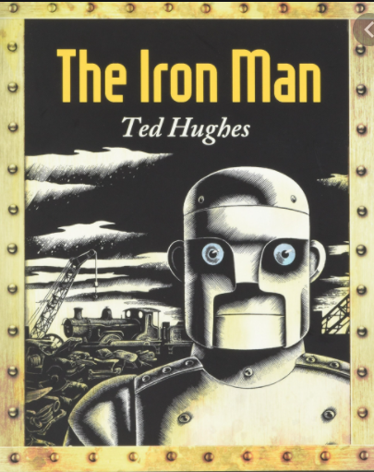
Thursday 3rd February 2022
L.O: To understand texts
C: The Iron Man- prediction skills.

Slide 2

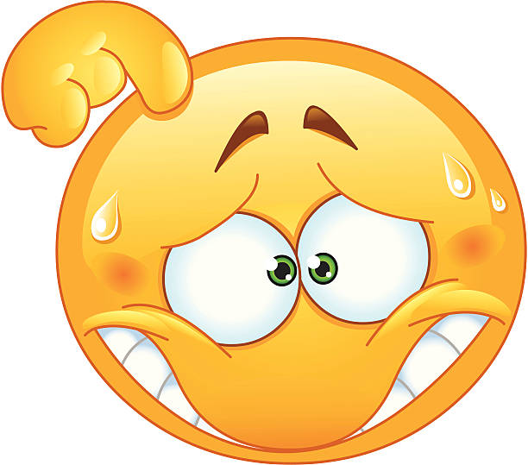
Starter:
Class Read : p.55-63
“Only Hogarth felt suddenly sorry. He felt guilty.”
Would you feel sorry or guilty if you had done the same thing to the Iron Man?

Slide 3
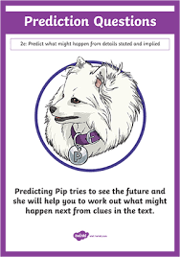
Predicting Pip!
What do you think is going to happen next? Can you think of 5 possible scenarios?
Perhaps the Iron Man is going to go back out into sea. Perhaps he is going to track down Hogarth. Perhaps he is going to start eating something else.

Slide 4

Red Pen: Using your Arlo the Author skills, which idea would you have chosen and why?

