Slide 1

Monday 14th June 2021
LO: To write with purpose
C: Problem Section
MY
STORY

Slide 2
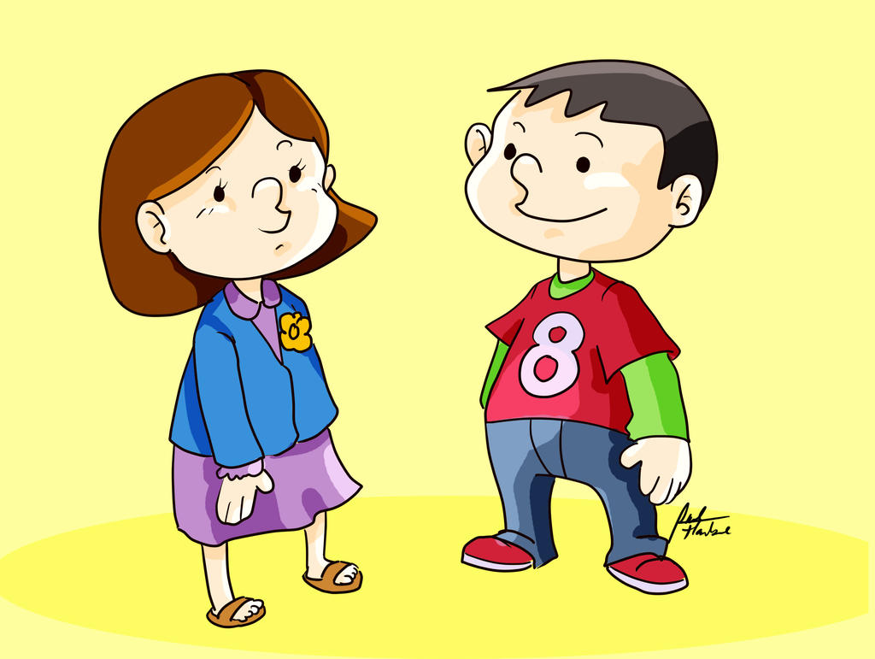
Starter
Read through story and make any edits

Slide 3
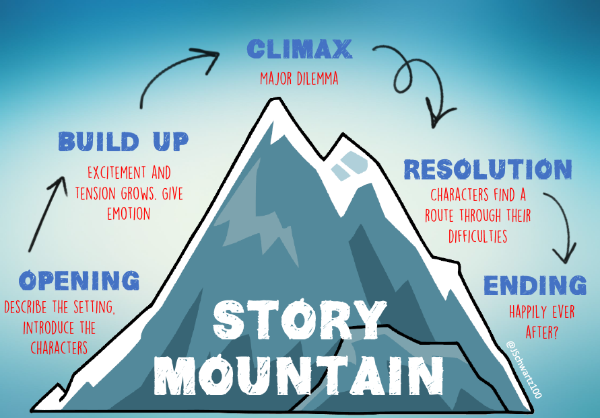
Today we are focusing on…

Slide 4
Problem Section
We have begun writing our problem section. We want this section to be dramatic and you need to ensure the reader wants to read on.

Slide 5

Finish writing your problem section
Once you have finished, please can you go on to Century Tech and complete the ‘Proofreading’ Nugget.

