Slide 1
Wednesday 24rd November 2021
LO: To write with purpose
C: Explanation Text

Slide 2
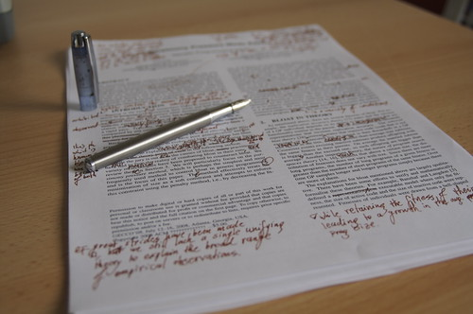
Time to edit your work from last week!

Slide 3

Finish your work from yesterday and make sure you take the time to edit it!

Slide 4
Conclusion
This can be one sentence which links to your intro.
Come up with some with your partner

