Slide 1
Tuesday 23rd November 2021
LO: To write with purpose
C: Explanation Text

Slide 2
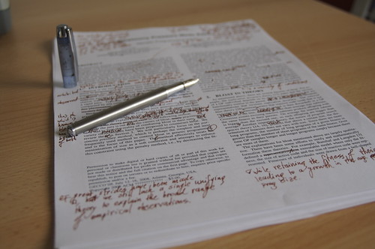
Time to edit your work from last week!

Slide 3


What are the final sections we need to write?

Slide 4
What are the two sub-headings?
What are you going to include?
http://www.ancientegypt.co.uk/mummies/story/page4.html

Slide 5

Tell your partner the key point in this stage!

Slide 6

It is time to write this section!
(Don’t forget to start with a sub-heading)

