Slide 1
Monday 22nd November 2021
LO: To write with purpose
C: Explanation Text

Slide 2
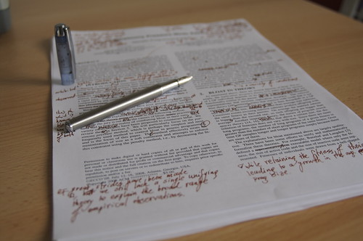
Time to edit your work from last week!

Slide 3
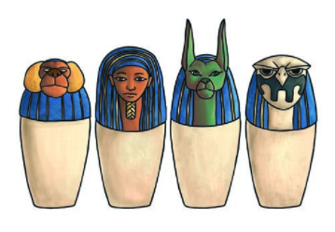
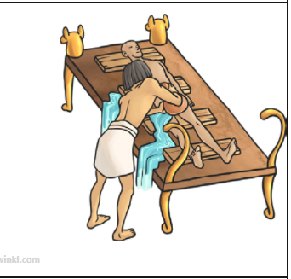
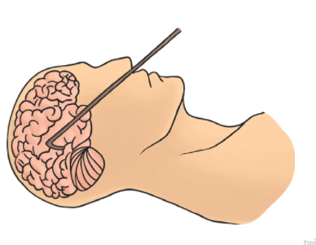
What sections have we written
about so far?

Slide 4
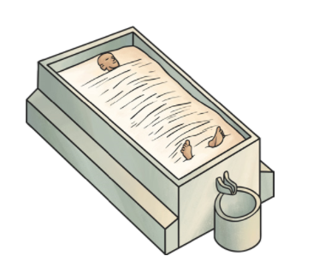
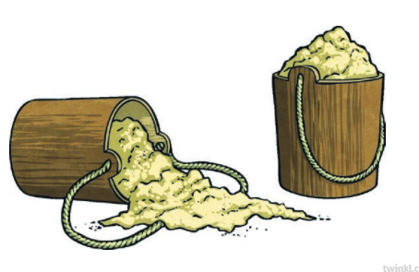
What is the next section we need to write about?
http://www.ancientegypt.co.uk/mummies/story/page4.html

Slide 5

Tell your partner the key point in this stage!
Can you come up with a first sentence?

Slide 6

It is time to write this section!
(Don’t forget to start with a sub-heading)

