Slide 1
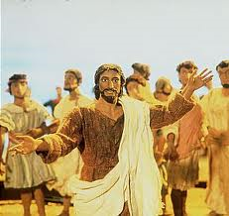
The Easter Story.

Slide 2
Remind the children of the 3 key dates and stories of the Easter.
Retell the three stories using:
- Matthew 21: 7-11
- Luke 23: 13-25, 32-48
- Luke 24: 1-12

Slide 3
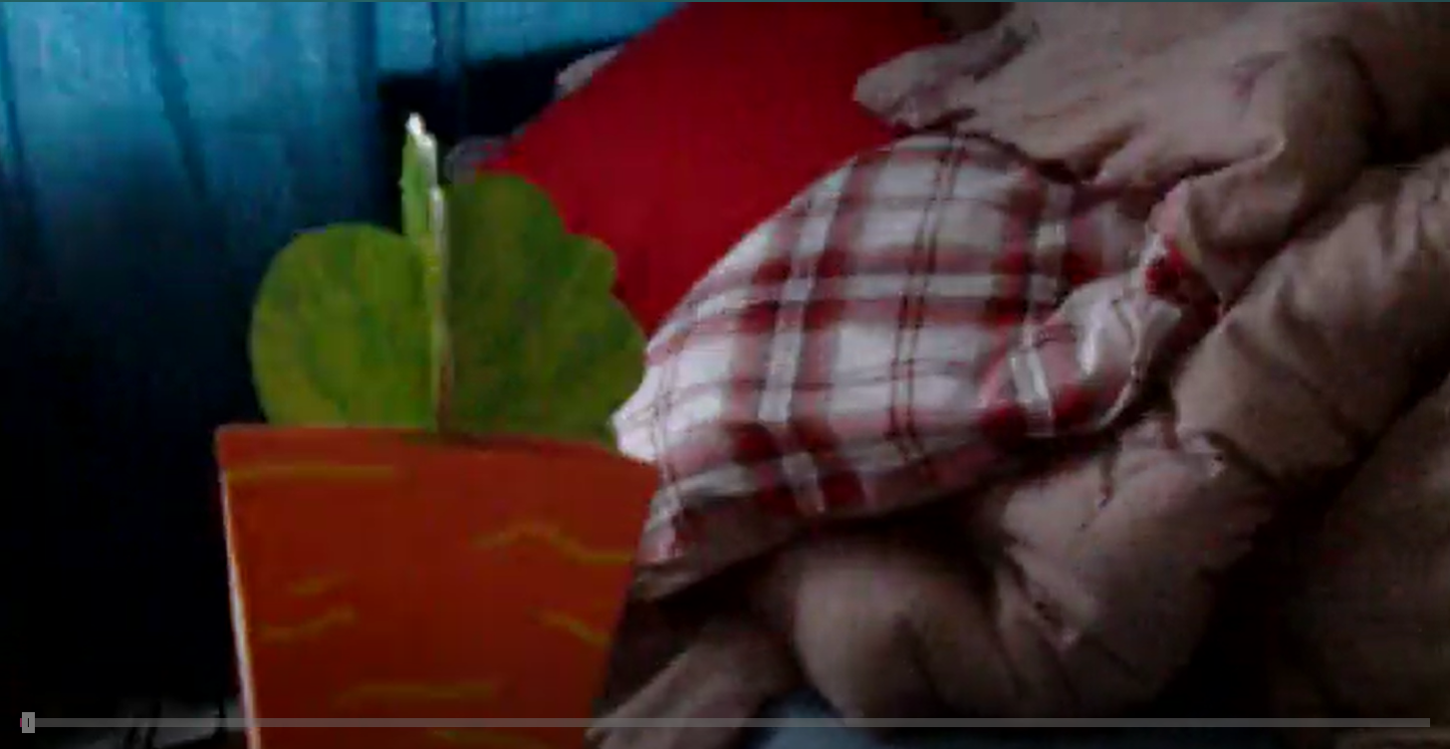
Let’s meet Nathan and Lara...
www.bbc.co.uk/programmes/p02mww94

Slide 4
This time, as you watch you will have a focus question which you need to take notes on.
www.bbc.co.uk/programmes/p02mww94

Slide 5
Can you create a freeze frame showing how Lara and Nathan are feeling on each of these days?
(we will get photographed)

Slide 6
Underneath the photographed freeze frame(s), write a short paragraph showing how the character is feeling and why, e.g. Nathan/Lara is feeling…because

