Slide 1
Thursday 10th March 2022
LO: To understand texts
C: The Iron Man
Let’s continue from where we got up to yesterday up until the end

Slide 2

Was your prediction from yesterday correct?

Slide 3
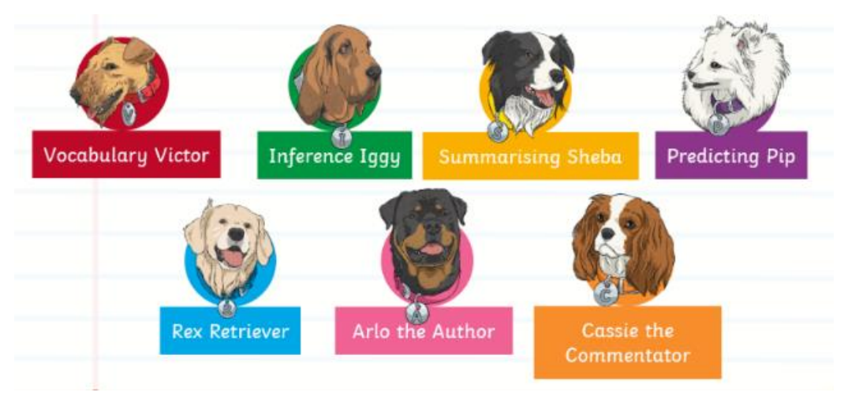
Today’s dog is...

Slide 4

Can you summarise the ending of the story in four sentences?

