Slide 1
Monday 7th March 2022
LO: to understand texts
C: The Iron Man
Let’s read from ‘I challenge you to a test of strength’ (p.103) up until ‘alright and he set off’.

Slide 2
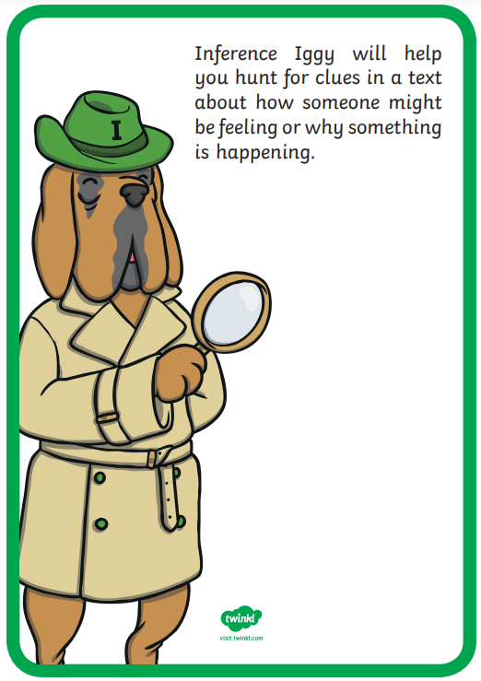
Which of the reading dogs are we going to be using today?

Slide 3
Using Inference Iggy, can you answer the following questions?
Why was the space-bat-angel surprised the Iron Man was challenging him to a test of strength?
Why do you think the space-bat-angel shocked that the Iron Man lay down on the metal bed? (2 marks)
Whilst walking on the sand, what colours did the Iron Man turn?
Why do you think the space-bat-angel felt cold inside?
RP: What do you think will happen next?

