Slide 1

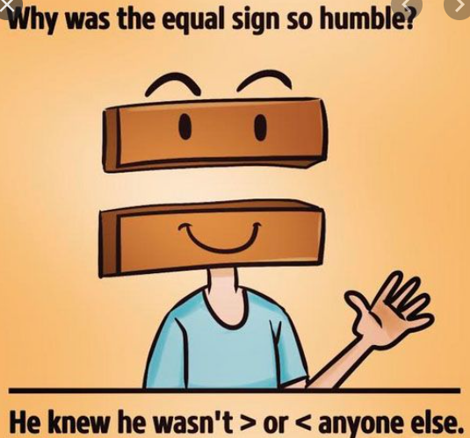
24.2.2021
L.O: Multiplication and Division
C: Multiply 2 digits by 1 digit.

Slide 2
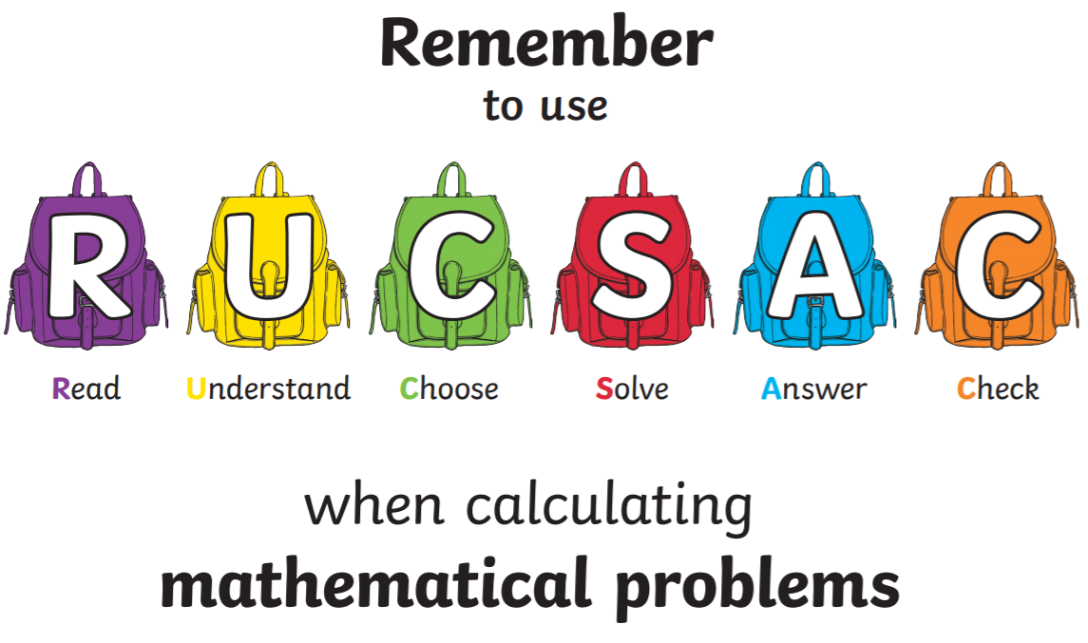
23.2.2021
L.O: Multiplication and Division
C: Multiply 2 digits by 1 digit.

Slide 3
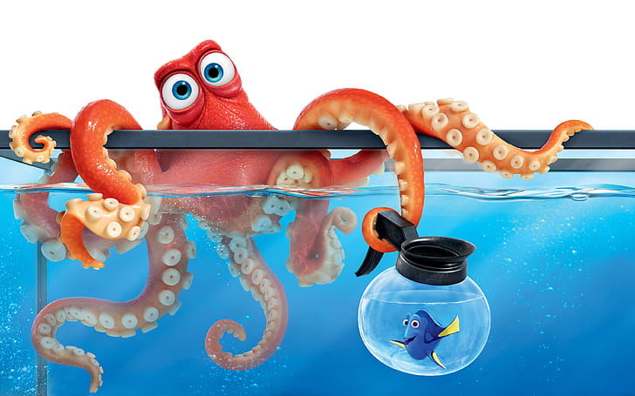
Hank has 7 tentacles. Each of his tentacles has 23 suckers. How many suckers does he have altogether?
Watch input video with
Miss Watton

Slide 4
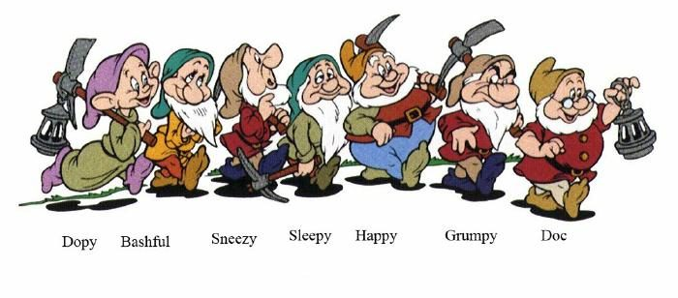
Sneezy, Sleepy, Doc, Bashful, Grumpy, Dopey and Happy each spend 40 hours a week mining diamonds. How many hours do the work all together ?
Watch input video with
Miss Watton

Slide 5
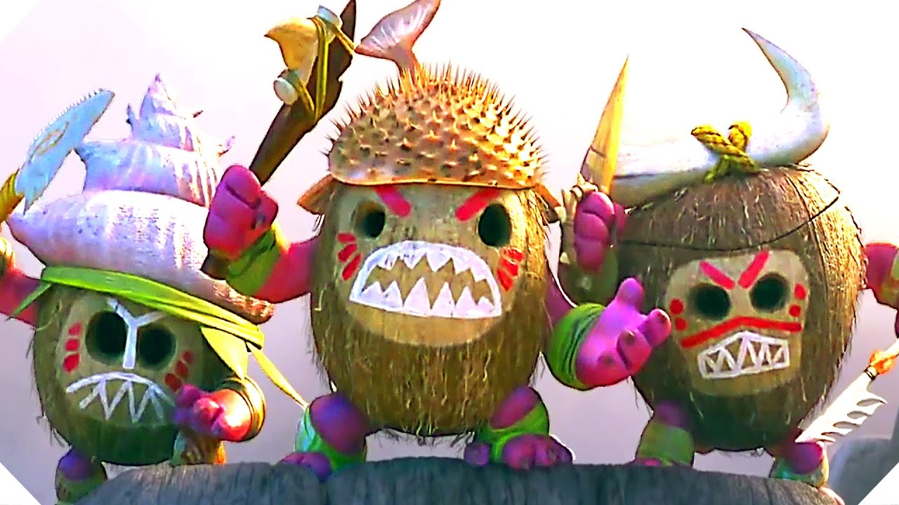
Moana is fighting the Kakamora! There are 33 on each boat, and three boats surrounding them. How many does she need to fight?

Slide 6
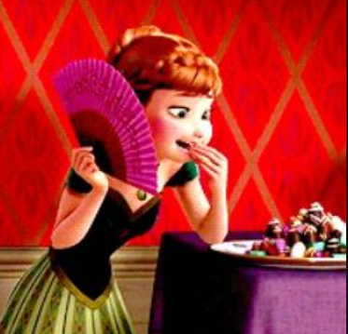
Anna receives 7 giant boxes of chocolates for her birthday. If there are 24 chocolates in each box, how many does she have it total?

Slide 7
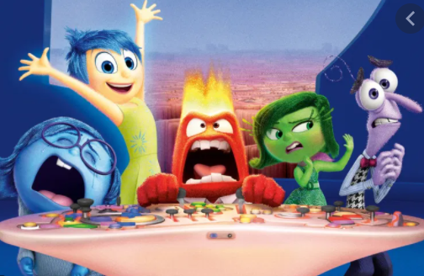
Riley has angry, sad, happy, disgusting and nervous memories. If she has 62 of each, how many memories does she have all together?

Slide 8
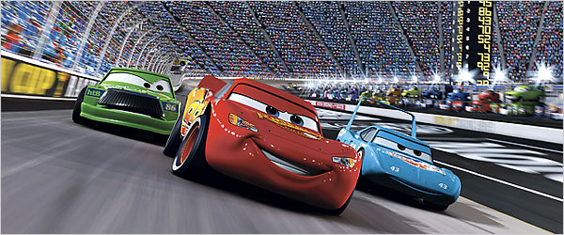
There are 53 races in the Piston Cup, with 9 cars in each race. How many cars compete over the competition?

Slide 9
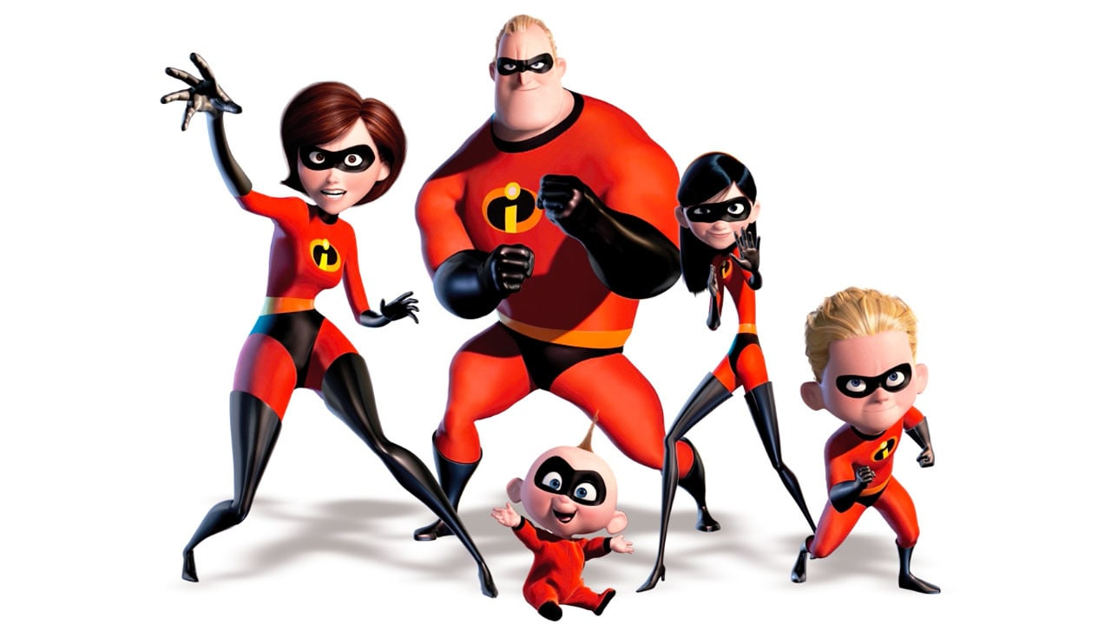
The Incredibles are trying to save the day! Mr Incredible, Elastagirl, Violet, Dash and Jack-Jack each tackle 23 bad-guys. What is the combined total number of bad-guys involved?

Slide 10
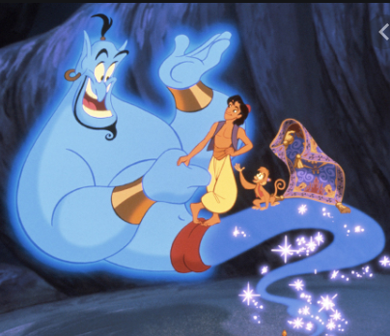
The Genie has had 22 masters in his lifetime. If each master is granted 3 wishes, how many wishes has he granted so far?

Slide 11
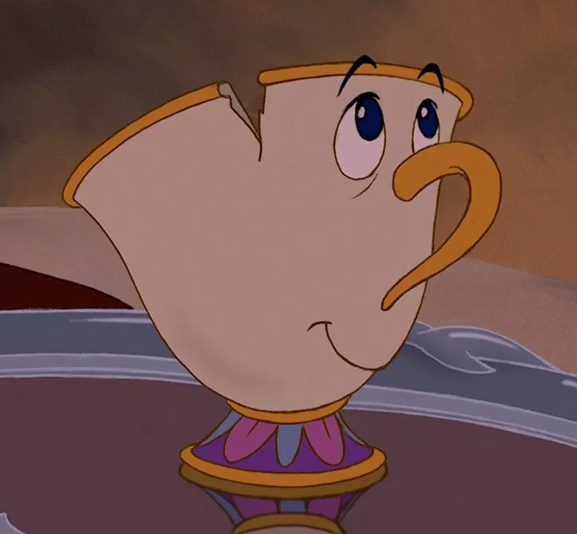
Chip has been a teacup for 72 weeks. How many days has he been a teacup?

Slide 12
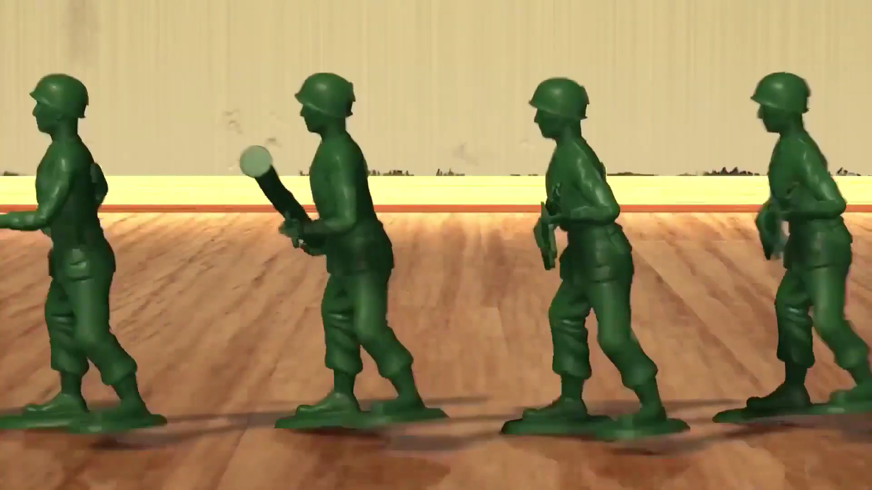
In Toy Story, there are 8 troops of green army men. Each troop has 43 soldiers. How many soldiers are in the army?

