Slide 1
8.3.2022
L.O: To use statistics.
C: Make tally charts.

Slide 2

Let’s warm up!

Slide 4







1) How many fingers?
2) Which set does not show 25?
a) b) c)
3) How much?

Slide 5
1) How many fingers?
2) Which set does not show 25?
a) b) c)
3) How much?
30
27p

Slide 7



Teddy is drawing a tally chart while his mum unpacks the shopping.

Slide 8




Slide 9





Draw a tally to represent each type of fruit
Have a think

Slide 10


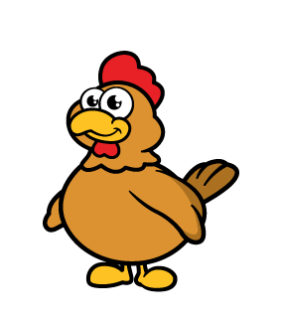



Animals | Tally | Total
Horses
Dogs
Chickens
Frogs
Sheep
1
2
7
4
9

Slide 11







Tally
Cars
Bikes

Slide 12




Slide 13



Which set of fruit matches the tally chart?
a) b) c)
Fruit | Tally
apples
pears
lemons
Have a think

Slide 14
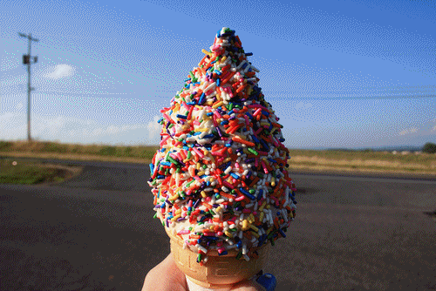
Let’s make our own tally charts!
First let’s think about our favourite ice creams.

Slide 15

Let’s make our own tally charts!
Now let’s explore how we travel to school.

Slide 16

Let’s make our own tally charts!
Finally, who is your favourite superhero?

