Slide 1
Friday 11thMarch 2022
LO: To plan, write and edit
C: News Report

Slide 2
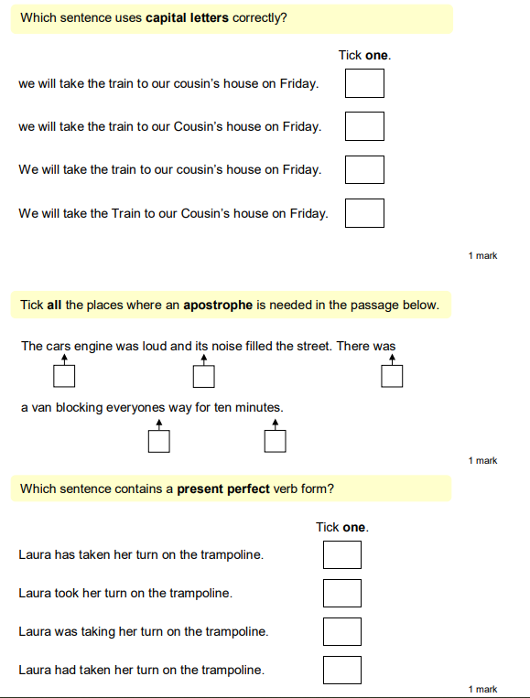
Starter

Slide 3
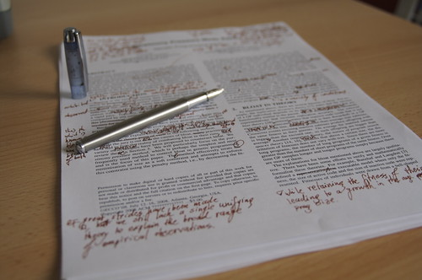
Edit your work from yesterday using my marking to help you!

Slide 4
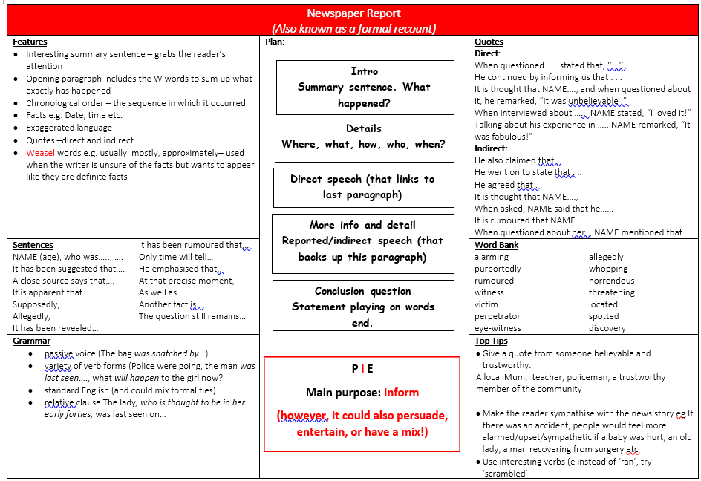

Slide 5
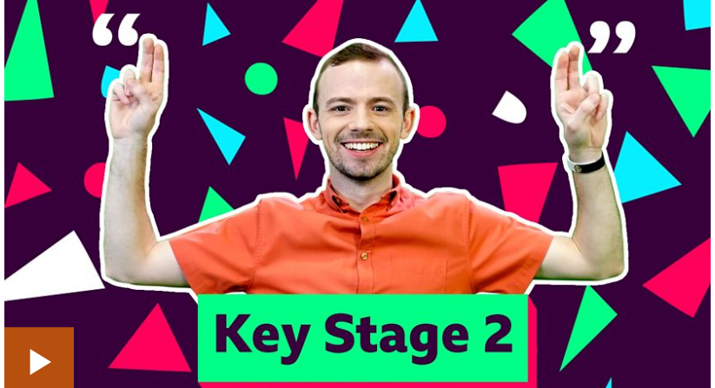
What detail can we add now? What might the reader need to know?
We may wish to include reported speech (indirect speech).
https://www.bbc.co.uk/bitesize/topics/zvwwxnb/articles/zm63c7h

Slide 6
Direct and Reported Speech
Direct speech
We usually use it in telling a straightforward narrative (story).
Direct speech uses the speaker’s actual words:
What he or she said is what you write...
inside speech marks of course.
“ .. .. ..”
Reported speech
We usually use it if we don’t want or need to say the person’s exact words.
It can sound a little more formal. It’s less immediate, but it can still be useful in telling a story.
It can make a change from dialogue.

Slide 7
Reported Speech
doesn’t use speech marks
changes pronouns, and often also changes word order
adjusts verb tenses (and time phrases if necessary)
usually starts by telling you who spoke
often uses “that…” - but you can omit it
sometimes changes the verb too.

Slide 8
John said “He was going to be late.” Who is he talking about?
John said he was going to be late. Who is John talking about now?
“I’m late,” said John.
John said he was late.
“Am I late?” John wondered.
John wondered whether he was late.
Doesn’t use speech marks.
Changes pronouns.
Often changes word order.

Slide 9
Help me include this is my writing!

Slide 10
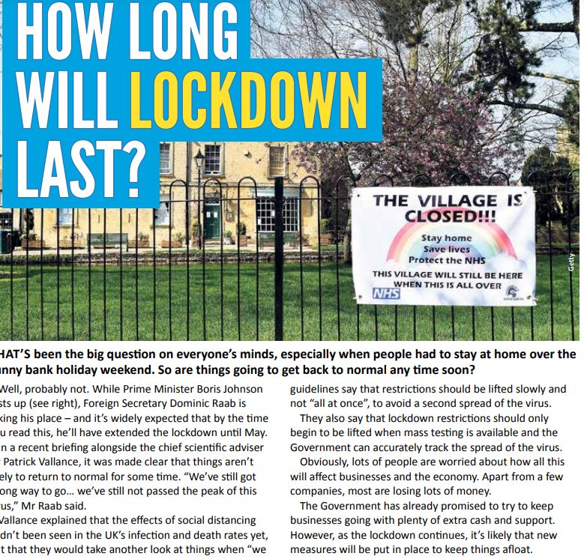

Conclusion

Slide 11
Let’s finish our news reports!

