Slide 1
Tuesday 8th March 2022
LO: To plan, write and edit
C: News Report

Slide 2
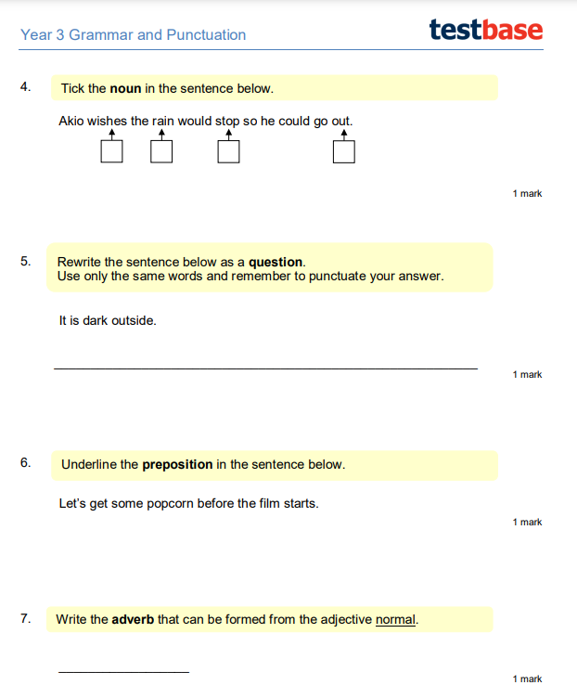
Starter:

Slide 3
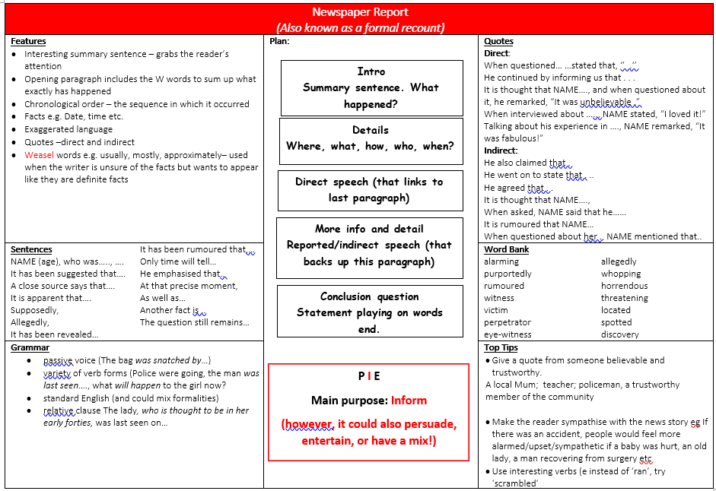
Look at your knowledge organiser. What is the first thing we need to write?

Slide 4




Let’s look at some summary sentences!

Slide 5
What could our summary sentence be?
Discuss, then write one in your books

Slide 6
Look at your knowledge organiser. What is the first thing we need to write?

Slide 7
What
Where
When
Who
How
On Monday 29th February, residents of Warfield, Bracknell awoke to find . . .

