Slide 1
Monday 7th March 2022
LO: To plan, write and edit
C: News Report

Slide 2
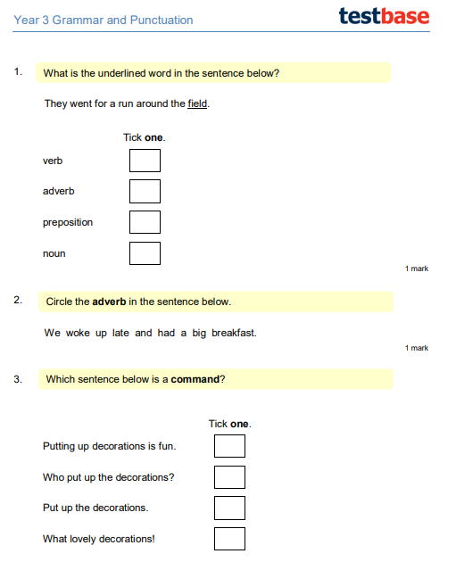

Slide 3
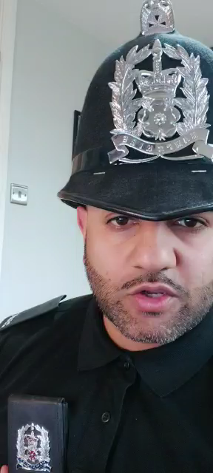
What have we learnt so far?
What don’t we know?

Slide 4
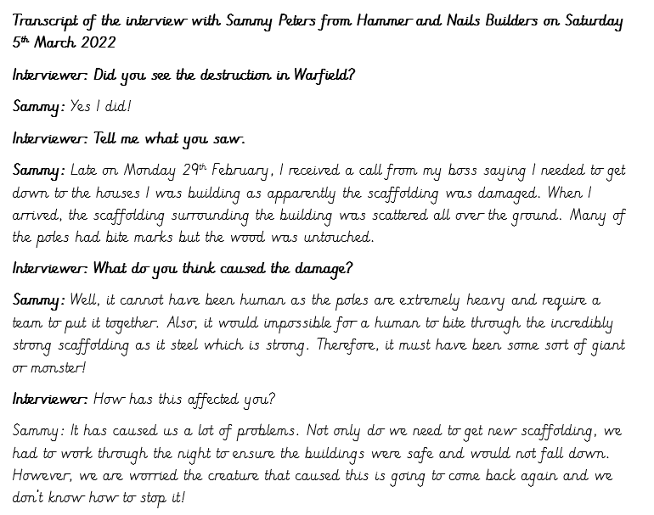
Let’s read the transcript from one of the eye-witnesses

Slide 5
Can we know add more detail to the plan we started on Friday?

Slide 6
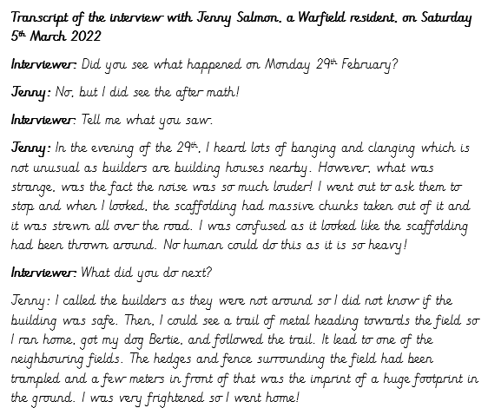
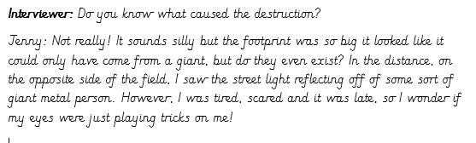
Let’s read another transcript from an eye-witness

Slide 7
Can we know add more detail to the plan we started on Friday?

Slide 8
Having read both articles, is there any key phrases you want to highlight for your news report?

