Slide 1
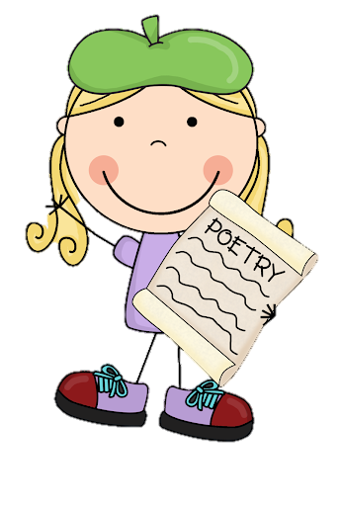
Monday 10th January 2022
L.O: To use the main features of a type of writing to plan and write.
C: Cinquain Poems

Slide 2

Quick reminder:
A cinquain is a special kind of poem. This week we are going to create our own!
Today we are going
to write one together,
to give you some ideas.

Slide 3
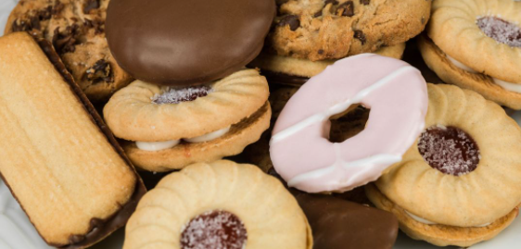
First we need a subject to write about….

Slide 4
Let’s make a mind-map to give us loads of ideas for our cinquain.

Slide 5

Our next step is to organise and refine our ideas!
Let’s remind ourselves of the pattern of themes used in a cinquain poem.

Slide 6
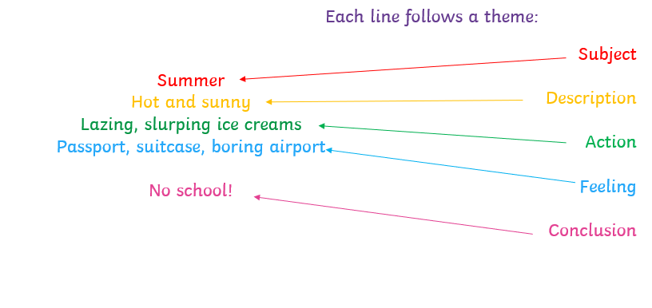
Our next step is to organise and refine our ideas!
Let’s remind ourselves of the
These themes would be a great way to organise our ideas!

Slide 7
Now our ideas our organised, let’s try to write our poem!
We are going to try and use a simile and alliteration to make our poem more interesting!

Slide 8
Alliteration:
https://www.bbc.co.uk/bitesize/articles/zc3v6g8
Simile:
https://www.bbc.co.uk/bitesize/articles/zmmpscw

Slide 9
Let’s remind ourselves of the features!
Cinquains have five lines;
The syllables follow a pattern in each line (2, 4, 6, 8, 2);
They form a diamond shape;
The lines are centered in the middle
The lines follow a theme pattern.

Slide 10
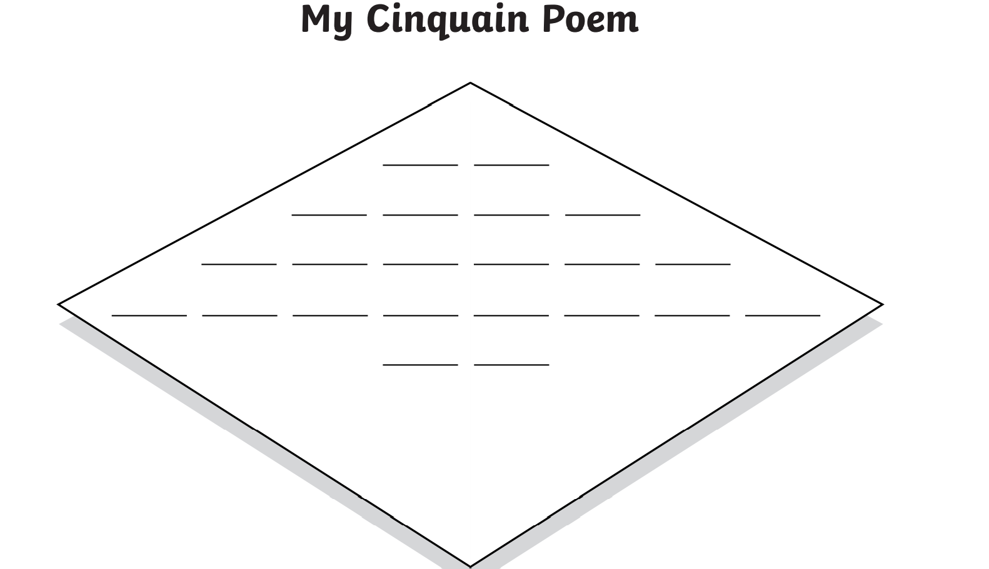
Let’s use this template to help us! Each line represents a syllable not a word.

Slide 11

RED PEN CHALLENGE!
ABC
A: Achievement- What do you like about this poem so far? What is successful?
B: Build On- How could you improve this poem?
C: Challenge: What challenge can you set yourself for next lesson?

