Slide 1

Tuesday 11th January 2022
L.O: To use the main features of a type of writing to plan and write.
C: Cinquain Poems

Slide 2

Quick reminder:
A cinquain is a special kind of poem.
Today, you are going to begin to plan your own Cinquain poem!

Slide 3

First you need a subject to write about….

Slide 4
First we need a subject to write about….
Divers: I would also like you to consider the overall mood of your cinquain.
e.g. a poem about puppies will have a joyful mood, whereas a poem about rain may have a miserable mood.

Slide 5
Once your teacher has approved your theme idea…
Spend 5 mins mind-mapping all of your ideas!
Here’s a reminder of my mind-map from last week…

Slide 6
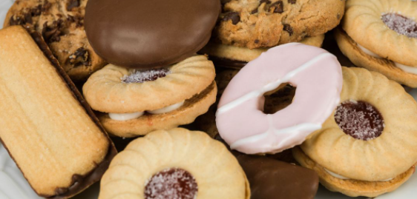
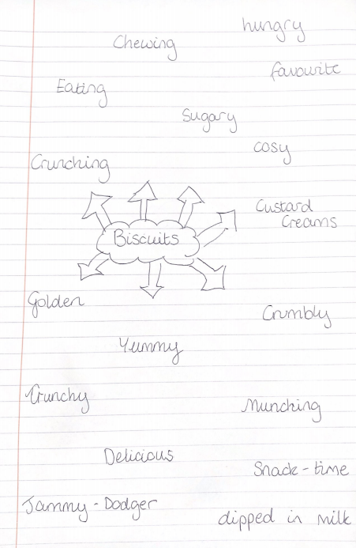
Here is my mind map!

Slide 7

Our next step is to organise and refine our ideas!
Let’s remind ourselves of the pattern of themes used in a cinquain poem.

Slide 8
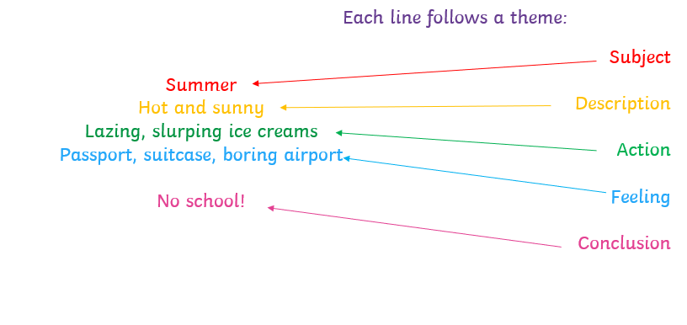
Our next step is to organise and refine our ideas!
Let’s remind ourselves of the
These themes would be a great way to organise our ideas!

Slide 9
Our next step is to organise and refine our ideas!
Let’s remind ourselves of the
Finally, organise your ideas into the sheet provided.
REMEMBER YOUR ALLITERATION AND SIMILE

Slide 10

RED PEN CHALLENGE!
Use your red pen to circle your favourite vocabulary from each section ready for next lesson when we begin writing.

