Slide 1
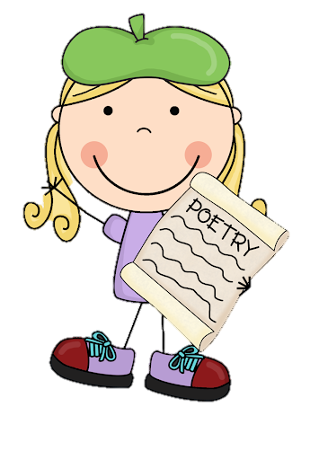
Thursday 12th January 2022
L.O: To use the main features of a type of writing to plan and write.
C: Cinquain Poems

Slide 2

Quick reminder:
A cinquain is a special kind of poem.
Today, you are going to begin to write the first three lines of your own Cinquain poem!

Slide 3

First, I would like you to review your ideas from yesterday!

Slide 4
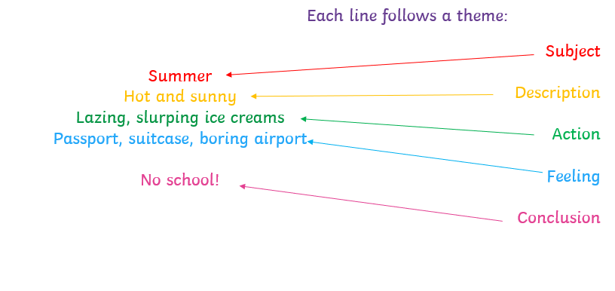

Our next step is to organise and refine our ideas!
Let’s remind ourselves of the
We are going to write the first three lines today!

Slide 5
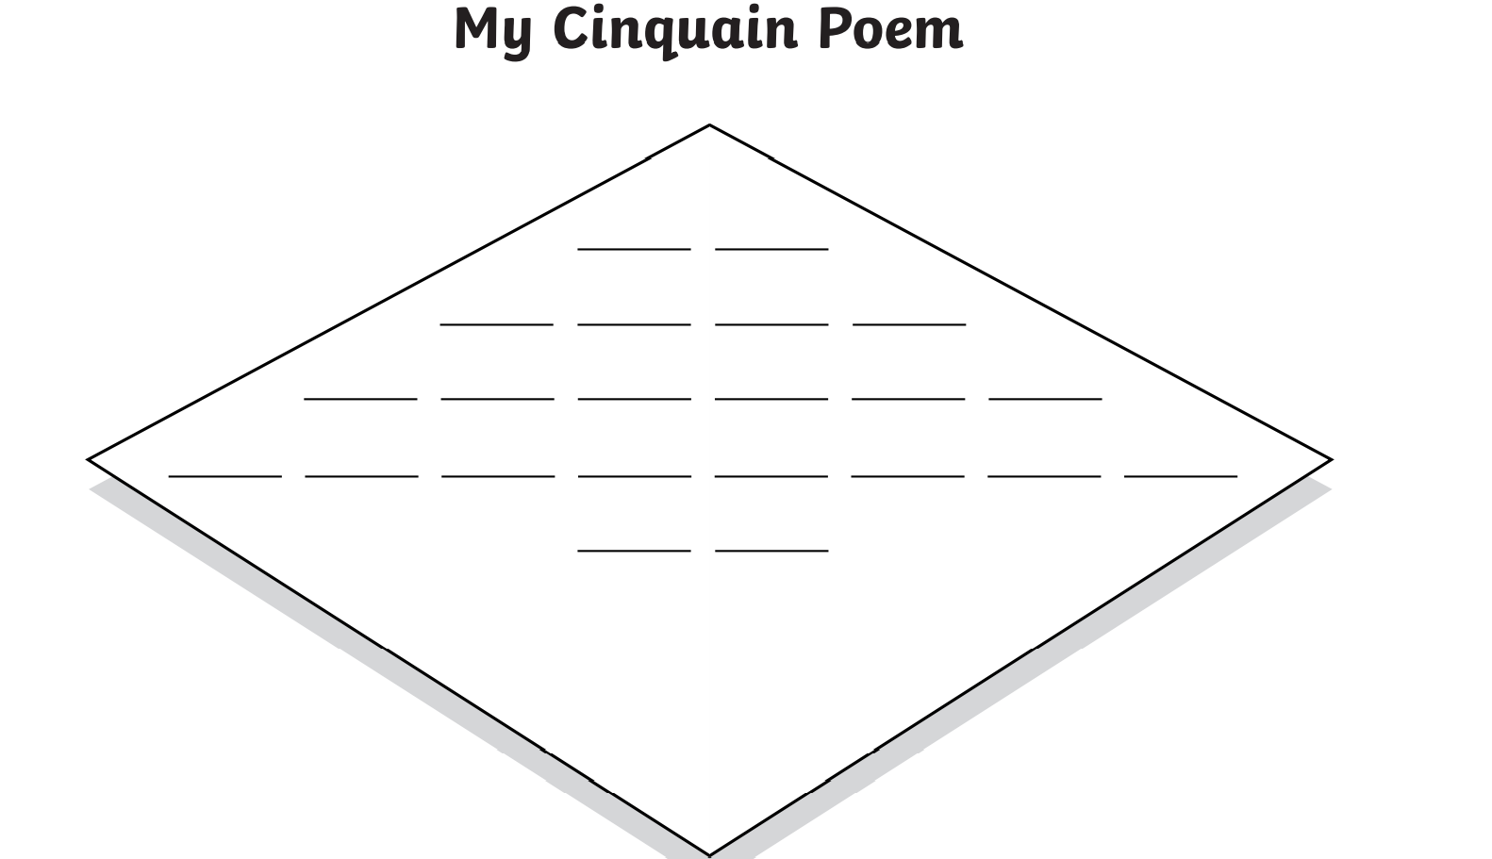
Let’s use this template to help us! Each line represents a syllable not a word.

Slide 6
Our next step is to organise and refine our ideas!
Let’s remind ourselves of the
Firstly, let’s begin with the subject line. This should be two syllables.

Slide 7
Our next step is to organise and refine our ideas!
Let’s remind ourselves of the
Let’s share our ideas. Do they follow the syllable pattern?

Slide 8
Next, let’s try the description line. We need to include adjectives. This line should be four syllables long.
Can you use alliteration?

Slide 9
Our next step is to organise and refine our ideas!
Let’s remind ourselves of the
Let’s share our ideas. Do they follow the syllable pattern?

Slide 10
Lastly, let’s try the action line. We need to include verbs. This line should be six syllables long. Can you make it a simile?

Slide 11
Our next step is to organise and refine our ideas!
Let’s remind ourselves of the
Let’s share our ideas. Do they follow the syllable pattern?

Slide 12

RED PEN CHALLENGE!
Star and a wish!
Read your partner’s work.
The star is something they have done well.
The wish is something to improve on or a challenge for next time.

