Slide 1
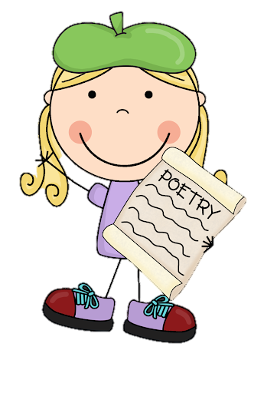
Friday 14th January 2022
L.O: To use the main features of a type of writing to plan and write.
C: Cinquain Poems

Slide 2

Let’s edit and publish!

Slide 3
Read your poem to your table.
Does your poem follow the syllable and theme patterns?
Could you improve your word choice?

Slide 4
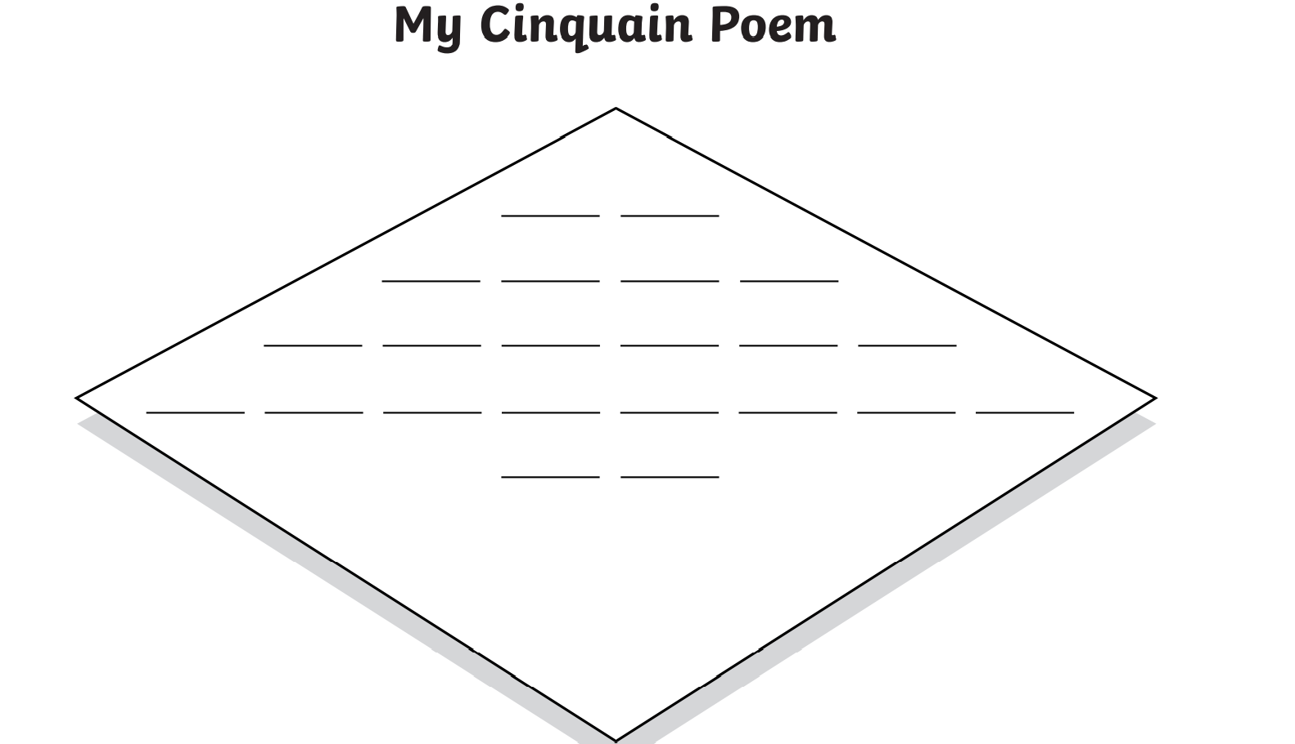
Let’s publish our poems with a title and a border!

