Slide 1
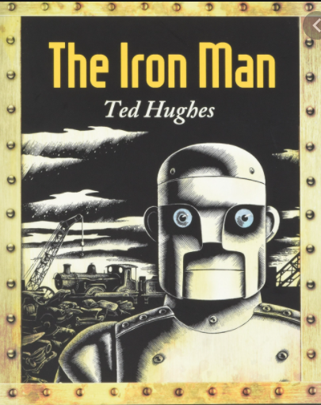
Monday 10th January 2022
L.O: To infer the reasons behind a character’s actions.
C: The Iron Man

Slide 2

Our first challenge!
Class Read: p.1-5
Glum
Shattered
Joyless
Devasted
Let’s try to order these synonyms for sad from strongest to weakest!

Slide 3
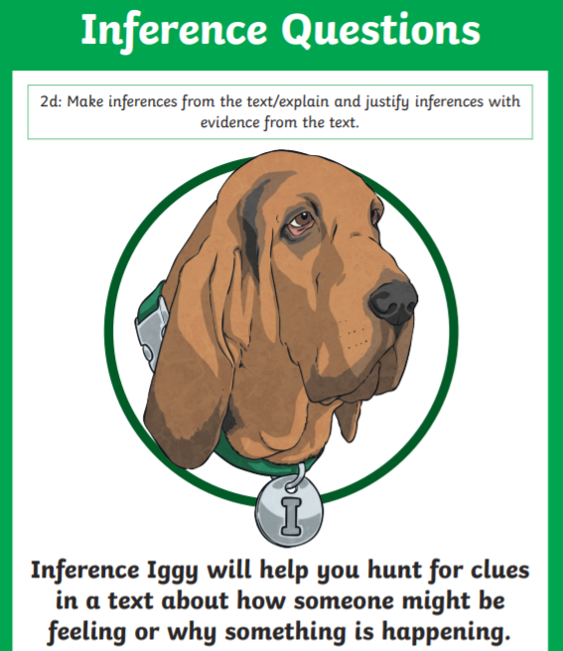
Today we are going to be using Inference Iggy!
We are going to read between the lines and use our inference skills!

Slide 4
Let’s work through some questions together!
Paddlers: Answer the questions Snorkellers: Answer the questions by using evidence from the text. Divers: Answer the questions giving the appropriate number of responses by using evidence from the text.

Slide 5
Today we are going to be using Inference Iggy!
Why do you think the Iron Man’s eyes glowed red?
I believed the Iron Man’s eyes glowed red because….

Slide 6
Today we are going to be using Inference Iggy!
Why do you think the Iron Man went off the cliff?
Did he choose to go?
Did he fall?
Was he trying to get to the sea?

Slide 7
Today we are going to be using Inference Iggy!
Why do you think the Iron Man went off the cliff?
I think the Iron Man ……. off the cliff because…
Divers: Which reason do you think is the most likely?

Slide 8
Today we are going to be using Inference Iggy!
Why did the Iron Man smash?
The Iron Man smashed because…

