Slide 1

Thursday 13th January 2022
L.O: To understand texts.
C: To learn and apply new vocabulary- The Iron Man.

Slide 2
Our first challenge!
hyper
terrified
Shattered
Panic-stricken
Energetic
Exhausted
Let’s match up the emotion synonyms!

Slide 3
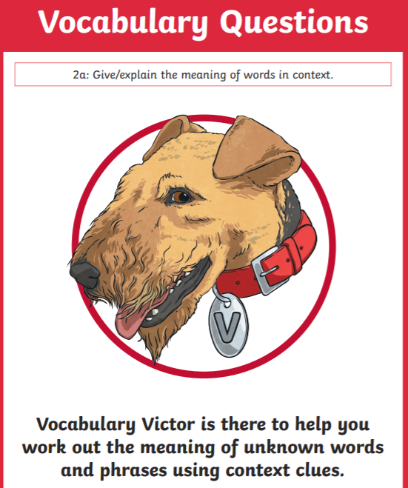
Vocabulary Victor Time!
Today we are going to find some new words and learn what they mean!
We are going to try and use them in context too!

Slide 4
Vocabulary Victor Time!
Today we are going to find some new words and learn what they mean!
We are going to try and use them in context too!
Why should we learn new words?

Slide 5
Vocabulary Victor Time!
Can you draw a table like this in your book?
Word | Meaning | Applied in a sentence

Slide 6
Vocabulary Victor Time!
Paddlers: Define and apply the new words in a sentence.
Snorkelers: Define and apply the new words in a sentence which includes a FANBOYS conjunction.
Divers: Define and apply the new words in a sentence which includes a FANBOYS conjunction and an adverbial phrase.

