Slide 1
Thursday 16th September 2021
L.O: To create a main character
C: Adventure Story

Slide 2
Think about an adventurer or explorer that you know of.
What skills and characteristics do they have?
Let’s make a word bank!
Bear Grylls and You vs Wild https://www.youtube.com/watch?v=unUycSGEcWY

Slide 3
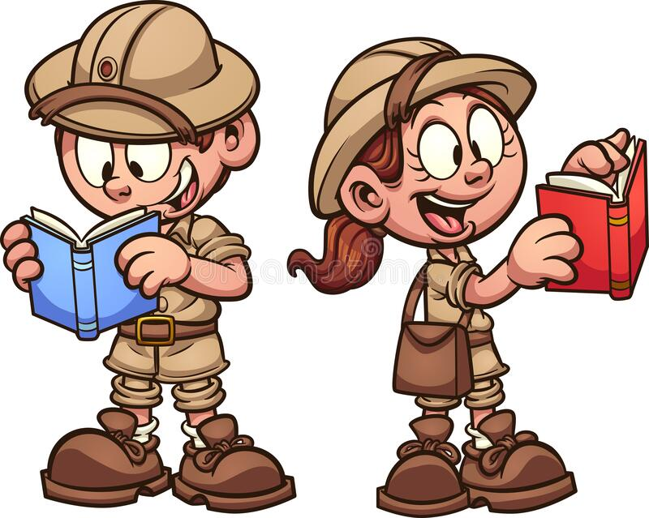
You are going to be the explorer in your own story! Your task today is to draw yourself with all the kit and supplies you might need!
Remember to add neat labels too!

