Slide 1
Friday 17th September 2021
L.O: To plan an adventure story
C: Adventure Story

Slide 2
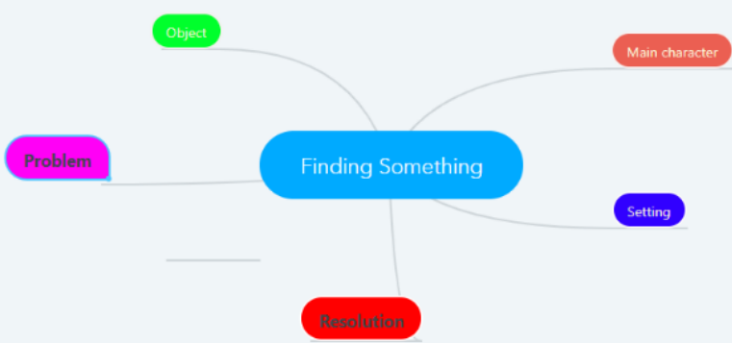
Let’s refer back to our large mindmap of ideas from Wednesday!

Slide 3

Today you are going to turn your favourite ideas into a story board plan!
Under each picture we need a brief description of each stage of the story.
I will model this for you.

