Slide 1

Year 3 Science

Slide 2
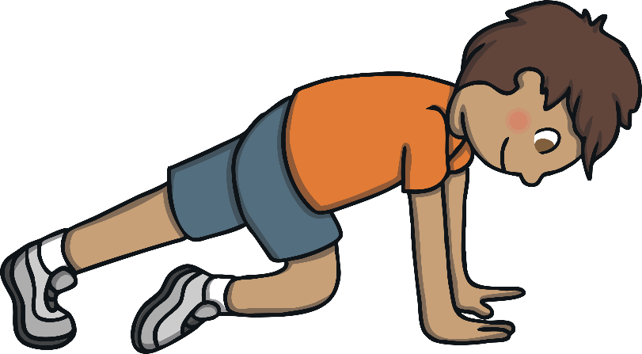
Wednesday 9th February 2022
L.O: Identify that animals, including humans, need the right types and amount of nutrition, and that they cannot make their own food; they get nutrition from what they eat.
L.O: Gather, record, classify and present data in a variety of ways to help answer questions.
L.O: Record findings using simple scientific language, bar charts, and tables.
C: Animals Including Humans

Slide 3
Let’s recap!
What do we need know about our clients so far?
Did they eat their five a day?
How could they improve their diet?

Slide 4
Let’s recap!
Apart from fruit and vegetables, what else do our clients need to stay fit and healthy?

Slide 5
Five types of food - KS2 Design and Technology - BBC Bitesize

Slide 6
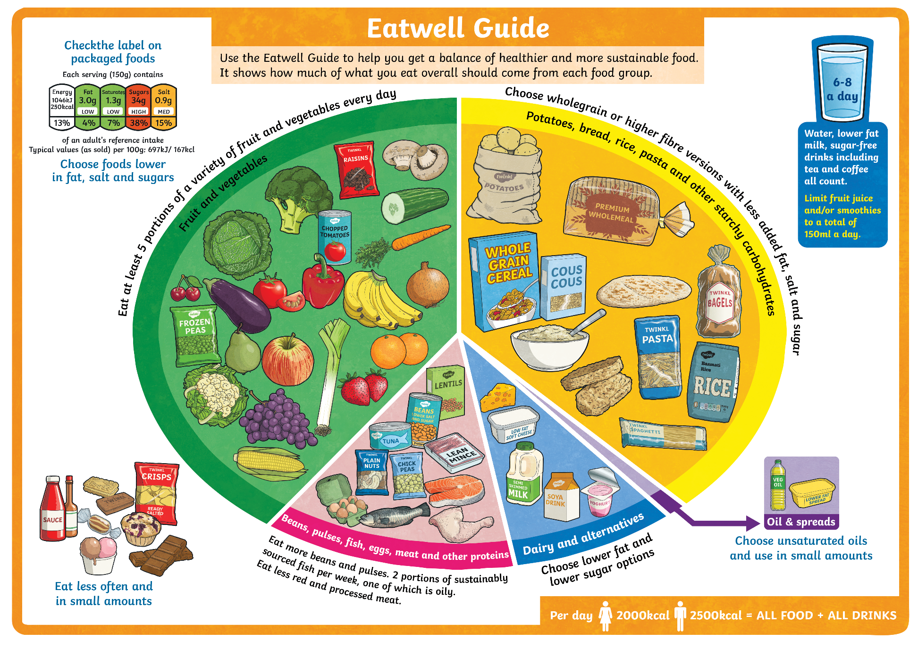
Check the label on packaged foods
.
potatoes,
fruit
.
beans,
oil,
dairy,
.
.

Slide 7
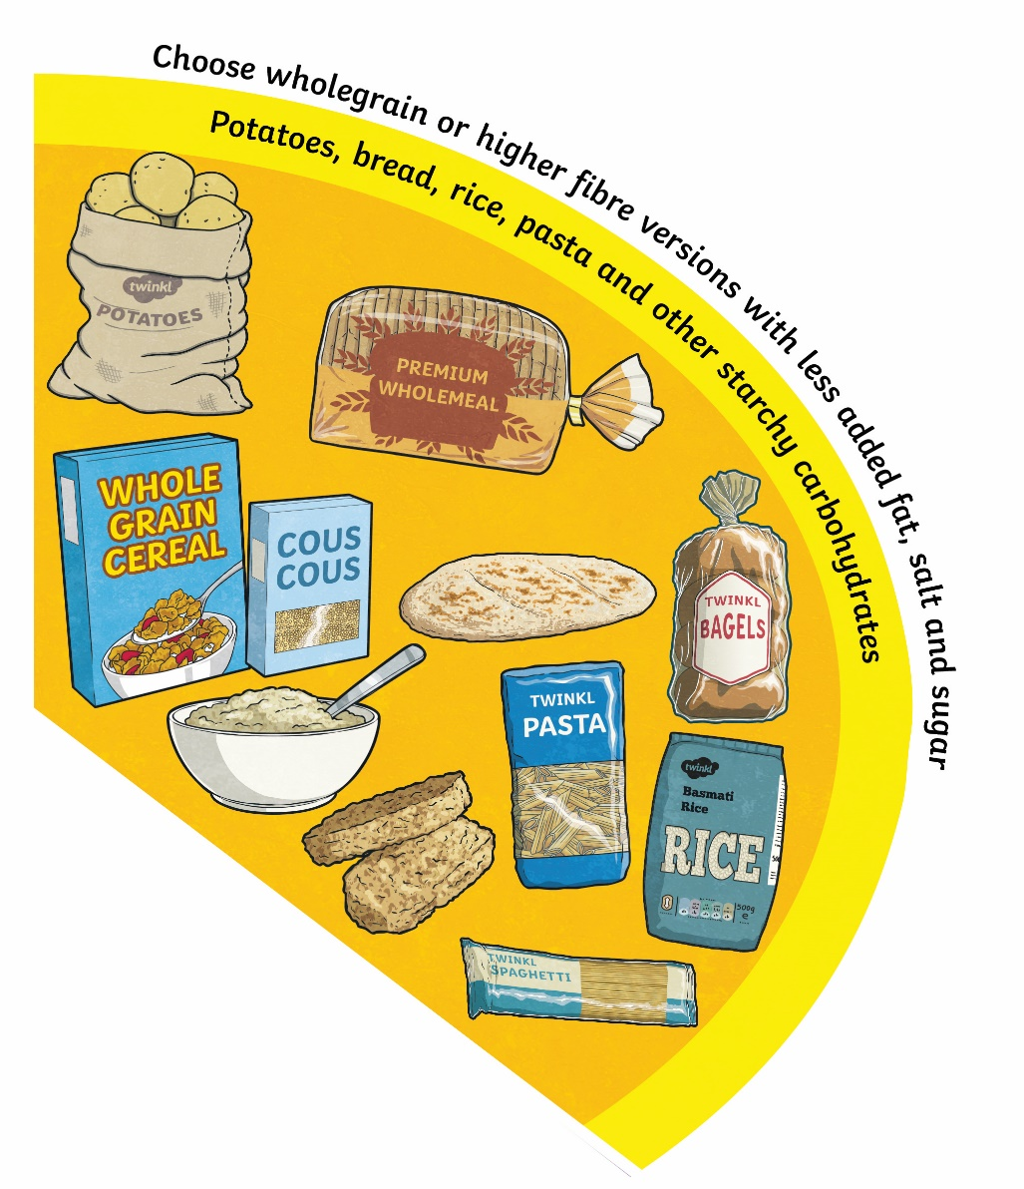
Carbohydrates
potatoes,
.

Slide 8
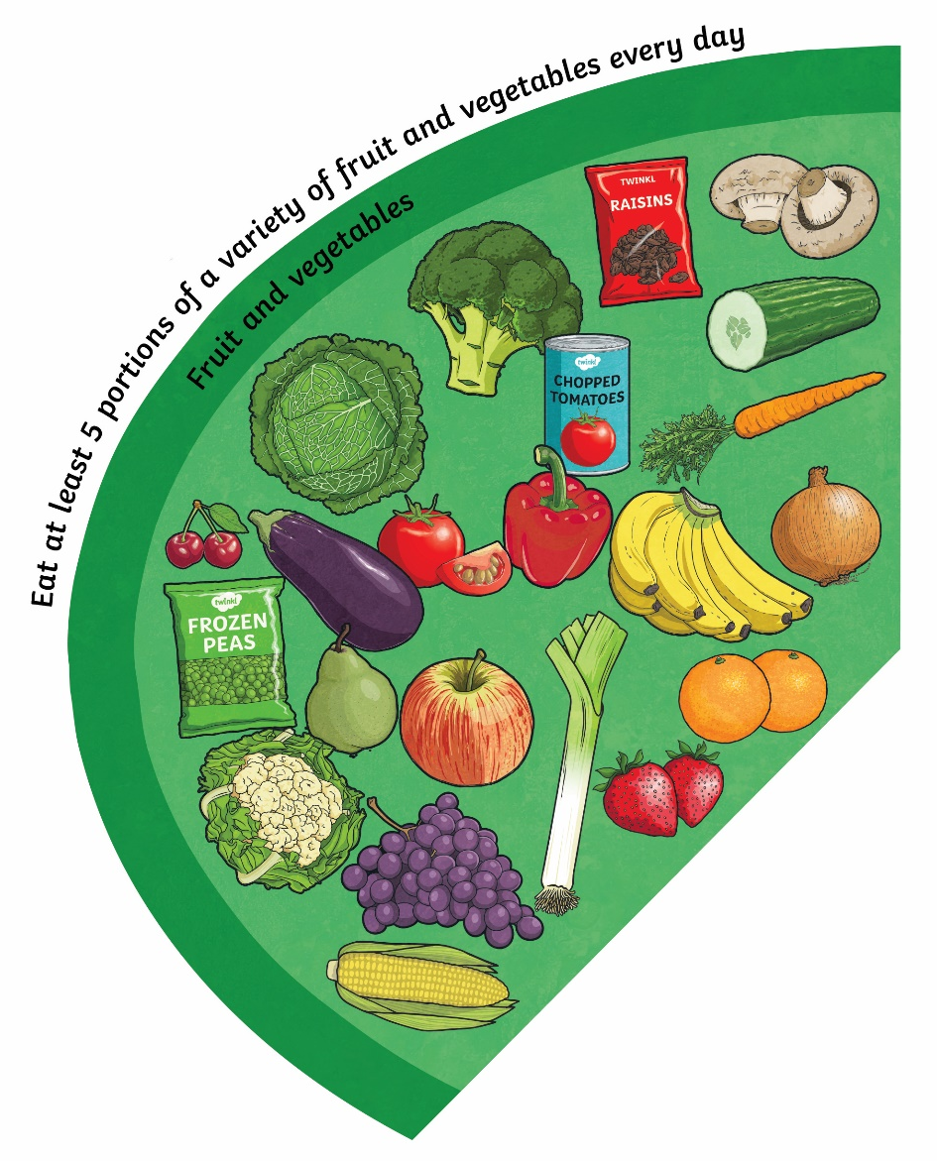
Fruit and Vegetables
.
fruit

Slide 9
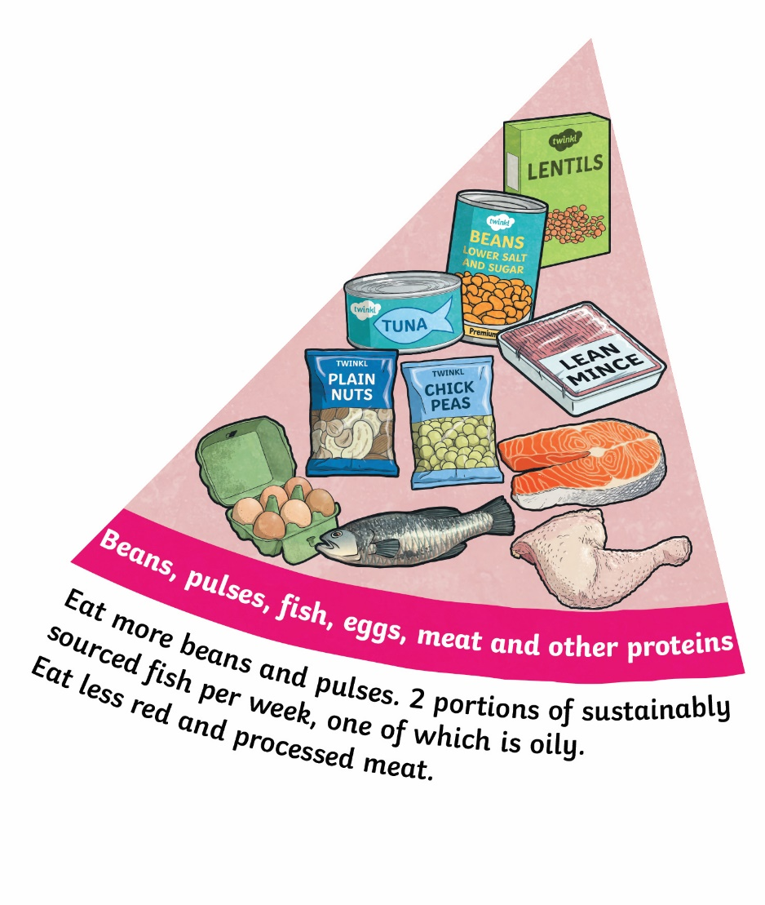
Beans, Pulses, Fish, Meat and Other Proteins
beans,

Slide 10

Dairy and Alternatives
dairy
.

Slide 11

Oil and Spreads
oil
.

Slide 12

Water

Slide 13
Our challenge today is to design a healthy balanced meal for our client!

Slide 14
Red Pen:
What is the difference between a balanced meal and a balanced diet?

