Slide 1


Thursday 10th February 2022
L.O: To understand texts
C: The Iron Man- prediction skills.

Slide 2
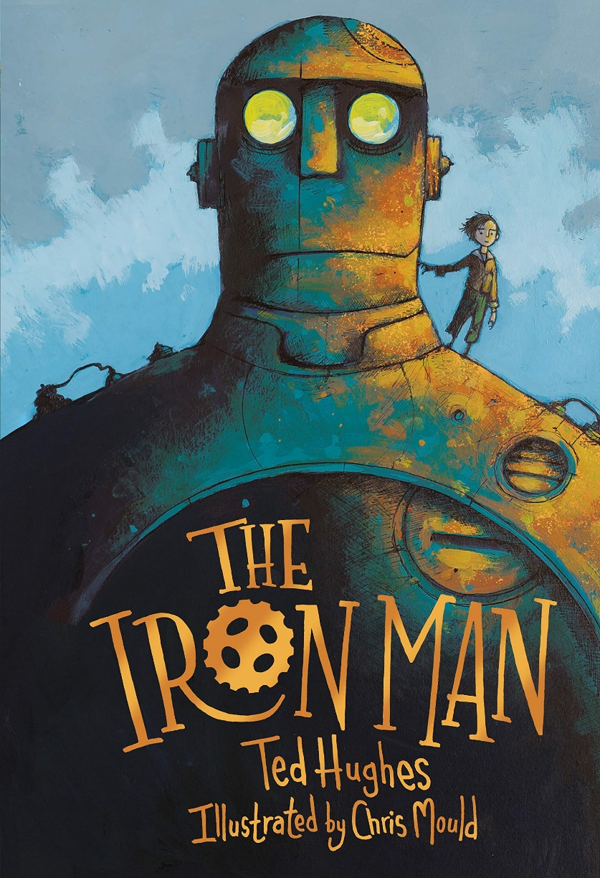
Starter: Can you describe the Iron Man?
You can’t use these words “metal”, “giant” or “monster”.
Class Read : p.75-78 “nearer, nearer”

Slide 3
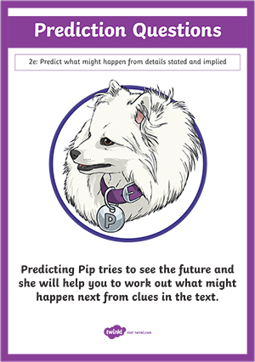
Today we are going to use our Predicting Pip skills to think about what is going to happen next.
Class Read : p.64-73
Class Read : p.75-78 “nearer, nearer”

Slide 4
Think, Pair, Share: What do you think is going to happen?
- Maybe the Iron Man is going to catch the star
- Maybe it is going to explode like a firework!
Class Read : p.64-73
Class Read : p.75-78 “nearer, nearer”

Slide 5
Can you draw your prediction with a caption?
Class Read : p.64-73
Class Read : p.75-78 “nearer, nearer”

