Slide 1

Monday 7th February 2022
L.O: To understand texts
C: The Iron Man- inference skills.
C: Mental Health Week

Slide 2


Starter: Let’s play fastest finger!
Class Read : p.64-73

Slide 3
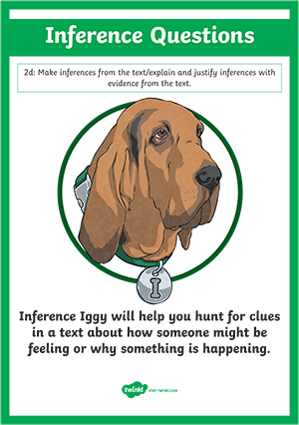
Today we are going to use our Inference Iggy skills to think about how the Iron Man has been feeling throughout the story.
Class Read : p.64-73

Slide 4
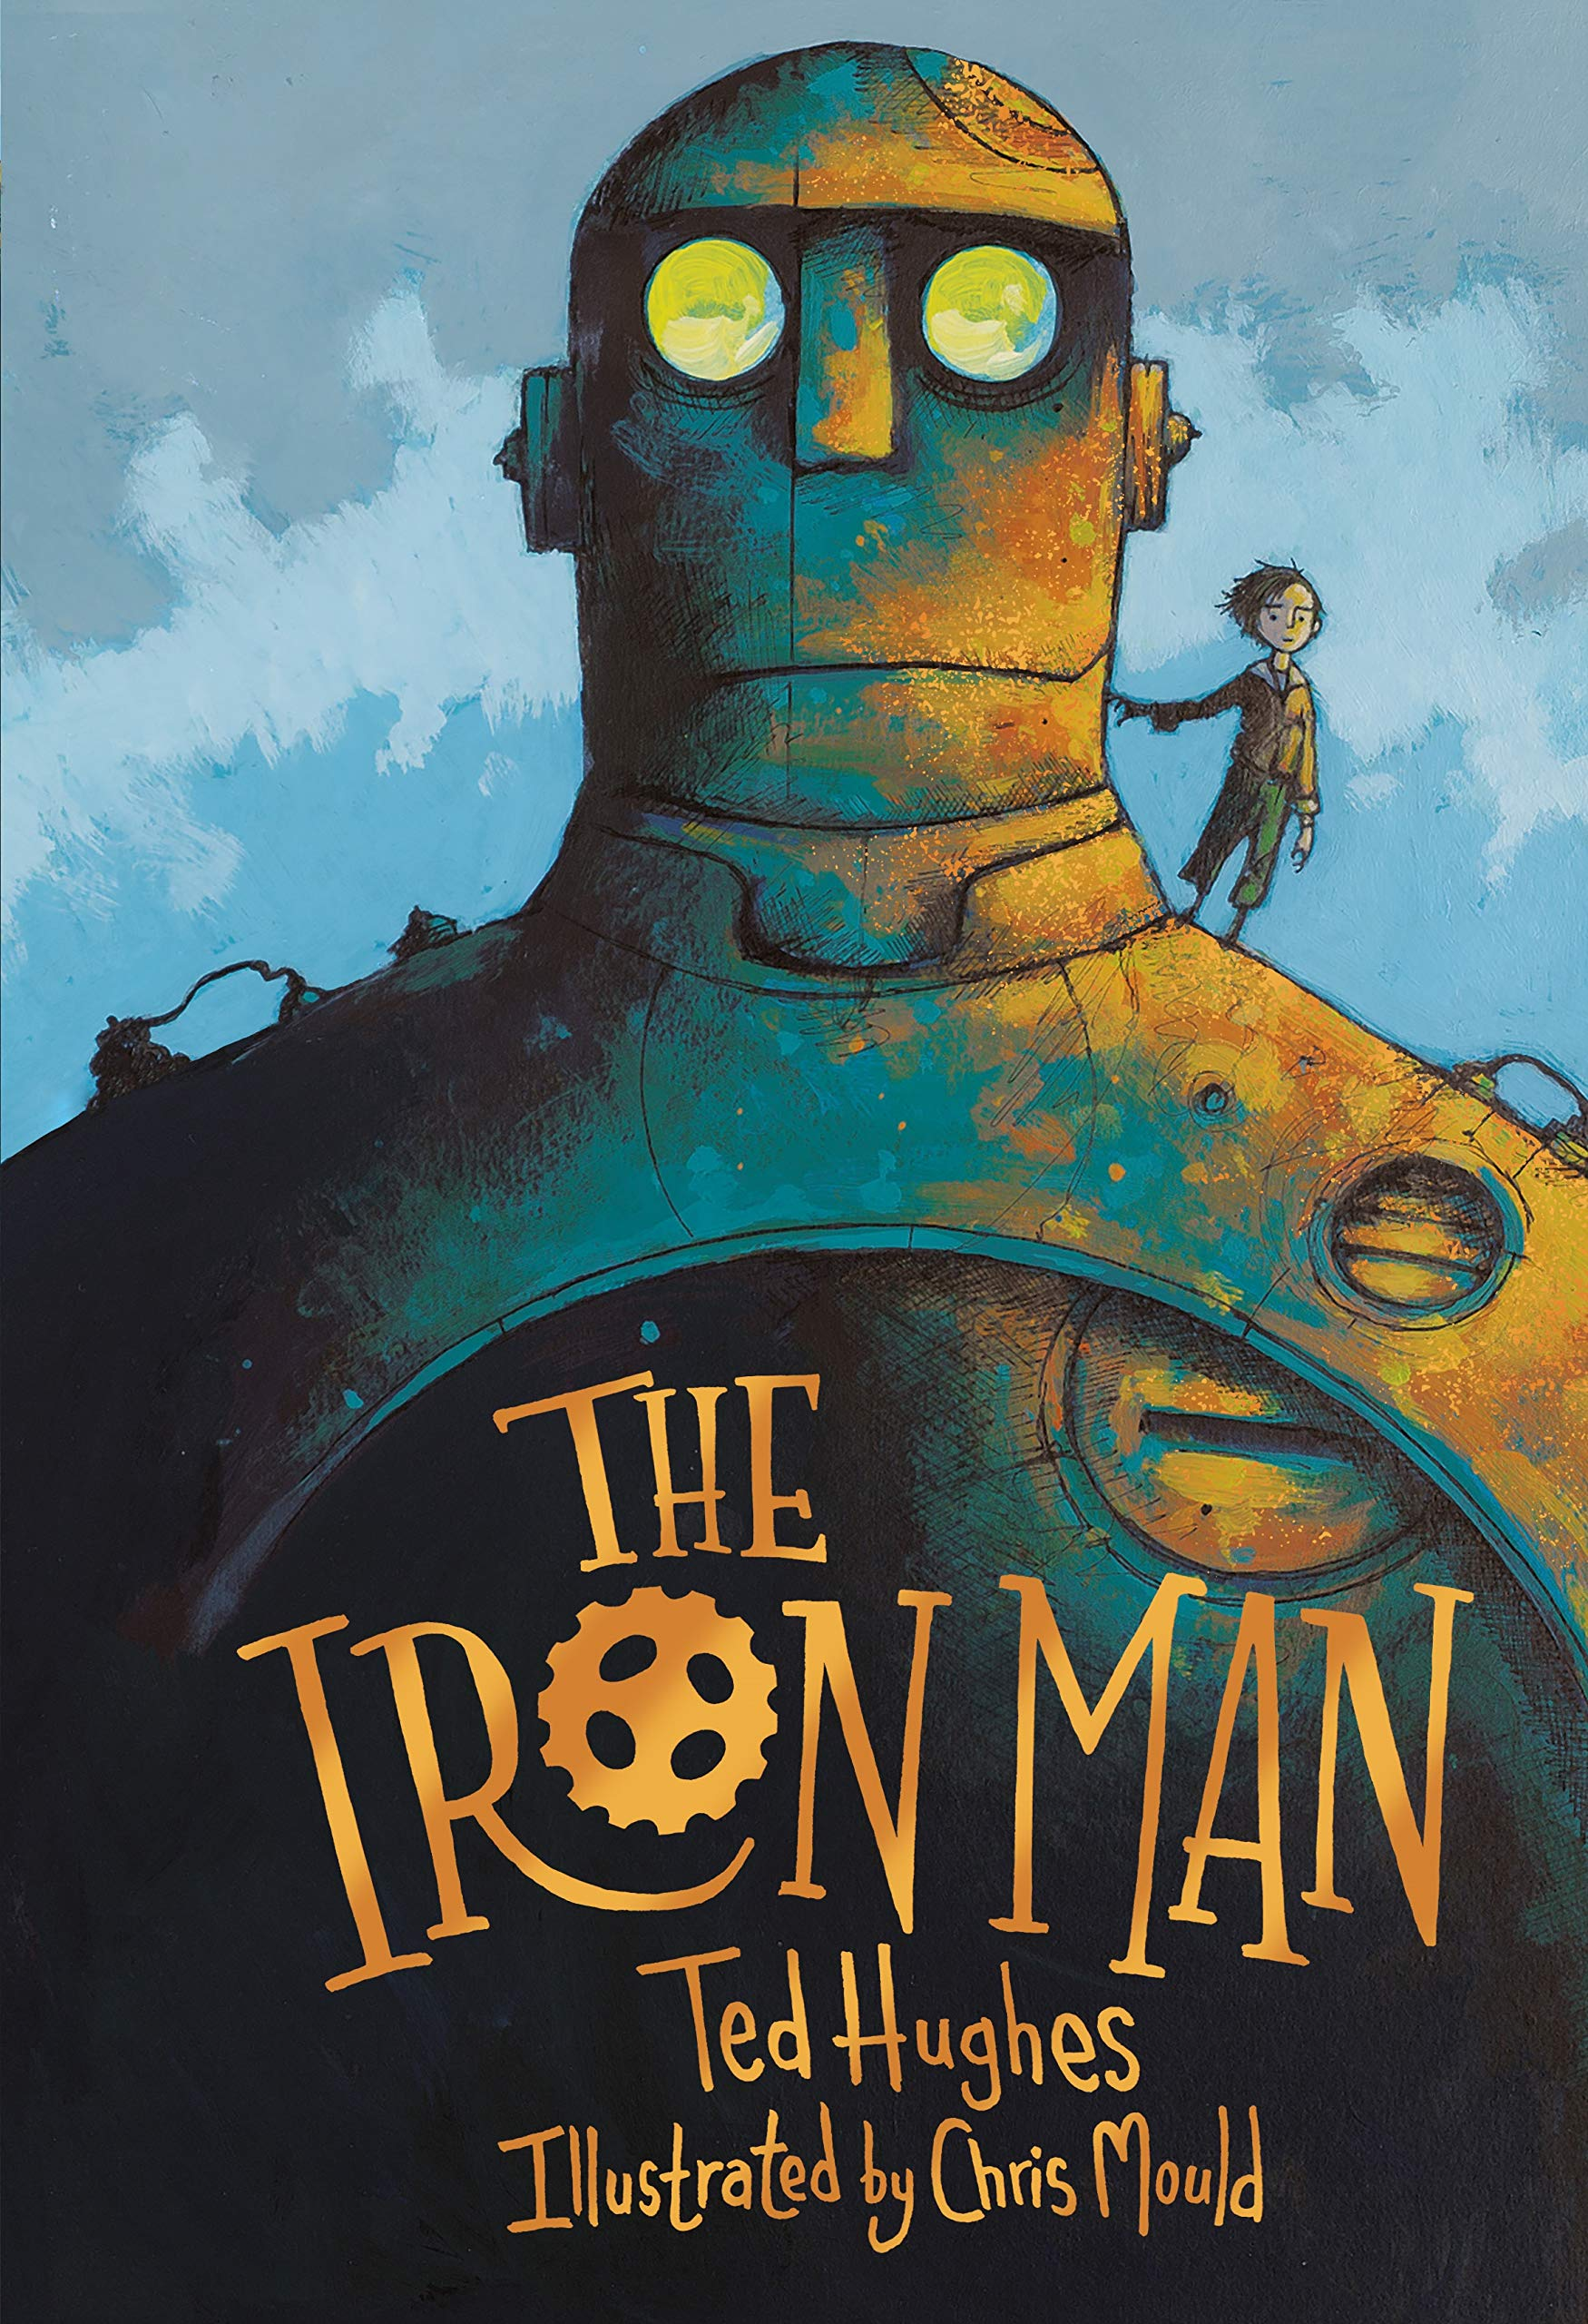
First you need to cut and order the story so far!
Class Read : p.64-73

Slide 5
Next let’s think about his emotions ☺
Class Read : p.64-73

Slide 6
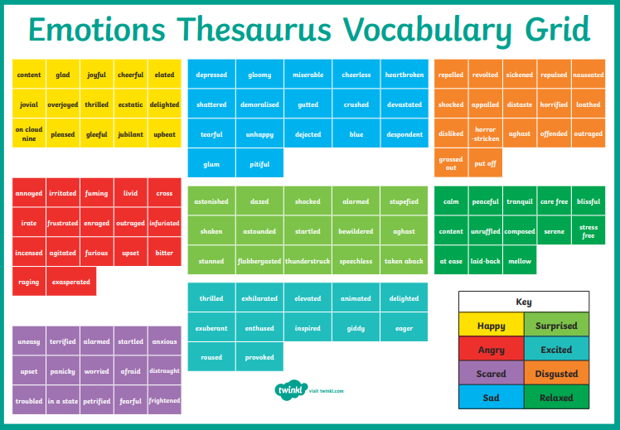
Class Read : p.64-73

