Slide 1


Dreams and Goals Piece 6!

Slide 2

Today is your final challenge!
In your group you need to prepare your egg for an egg drop! We are going to drop the eggs from the top of the step ladder. You need to prep your egg so it is protected.

Slide 3
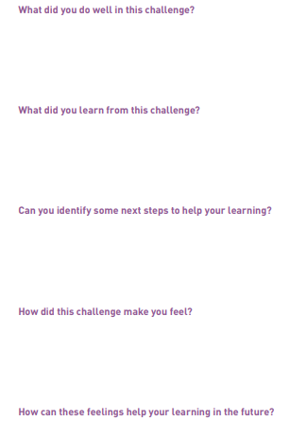
When you have completed the challenge, try and answer these questions.

