Slide 1
Wednesday 9th February 2022
L.O: To understand how different emotions can affect our bodies.
C: Charlie Changes into a Chicken
C: Mental Health Week

Slide 2

Let’s read to Chapter 5!
How does Charlie feel before he changes?

Slide 3

Before becoming a spider…
“A feeling past through the whole of his body, like he’d just been shot through an electrical wire, like he was the electricity. Every part of his body fizzed and hummed. The fizzing and humming became stronger, until he felt he was on fire, but a fire inside a never-ending tube, squeezed and vibrating.”

Slide 4
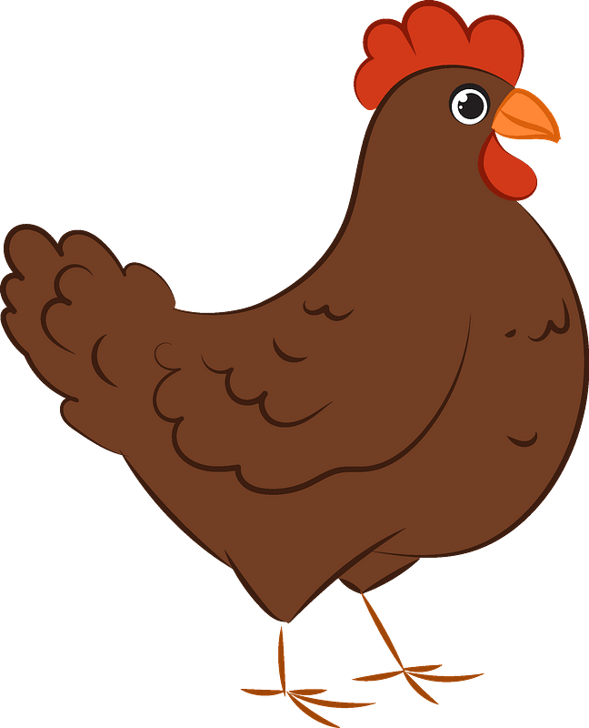
Before becoming a chicken…
““The feeling burst through his whole body like an electric flower. It exploded inside him. Every part of his body was aflame, but with fire that was squeezed and crushed throughout his veins and arteries and back out through every pore of his skin”

Slide 5
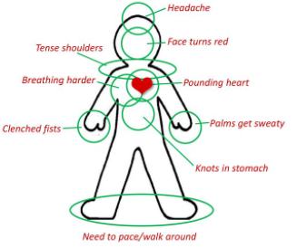
How do you feel different emotions around your body?
What emotion do you think this shows?

Slide 6
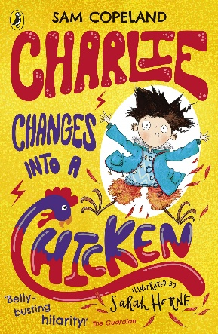
Your task!
Can you chose an emotion and label your gingerbread man to show how that emotion may effect the body?

