Slide 1
Tuesday 8th February 2022
L.O: To be able to name different emotions.
C: Charlie Changes into a Chicken
C: Mental Health Week

Slide 2
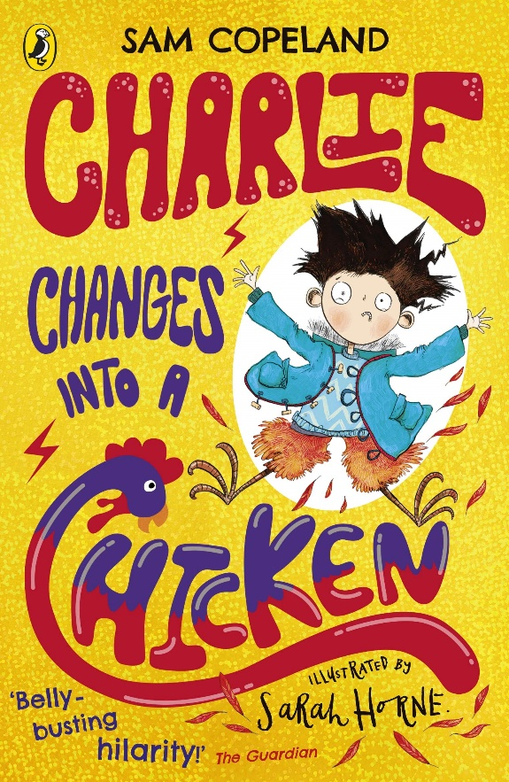
Let’s recap!
What animal did Charlie change into at the end of chapter 1?

Slide 3
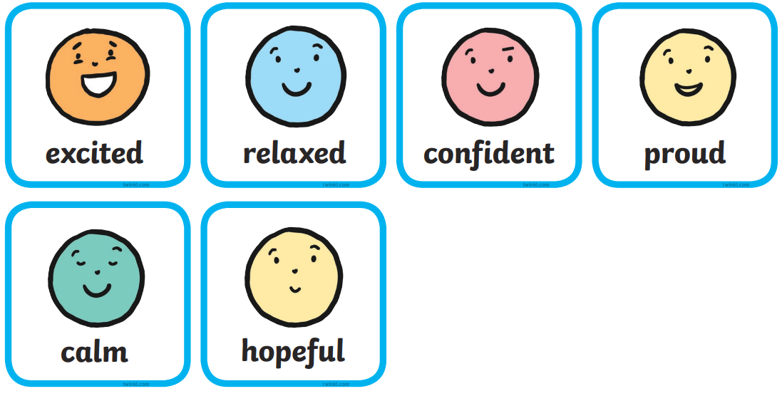
Today we are going to explore different emotions! Let’s play the emotion game!

Slide 4
Let’s read chapter 2!
How do you think Charlie is feeling?

Slide 5

Let’s read chapter 2!
What do you think has happened to Charlie?
Has he really turned into a spider?

Slide 6
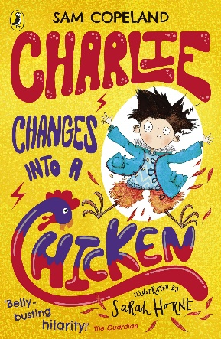
Let’s step into Charlie’s shoes!
What happened?
What emotions were you feeling?
What did you do to try and solve the problem?

Slide 7
Let’s step into Charlie’s shoes!
Can you write a paragraph from Charlie’s perspective?

