Slide 1

Monday 7th January 2022
LO: To understand that some emotions are bigger than others
C: Mental Health Week
C: Charlie Changes into a Chicken

Slide 2

Mental Health Week Assembly
https://www.youtube.com/watch?v=zisXE4KlLAI

Slide 3

How many emotions can you write down in 1 minute?
Have you thought of any no one else has?

Slide 4
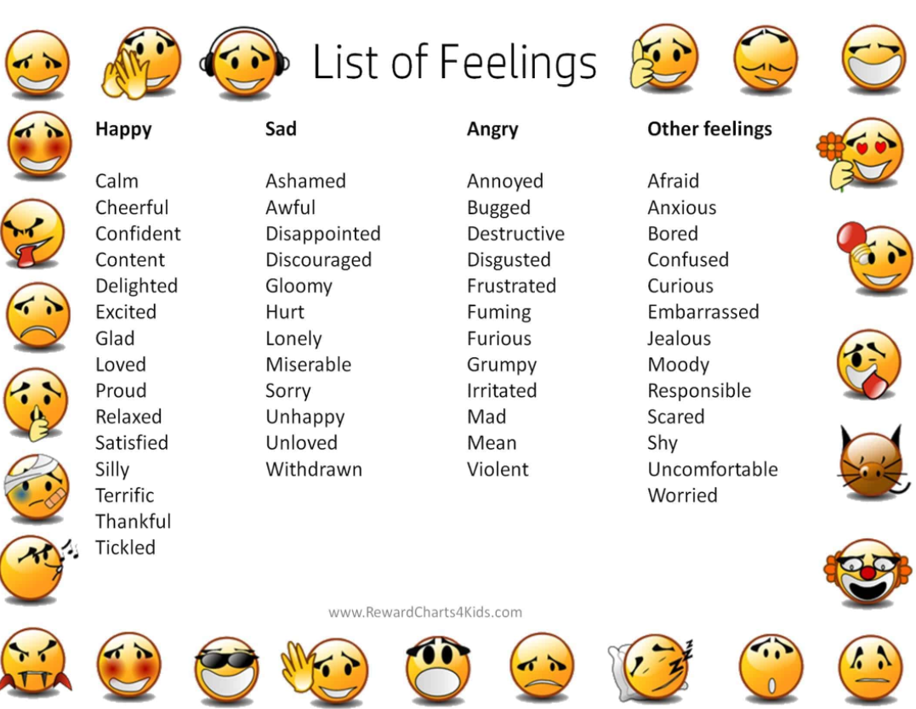

Slide 5
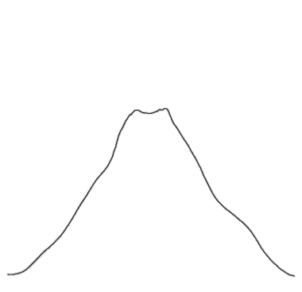
Having read some of the text, how do you think Charlie is
feeling? Where is his emotion on the volcano?
Where do these emotions fit on our volcano?
inconsolable
devastated
upset
sad

