Slide 1


Slide 2
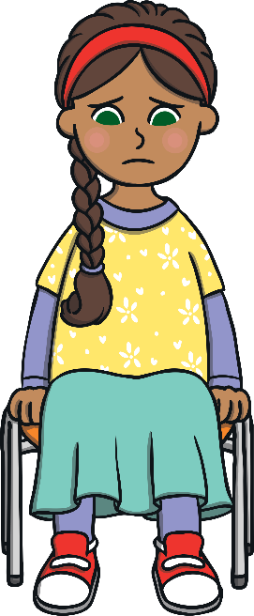
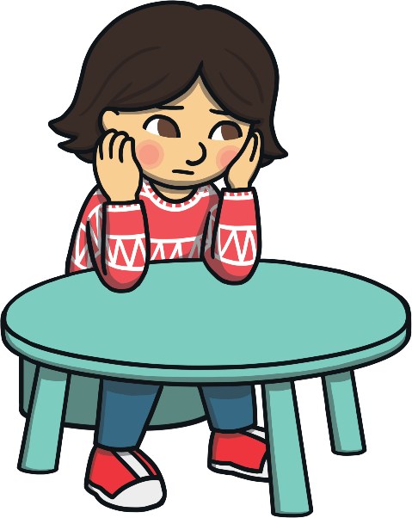
What is Mental Health?
Mental health is about how you feel, think and sometimes behave. Lots of children have mental health problems and it means they can feel sad, angry or anxious.

Slide 3
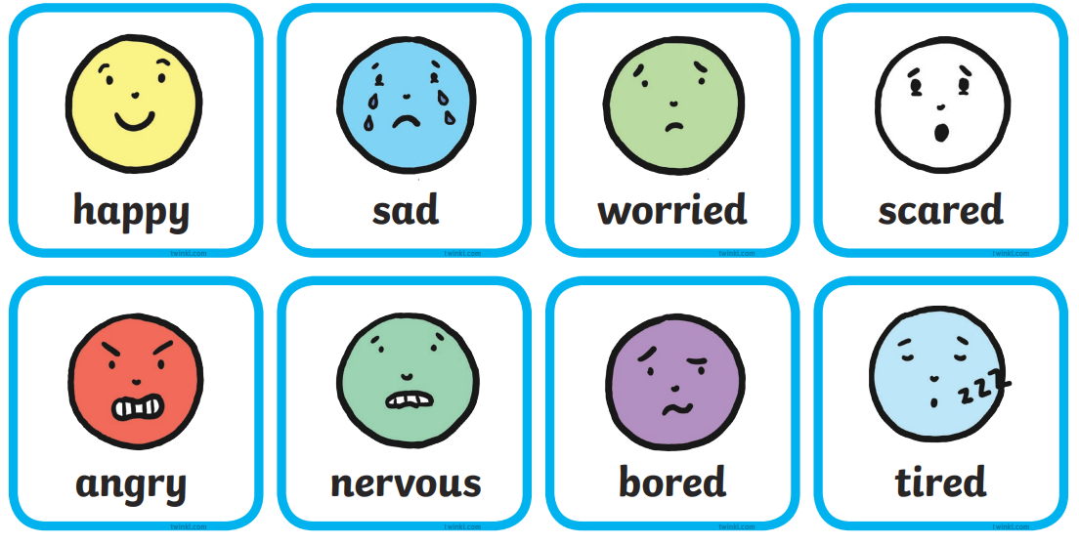
Today let’s think about antonym emotions!

Slide 4
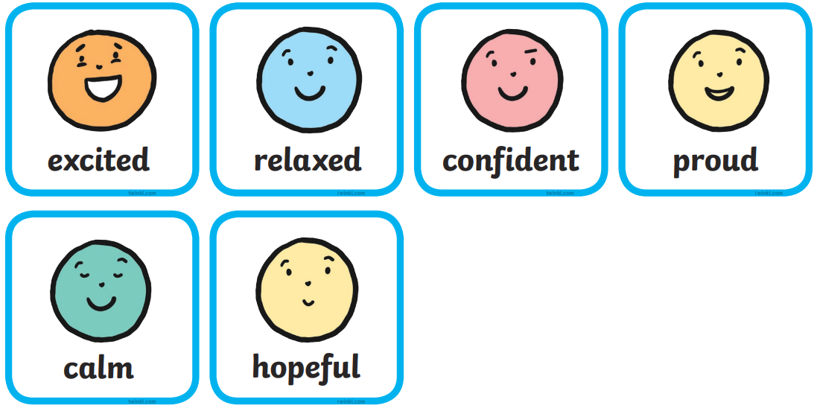
Today let’s think about antonym emotions!

