Slide 1


Slide 2
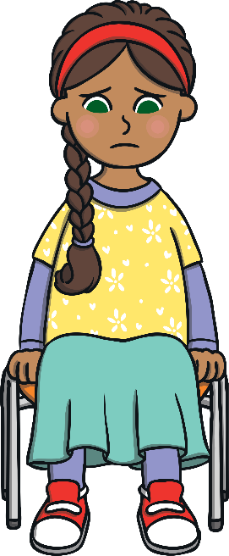
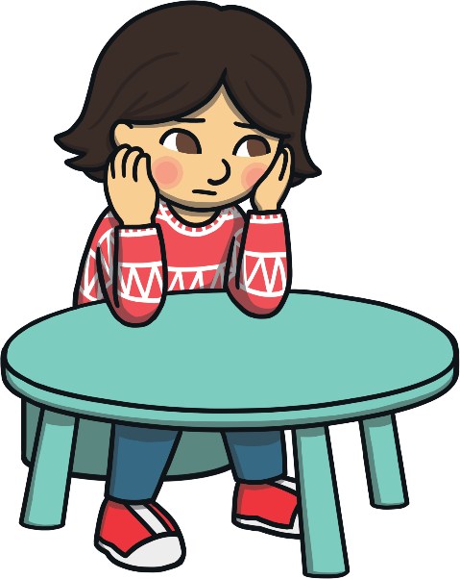
What is Mental Health?
Mental health is about how you feel, think and sometimes behave. Lots of children have mental health problems and it means they can feel sad, angry or anxious.

Slide 3
We can express our mental health and emotions through art!
https://www.childrensmentalhealthweek.org.uk/news/i-express-myself-through-virtual-sessions-on-creative-expression/

Slide 4
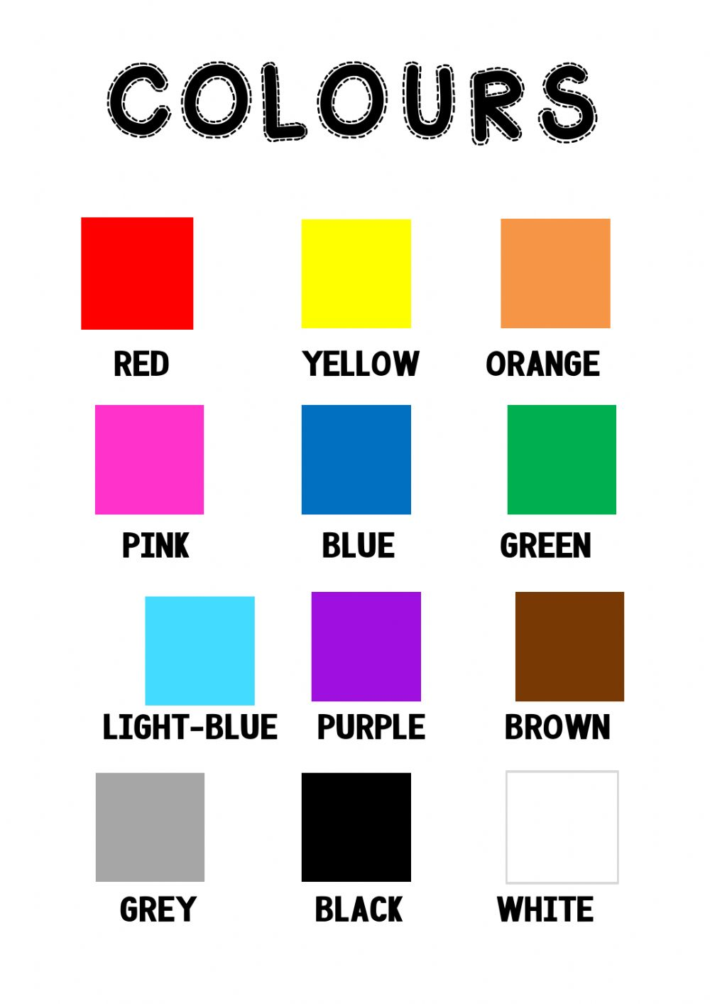
What emotions do you associate with these colours?
https://www.childrensmentalhealthweek.org.uk/news/i-express-myself-through-virtual-sessions-on-creative-expression/

Slide 5
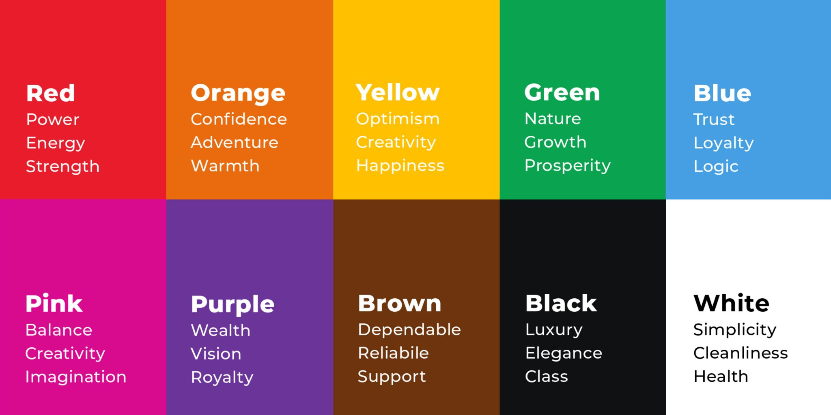
What emotions do you associate with these colours?
https://www.childrensmentalhealthweek.org.uk/news/i-express-myself-through-virtual-sessions-on-creative-expression/

Slide 6
What emotions do you associate with these colours?
https://www.childrensmentalhealthweek.org.uk/news/i-express-myself-through-virtual-sessions-on-creative-expression/

Slide 7
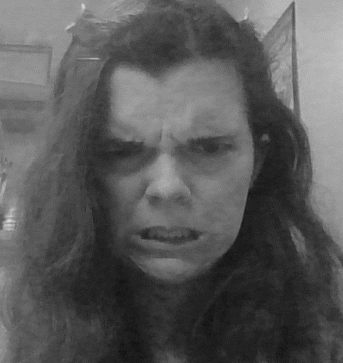
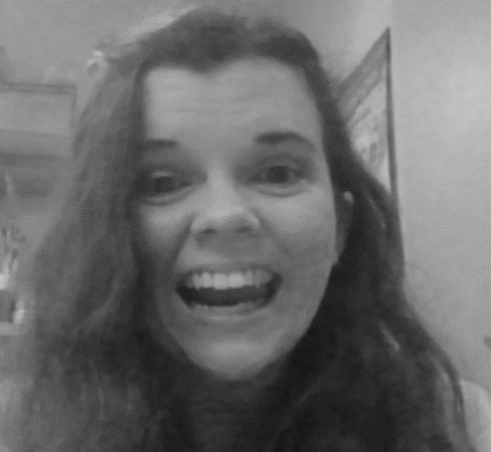
What colours would you add to these photos of me?

Slide 8
We are going to colour over our black and white photos to show our emotions.

