Slide 1

Monday 7th June 2021
LO: To write with purpose
C: Setting description
MY
STORY

Slide 2
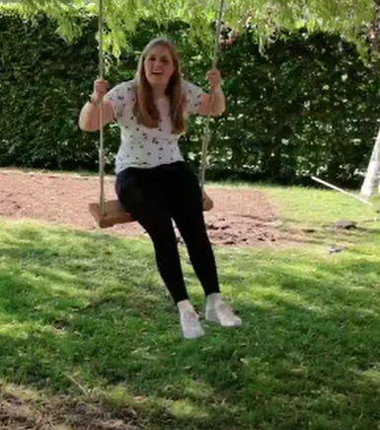
How many different places have you been?
Forest walk
Parent’s garden
Legoland
Camping
Day out in Billingshurst to see my cousin

Slide 3
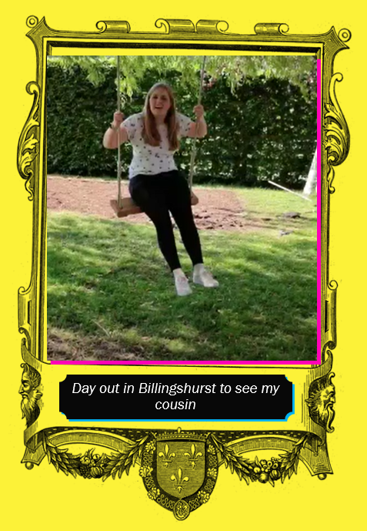
My Story
The main character in my story is going to be me!
You are the main character for your story!
The setting is a place I know well.
The setting for your story is a place you know well.

Slide 4
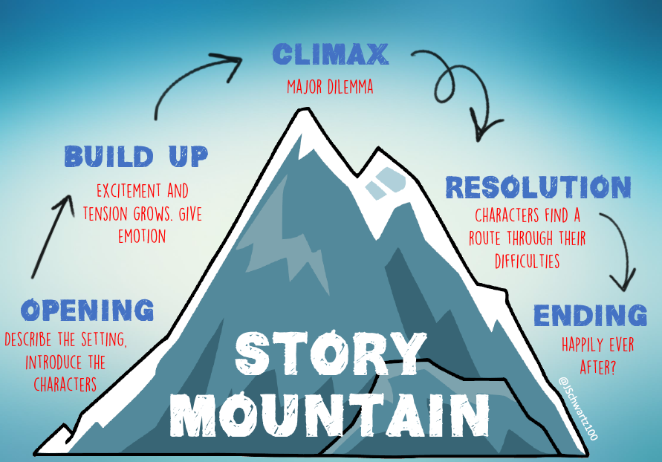
Where does the setting fit within a story?

Slide 5
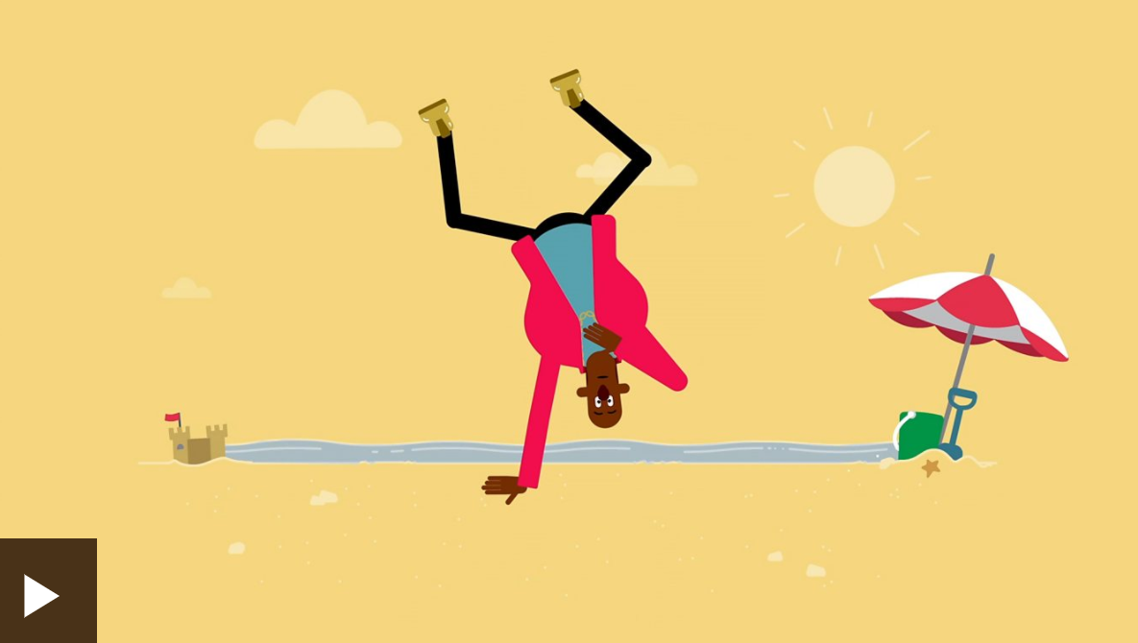
Why is the job of the setting?
https://www.bbc.co.uk/bitesize/articles/zcxnm39

Slide 6
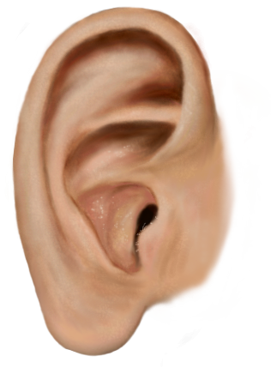

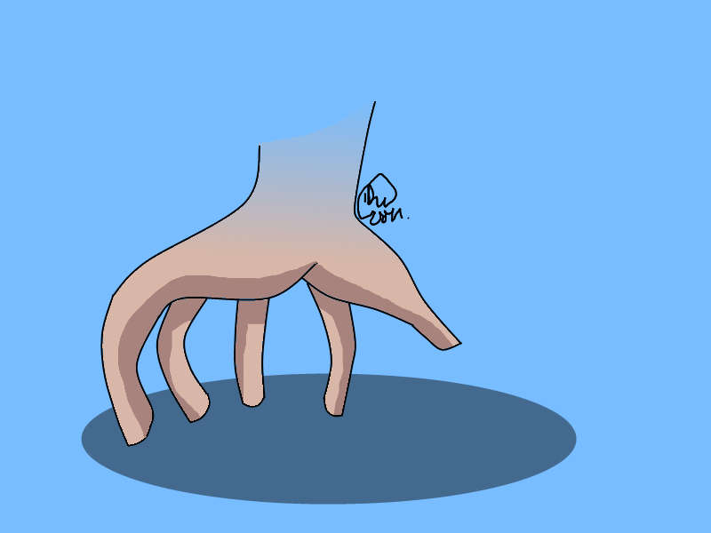


What to include in the setting!
hear
touch
taste
see
smell

Slide 7
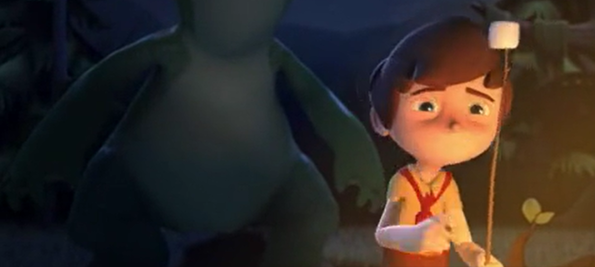
What can you see, hear, taste, smell and touch?
(you may need to use your imagination)
Fitst 17secs/sound off - https://www.literacyshed.com/marshmallows.html

Slide 8
Task
Draw, or stick in, a picture of where you have been and where you want your story to be set.
Then, list the things you could hear/see/taste/smell/touch.

