Slide 1
Tuesday 1st March 2020
LO: To understand teaching and beliefs
C: To reflect

Slide 2

Is there a time in your life when you
have felt....

Slide 3
Let’s revisit the three stories from last week
What happened on...

Slide 4
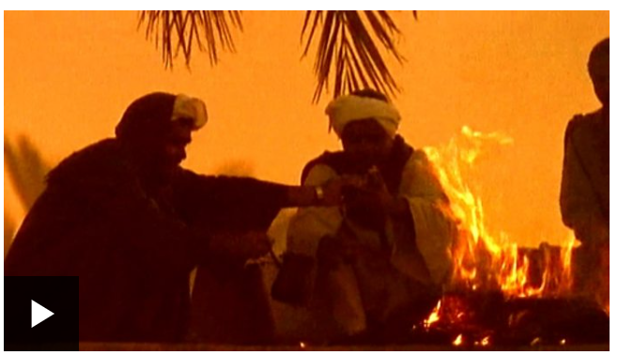
PALM SUNDAY
https://www.bbc.co.uk/bitesize/clips/zvxn34j

Slide 5
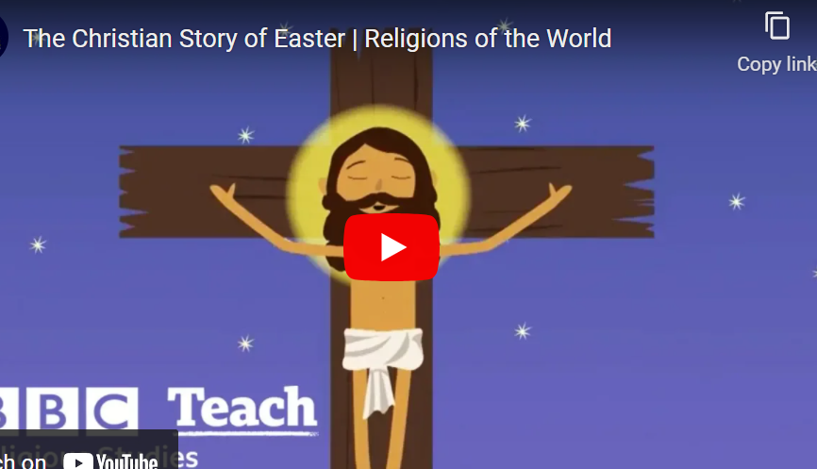
GOOD FRIDAY
https://youtu.be/Wnbo2AmS3OI

Slide 6
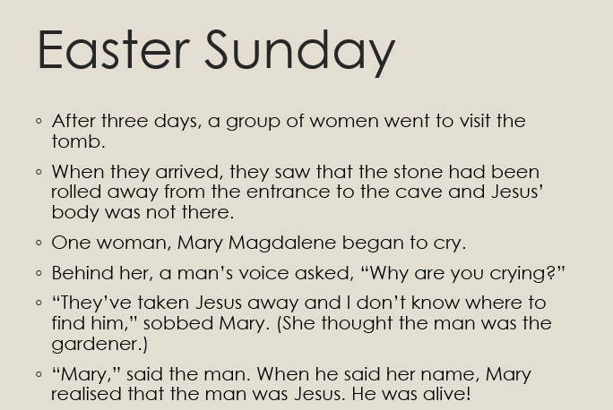
EASTER SUNDAY

Slide 7

Would Mary would call the day Jesus died Good Friday? Why? Why not?

Slide 8
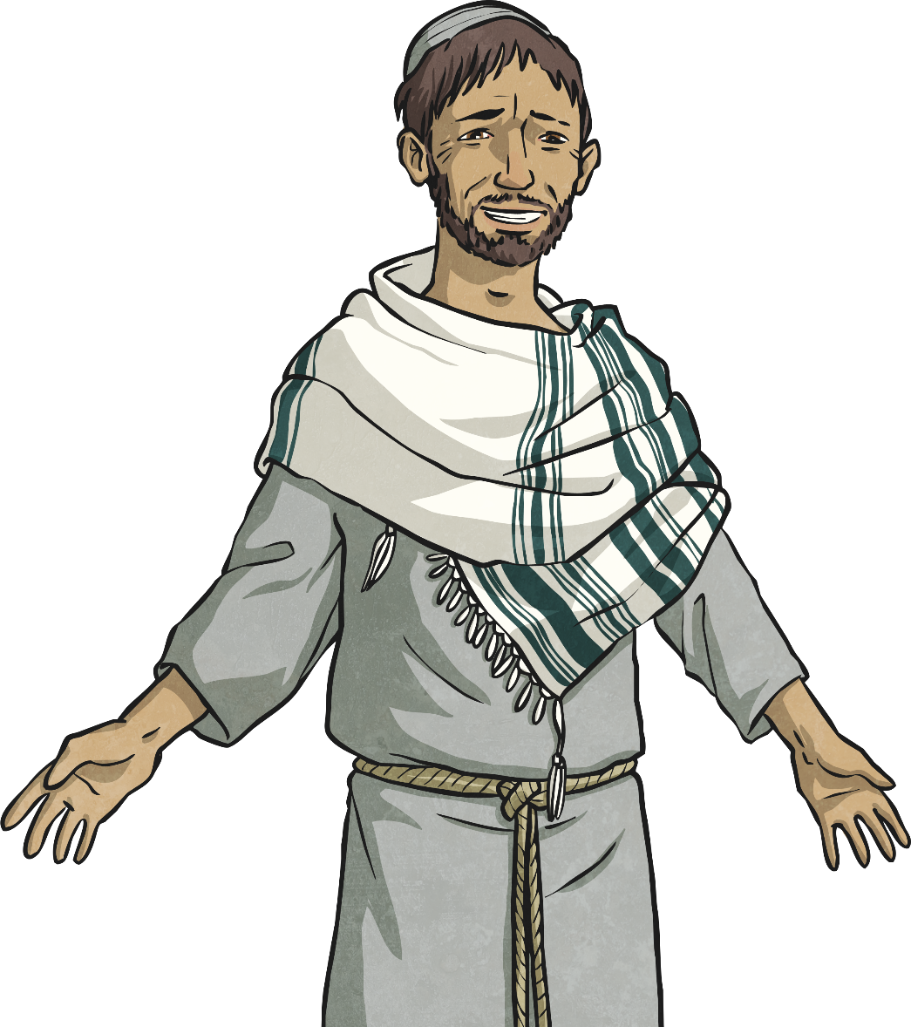
Why ‘Good Friday’?
If Good Friday is a sad day, why is it called ‘good’?
Good Friday is a sad day but Christians believe that Jesus gave his life for the good of everyone. He died so that others could be forgiven for the things they do wrong.

Slide 9
TASK
Paddling:
As a group, write a diary entry for Mary for the entry into Jerusalem, Good Friday and Easter Sunday.
In her diary, Mary needs to explain what has happened on that day, how she feels and what she thinks the day might mean.
Red Pen: Would Mary call the day Jesus died ‘Good Friday’? Why/why not?
Snorkelling:
Write a diary entry for Mary for the entry into Jerusalem, Good Friday and Easter Sunday.
In her diary, Mary needs to explain what has happened on that day, how she feels and what she thinks the day might mean.
Red Pen: Would Mary call the day Jesus died ‘Good Friday’? Explain your reasoning.
Diving:
Write a diary entry for Mary for the entry into Jerusalem, Good Friday and Easter Sunday.
In her diary, Mary needs to explain what has happened on that day, how she feels and what she thinks the day might mean.
Red Pen: Would Mary call the day Jesus died ‘Good Friday’? Explain your reasoning.
What would she say about Sunday?

