Slide 1
News report
Lesson 4

Slide 2
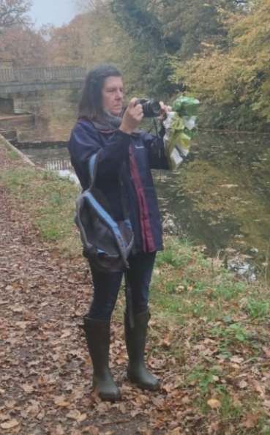
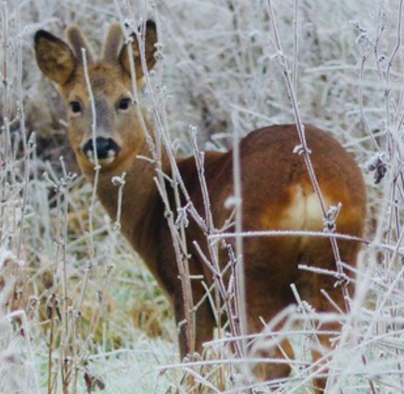
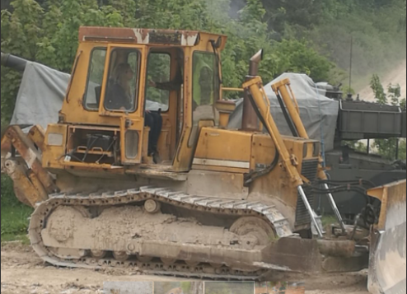
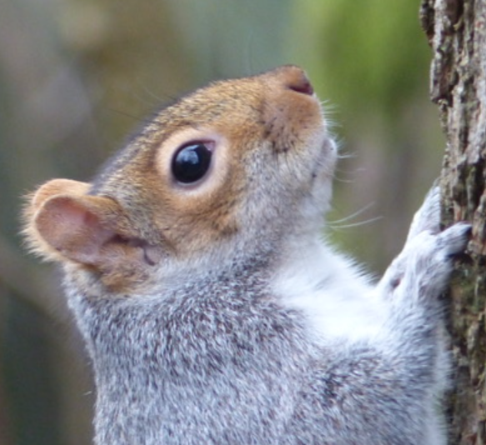
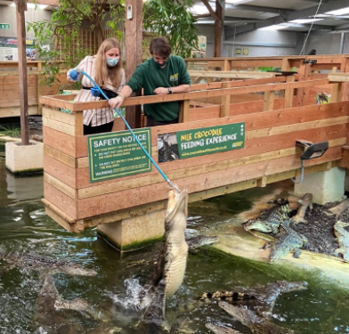
Starter
Miss George
Tell your partner 3 things about yourself that they may not know.
I have driven a digger
My aunt is a talented
photographer
I have fed Nile Crocodiles

Slide 3
Which of these are a fact and which are an opinion?
I have driven a digger
My aunt is a talented
photographer
I have fed Nile Crocodiles

Slide 4
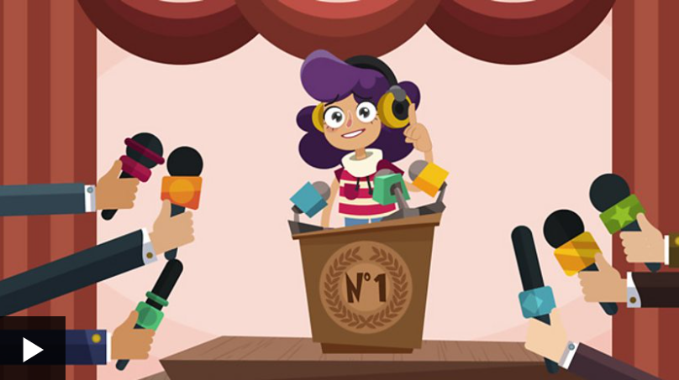
https://www.bbc.co.uk/bitesize/topics/zs44jxs/articles/z3wgqhv

Slide 5
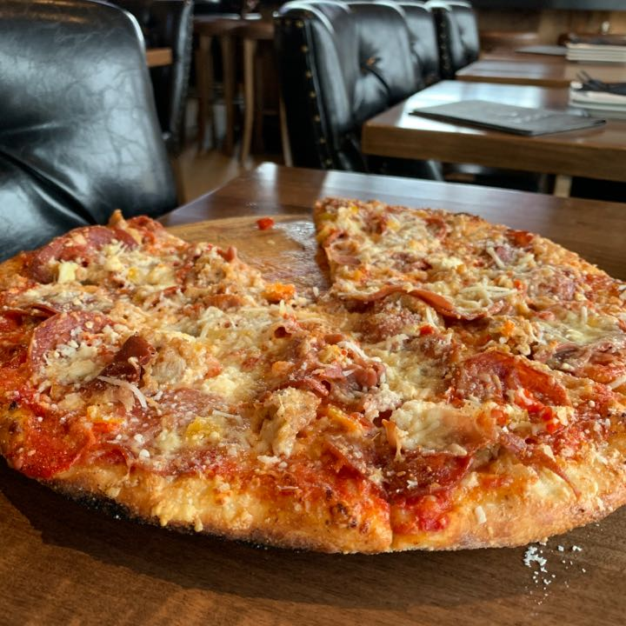
Write 3 facts and 3 opinions about pizza.
Facts are...
Opinions are...

Slide 6
What language do reports use to show if something is fact or opinion?
FACTS
It is proven that...
We have demonstrated that...
It is evident that...
Evidence shows...
...have discovered that...
Nav verified/confirmed that...
Newshound stated that. . .
He argued that...

Slide 7
OPINIONS
She suggested that...
Nav thinks...
Newshound believes...
Her opinion/idea is that...
I feel...
I like/don’t like...
He argued that. . .

Slide 8
Here are some articles, can
you spot any of the phrases
in them?

