Slide 1
News report
First News

Slide 2
Why do we have news report?
News reports, which are used to inform people of events, discoveries and information which may be of interest to their reader.
Newspapers are traditional type of this type of writing. However, news reports have now moved online or are told by news reports on the TV.

Slide 3
Let’s look a newspaper and practise the kills required to write one!
Name of Newspaper
The Daily Mirror
Headline
DOG SAVES THE DAY!
Heroic action of dog saves owner from certain death
An opening paragraph is usually written in bold font and tells the reader briefly about the details of the story.
The rest of the article provides a more detailed report of the event.
Xxxxx xxxxx xxxxxxxx xx xxxx x x x x x xxxxxxxxxxx
xxxxxx xxxxxxxx xxxxxx x x xxx xxx x xxxxxxx xxxxxxxx xxxxxxx xxx xxxxxxx xxxx xxx xxx xxxxxxx xxxx.
xxxxxx xxxxxxxx xxxxxx x x xxx xxx x xxxxxxx xxxx.
xxxxxxx xx xxxxxx xxxxxxxx xxxxxx x x xxx xxx x xxxxxxx xxxxxxxx xxxxxxx xxx xxxxxxx xxxx xxx xxx xxxxxxx xxxx.
Xxxxxxxxx xxx xx xxxxx xxxxxx xxxx xxxxx.
Sub-heading
Image
The condemned gate
xx xxxx x x x x x xxxxxxxxxx xxxx xxxxxxxxxxxxxxx xx xxxxxx.
Caption
Opening paragraph
Secondary Story
This story may or may not be related in some
way to the first story. It is an important story
but it isn’t the ‘top’ story of the issue.
Columns

Slide 4
Headlines]
What is their job?
In the media industry, people say that headlines “tell and sell.”
‘tell’ = telling people what the news story is about.
‘sell’ = making people read, watch, click or listen to the news story.

Slide 5
What do headlines need to be?
SHORT
SNAPPY
GRAB THE READERS ATTENTION

Slide 6
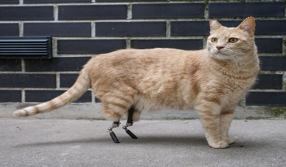
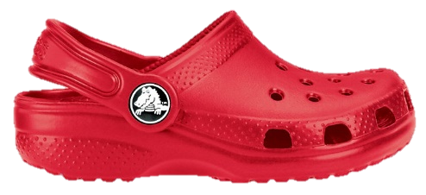
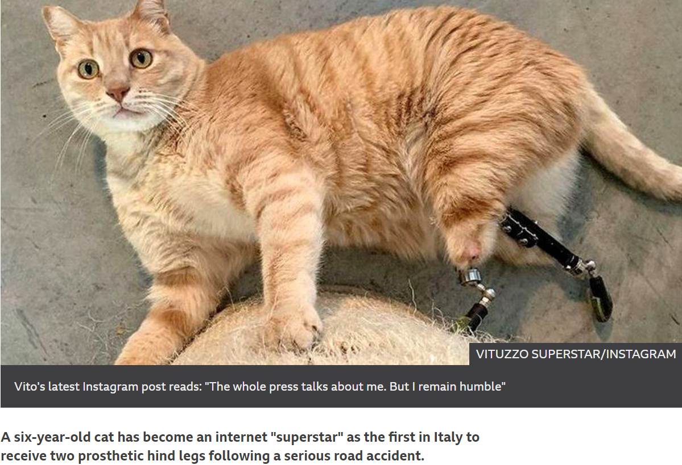
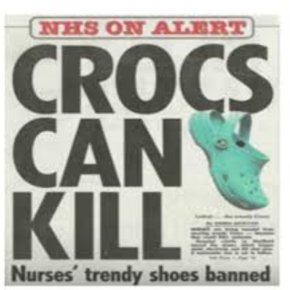
What could the story behind the headline be?
Crocs can kill!
Miracle Moggy

Slide 7
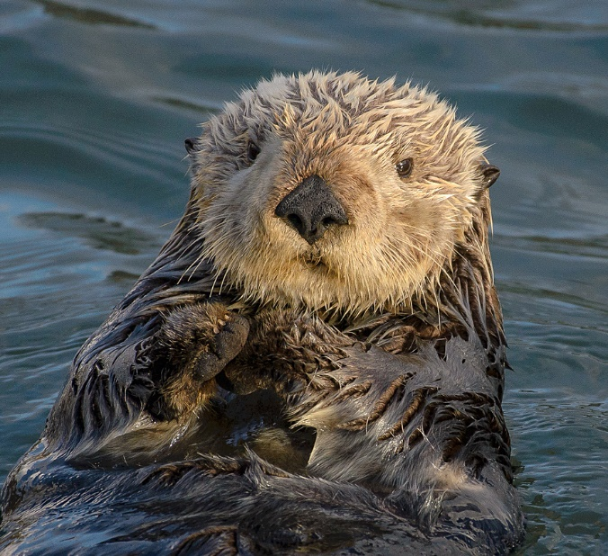
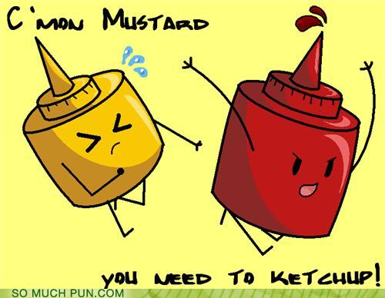
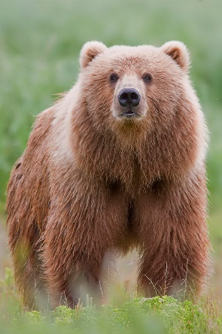
Headline Techniques
Puns
Crocs can kill!
Otter-ly amazing!
Bear with us!

Slide 8
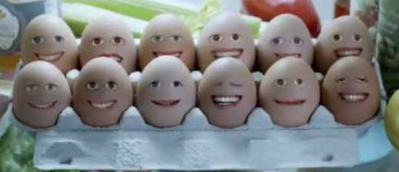
How about this one?
Cracking vocals
Eggcellent vocals
Surely this is some kind of
yolk?

Slide 9
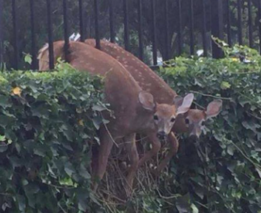
Can you think of a pun to go with this picture?
Oh deer!
Whose I-deer
was this?
Deer-y me!
I doe not believe
It!
I’m staggered!
It’s a deer-saster!

Slide 10
Alliteration
Friends Find Fish
Magic Moggy’s Makeover
Soccer Star Scores Sitter!
Tennis Star Takes A Tumble

Slide 11
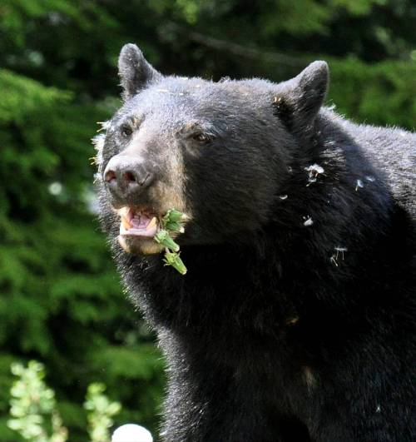
Create a headline for this picture which uses alliteration
Bear Breaks for Breakfast
Bear Breaks Boundary
Brown Bears
Discovers Branches

Slide 12
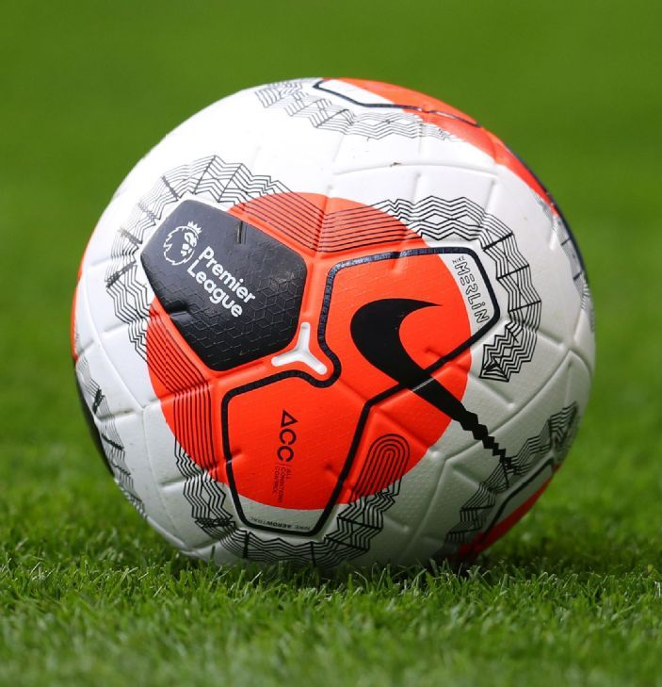
Harry Kane is
Hat-trick Hero
Pompey Play for
Promotion
My chosen sport is…
England’s Early
Exit
Ronaldo Rescue’s
Result
Football’s Famous
Foul
Red’s are on
a Rampage!

Slide 13
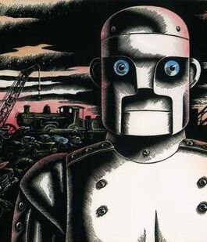
Destructive Demon Destroys Village
Metal Monster is
Munching Again!
It’s Iron-ic that no
machinery can stop this breast.

