Slide 1
Newspaper Reports
First News

Slide 2
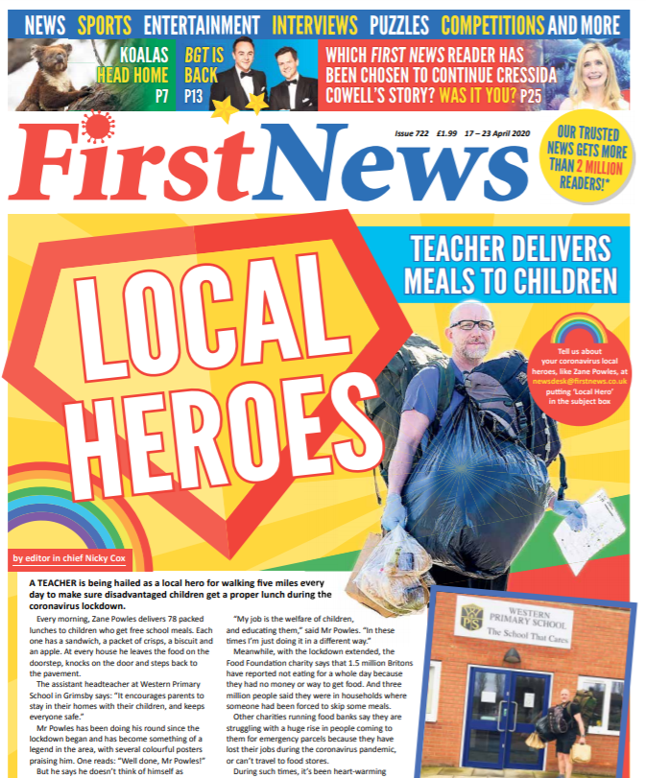
Let’s Explore a Newspaper

Slide 3
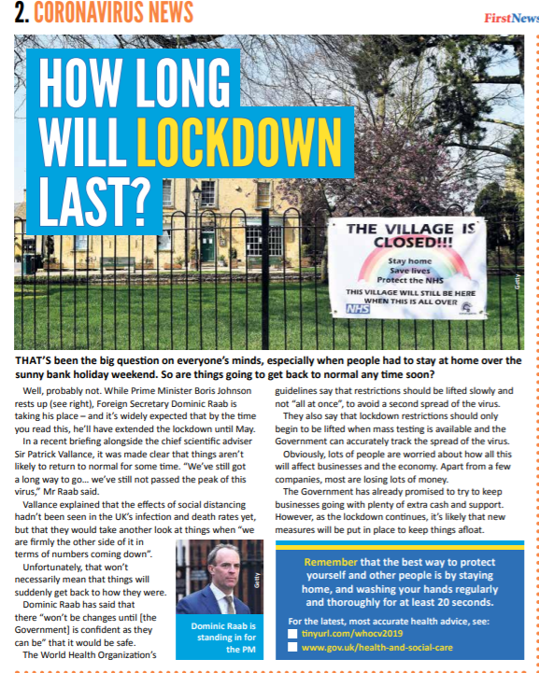
What features did you notice?
Headline
Pictures
Paragraphs
Captions
Written in columns
Third person
Quotes

Slide 4
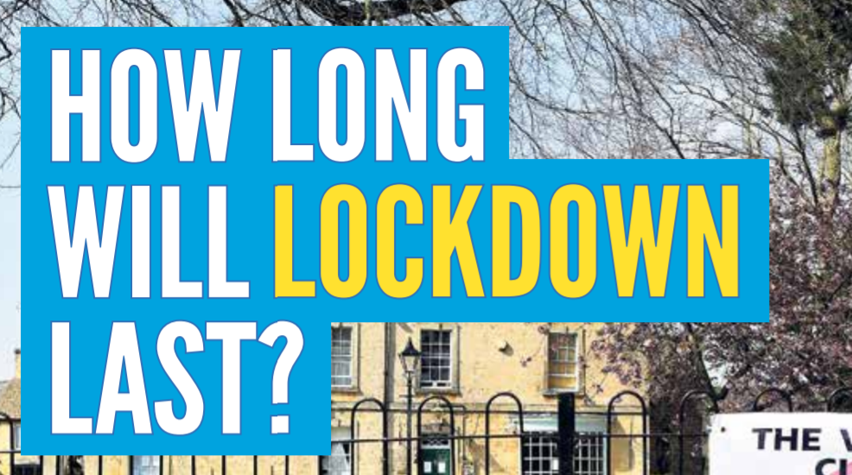
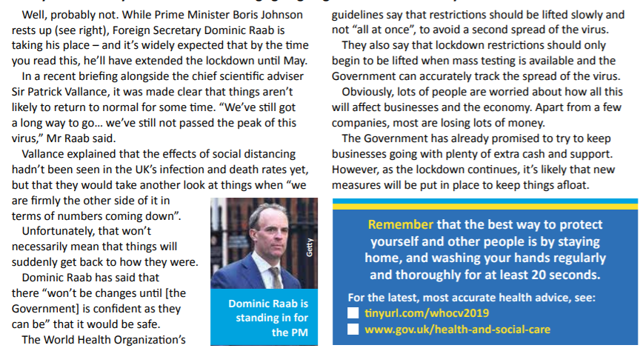
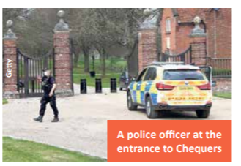
The Features
Third person
Headline
Pictures
Paragraphs
Captions
Written in columns
Quotes

Slide 5
The Features
Headline
Pictures
Paragraphs
Captions
Written in columns
Third person
Quotes

