Slide 1
Wednesday 19th January 2022
L.O. To investigate places
C: The physical geographical
features Binfield

Slide 2
Look at the map
https://digimapforschools.edina.ac.uk/?error=session&context=/roam/map/schools
Or Google Maps
What can features can you spot in
Binfield?
e.g. Fields or buildings
Can we sort these features into groups?
What could the groups be?

Slide 3
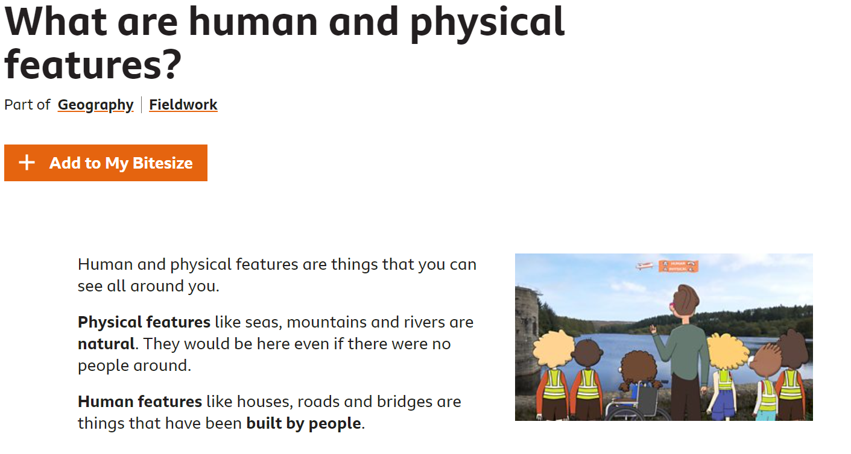
Work through the website to gain a better
understanding of human and physical features
https://www.bbc.co.uk/bitesize/topics/zqj3n9q/articles/zr8q7nb

Slide 4
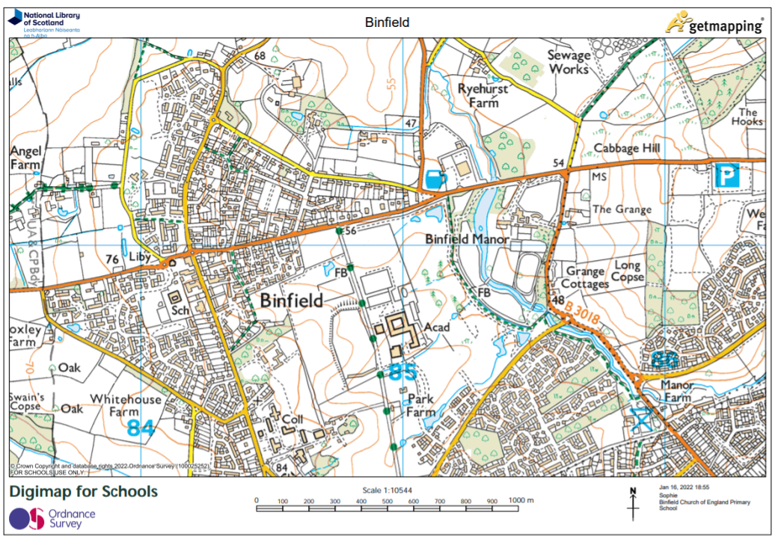
Task
Paddling supported:
Physical geography is….
Identify 3 physical features on map
Snorkelling:
Physical geography is….
Identify 3 physical features on map
Diving:
Physical geography is….
Human geography is….
Identify 3 physical features in 1 colour and 3 human features in another

