Slide 1
Tuesday 18th January 2022
L.O: To understand practices and lifestyles
Context: Belonging

Slide 2
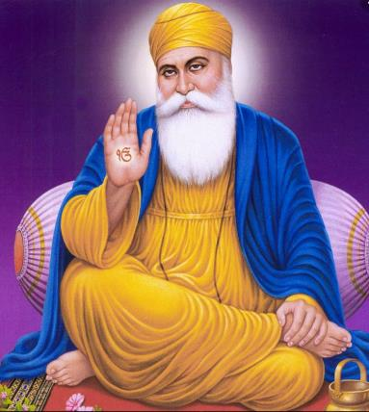
What do we know so far?
Guru Nanak

Slide 3
Does joining the Khalsa make a person a better Sikh?
belonging

Slide 4






What do you belong to?

Slide 5
safe
community
How does being part
of a group make you feel?
belong
happy

Slide 6

The Amrit Ceremony
What questions do you have?

Slide 7
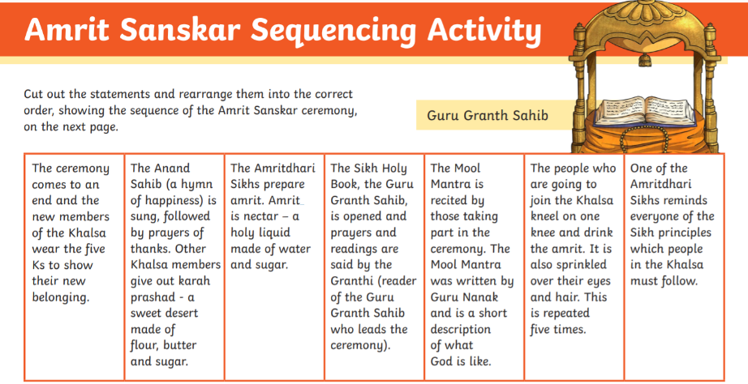
Task

