Slide 1

Thursday 20th January 2022
L.O: To understand texts
C: The Iron Man- summary.

Slide 2

Our First Challenge!
Class Read : p.25-p.33 “the iron man has gone back to the sea”
Famished
Sophisticated
Graceful
Disengaged
Daydreaming
Starving
Let’s match up these emotion synonyms.

Slide 3
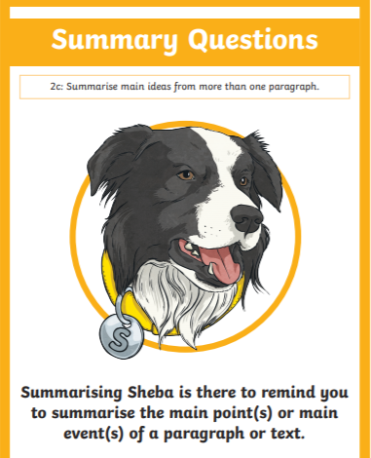
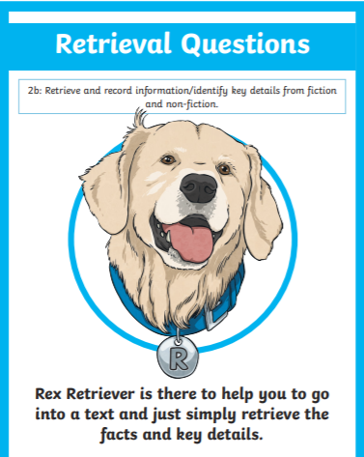
Today we are going to use Summarising Sheba and Rex Retriever to recall and summarise what has happened.

Slide 4
Today’s Activity!
We are going to write a newspaper report summarising the key information and interviewing Hogarth’s father.

Slide 5
Today’s Activity!
We are going to write a newspaper report summarising the key information and interviewing Hogarth’s father.
What are the key features of a newspaper report?

Slide 6
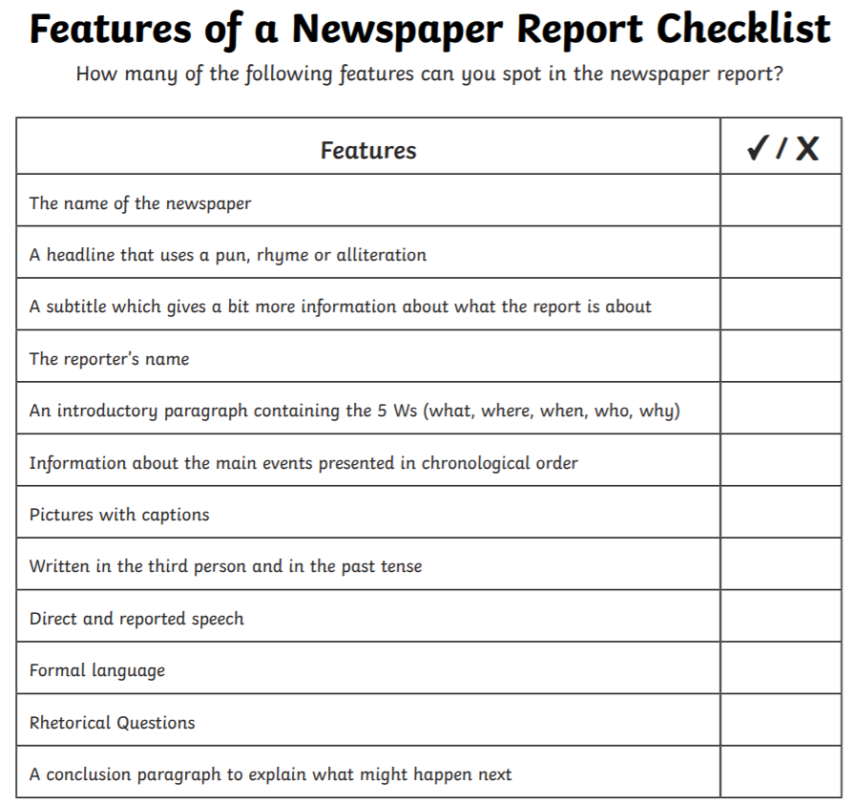

Slide 7
Today’s Activity!
It’s your turn to write your newspaper report!

