Slide 1

Monday 17th January 2022
L.O: To understand texts
C: The Iron Man- inferring emotions.

Slide 2


Fastest Finger Challenge!
Class Read : p.21-25 “his feet will have left tracks in the earth”.
Let’s play our fastest finger game!

Slide 3
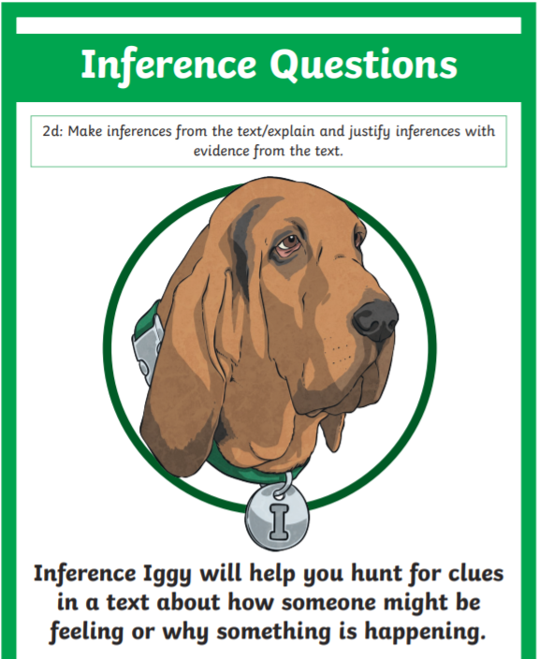
Inference Iggy Time!
Today we are going to infer a character’s emotions.
We are going to try and get in their shoes!

Slide 4
Inference Iggy Time!
We are going to role play!
Imagine you are Hogarth or Hogarth’s Dad.
How are you feeling? Why?

Slide 5

Inference Iggy Time!
  Let’s hotseat so we can all hear your amazing ideas!

Slide 6
Inference Iggy Time!
  I’m going to take photos for your book.
  Please may you complete the Red Pen question:
  If I were…….. I would feel…… because……

