Slide 1
7.6.2021
L.O: To use fractions
C: Making the whole

Slide 2
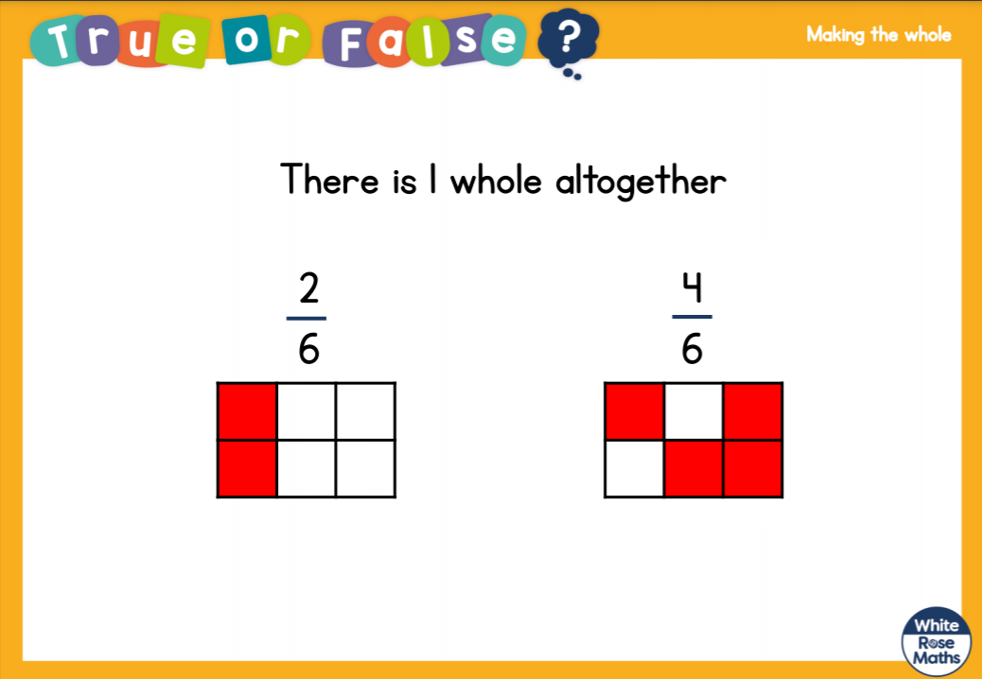

Slide 3
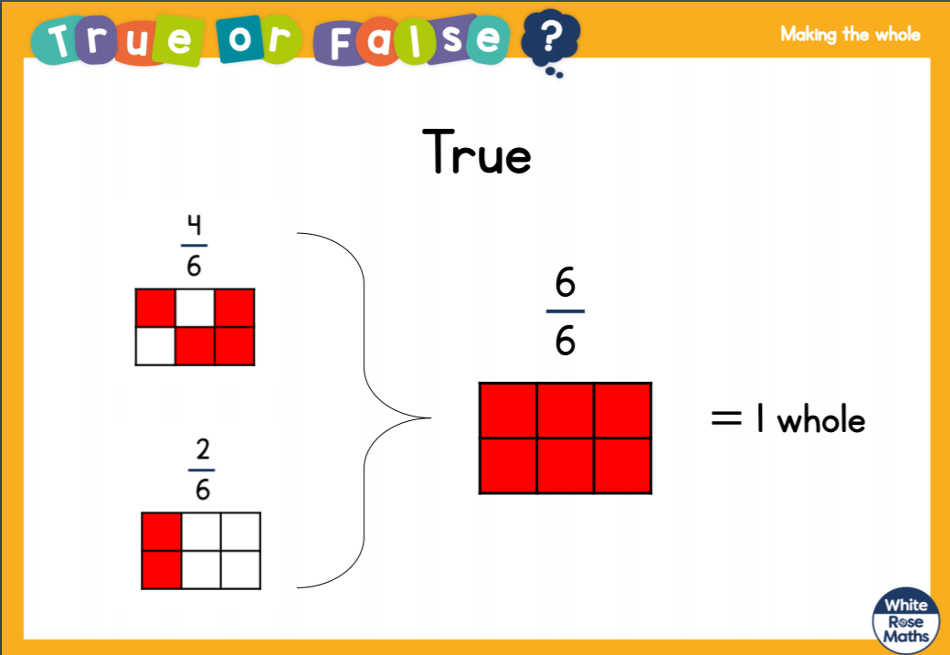

Slide 5


1) What fraction of the cubes are yellow?
What fraction of the cubes are red?
2) What fraction of the counters are yellow?
What fraction of the counters are red?

Slide 6




1) What fraction of the cubes are yellow?
What fraction of the cubes are red?
2) What fraction of the counters are yellow?
What fraction of the counters are red?
$\frac{\text{3}}{\text{4}}$
$\frac{\text{1}}{\text{4}}$
$\frac{\text{5}}{\text{8}}$
$\frac{\text{3}}{\text{8}}$

Slide 8
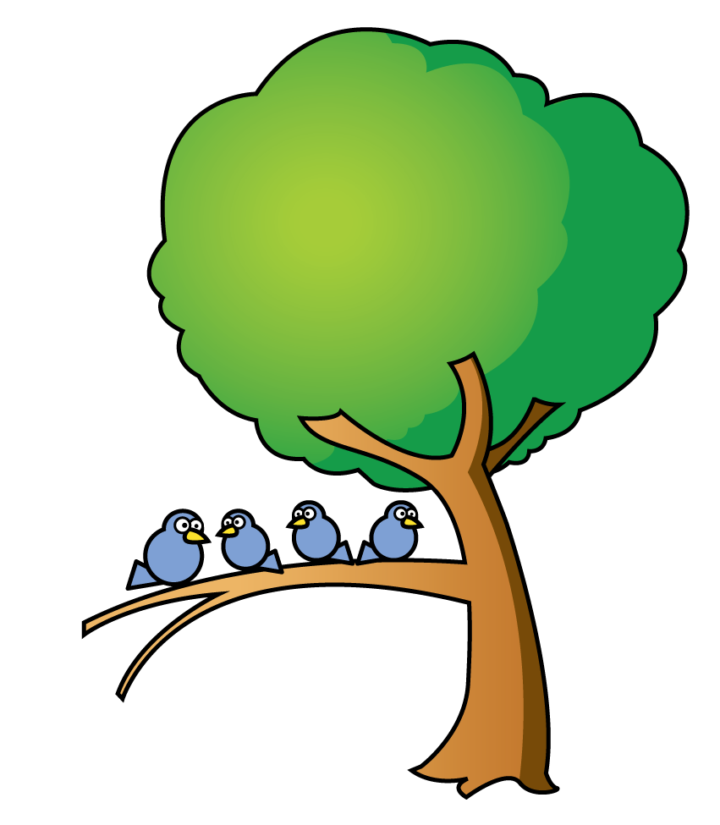





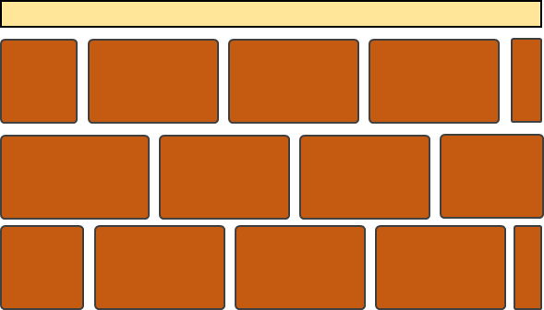








What fractions can you see in the picture?
$\frac{\text{1}}{\text{4}}$
$\frac{\text{3}}{\text{4}}$
$\frac{\text{3}}{\text{5}}$
$\frac{\text{1}}{\text{3}}$
$\frac{\text{4}}{\text{7}}$
$\frac{\text{2}}{\text{3}}$
$\frac{\text{3}}{\text{7}}$
$\frac{\text{2}}{\text{5}}$
Have a think

Slide 9
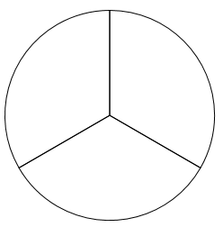




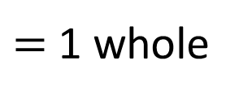











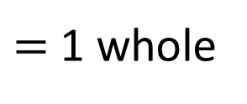




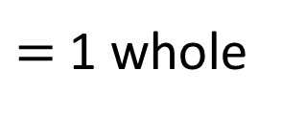














When the numerator and the denominator are the same, the fraction is equal to one whole.
Label each fraction on the shapes below.
What do you notice?
$\frac{\text{1}}{\text{3}}$
$\frac{\text{1}}{\text{3}}$
$\frac{\text{1}}{\text{3}}$
$$+$$
$\frac{\text{1}}{\text{3}}$
$$+$$
$\frac{\text{1}}{\text{3}}$
$$=$$
$\frac{\text{3}}{\text{3}}$
$\frac{\text{3}}{\text{3}}$
$=$ 1 whole
$\frac{\text{1}}{\text{3}}$
$\frac{\text{1}}{\text{2}}$
$\frac{\text{1}}{\text{2}}$
$\frac{\text{1}}{\text{2}}$
$$+$$
$\frac{\text{1}}{\text{2}}$
$$=$$
$\frac{\text{2}}{\text{2}}$
$\frac{\text{2}}{\text{2}}$
$=$ 1 whole
$\frac{\text{1}}{\text{4}}$
$\frac{\text{1}}{\text{4}}$
$\frac{\text{1}}{\text{4}}$
$\frac{\text{1}}{\text{4}}$
$\frac{\text{1}}{\text{4}}$
$$+$$
$\frac{\text{1}}{\text{4}}$
$$+$$
$\frac{\text{1}}{\text{4}}$
$$+$$
$\frac{\text{1}}{\text{4}}$
$$=$$
$\frac{\text{4}}{\text{4}}$
$\frac{\text{4}}{\text{4}}$
$=$ 1 whole

Slide 10






When the numerator and the denominator are the same, the fraction is equal to one whole.
Which of these fractions are equal to one whole?
$\frac{\text{3}}{\text{3}}$
$\frac{\text{7}}{\text{9}}$
four quarters
$\frac{\text{4}}{\text{4}}$
Have a think
When the numerator is less than the denominator, the fraction is less than one whole.
$\frac{\text{1}}{\text{10}}$
$\frac{\text{8}}{\text{8}}$
six sixteenths
$\frac{\text{6}}{\text{16}}$

Slide 11
Have a go at questions
1 – 6 on the worksheet

Slide 12

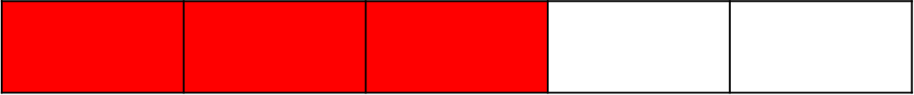
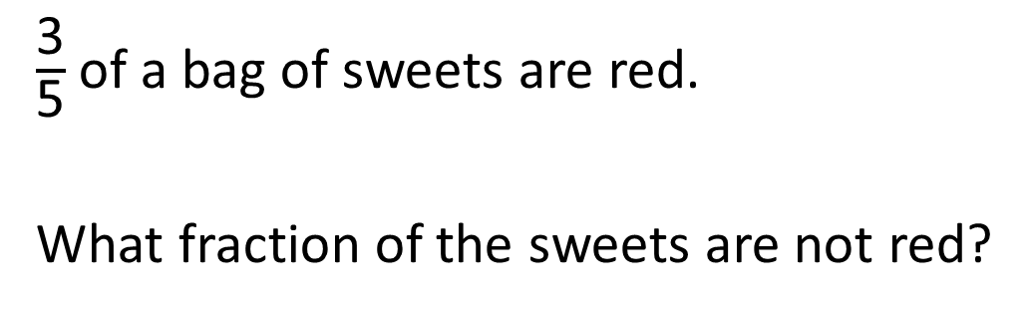
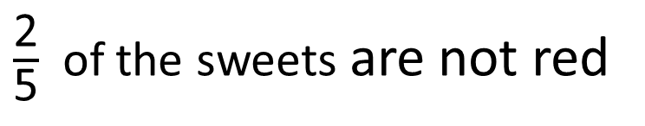
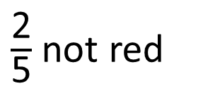
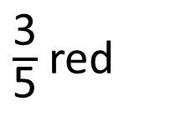
$\frac{\text{3}}{\text{5}}$ of a bag of sweets are red.
What fraction of the sweets are not red?
$\frac{\text{3}}{\text{5}}$ red
$\frac{\text{2}}{\text{5}}$ not red
$\frac{\text{2}}{\text{5}}$ of the sweets are not red
Have a think

Slide 13

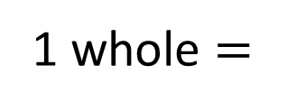





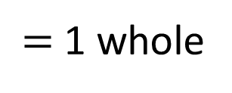
Complete the calculations.
$\frac{\text{3}}{\text{4}}$
$$+$$
$\frac{\text{1}}{\text{4}}$
$=$ 1 whole
1 whole $=$
$\frac{\text{7}}{\text{9}}$
$$+$$
$\frac{\text{2}}{\text{9}}$
Have a think

Slide 14









Complete the part-whole models.
$\frac{\text{2}}{\text{5}}$
$\frac{\text{3}}{\text{5}}$
Have a think
$\frac{\text{5}}{\text{5}}$
1
$\frac{\text{10}}{\text{10}}$
1
$\frac{\text{2}}{\text{10}}$
$\frac{\text{1}}{\text{10}}$
$\frac{\text{7}}{\text{10}}$

Slide 15




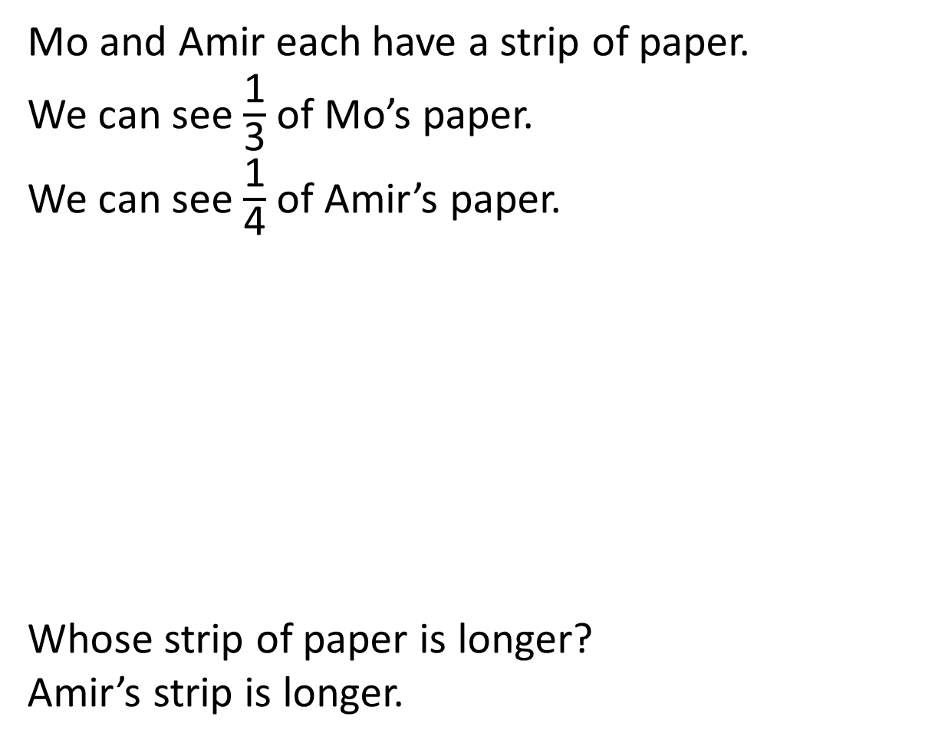





Mo and Amir each have a strip of paper.
We can see $\frac{\text{1}}{\text{3}}$ of Mo’s paper.
We can see $\frac{\text{1}}{\text{4}}$ of Amir’s paper.
Whose strip of paper is longer?
Amir’s strip is longer.
$$\frac{\text{1}}{\text{3}}$$
$$\frac{\text{1}}{\text{3}}$$
$$\frac{\text{1}}{\text{3}}$$
$$\frac{\text{1}}{\text{4}}$$
$$\frac{\text{1}}{\text{4}}$$
$$\frac{\text{1}}{\text{4}}$$
$$\frac{\text{1}}{\text{4}}$$
Have a think

Slide 16
Have a go at your worksheet!
Paddlers: Please work with Mrs Cox
There is a red pen question for each group too!

