Slide 1
11.3.2022
L.O: To use statistics.
C: Compare Angles

Slide 2
https://www.youtube.com/watch?v=NVuMULQjb3o
Angle Song!

Slide 3

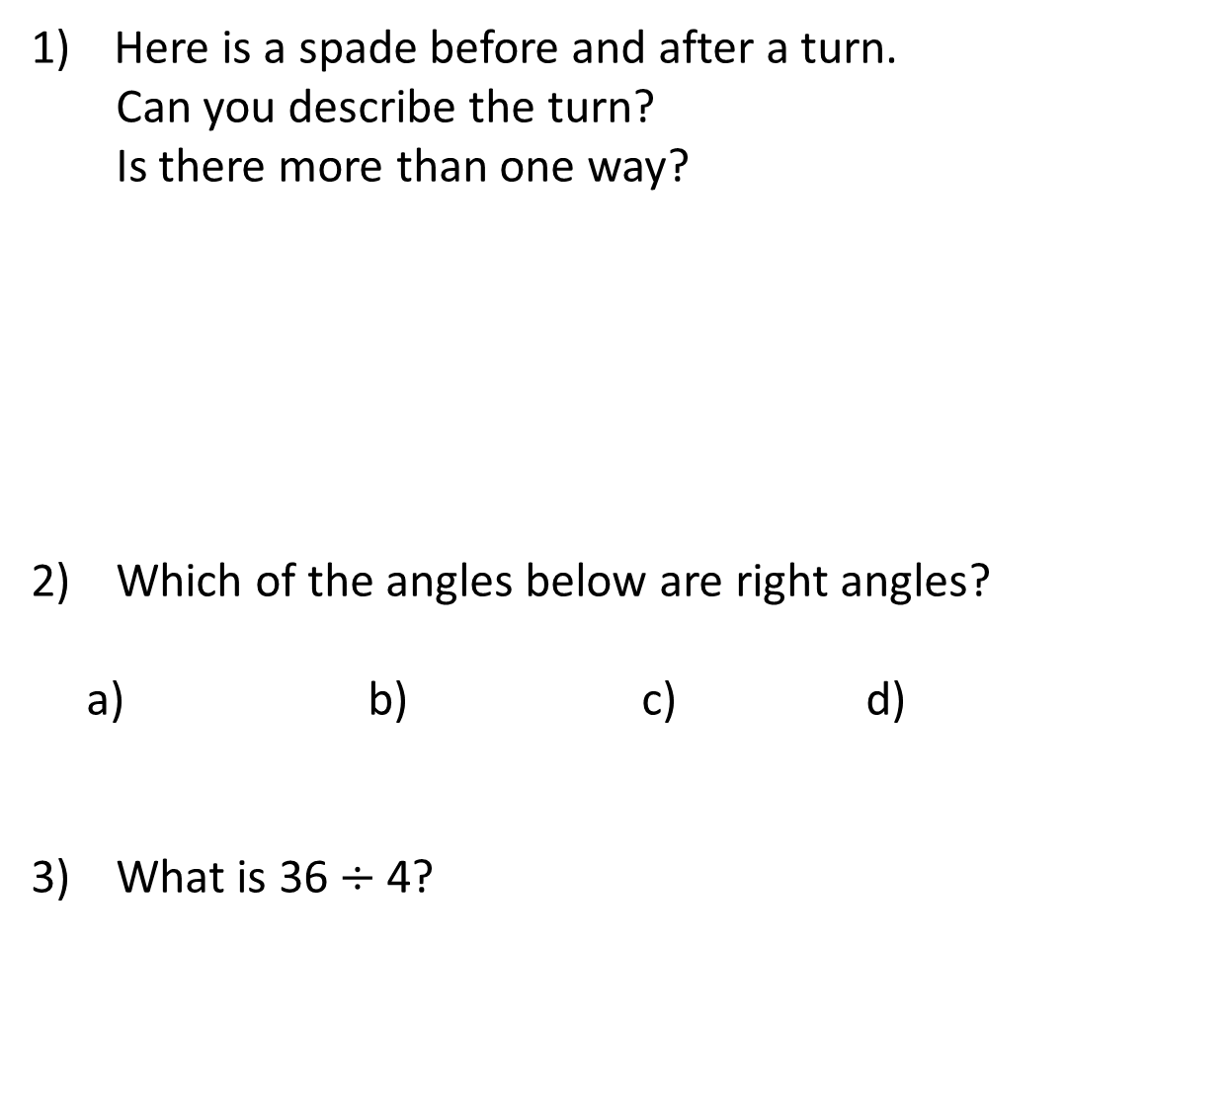
Here is a spade before and after a turn.
Can you describe the turn?
Is there more than one way?
2) Which of the angles below are right angles?
a) b) c) d)
3) What is 36 $÷$ 4?
before
after

Slide 4

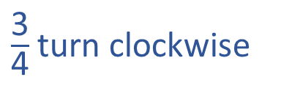

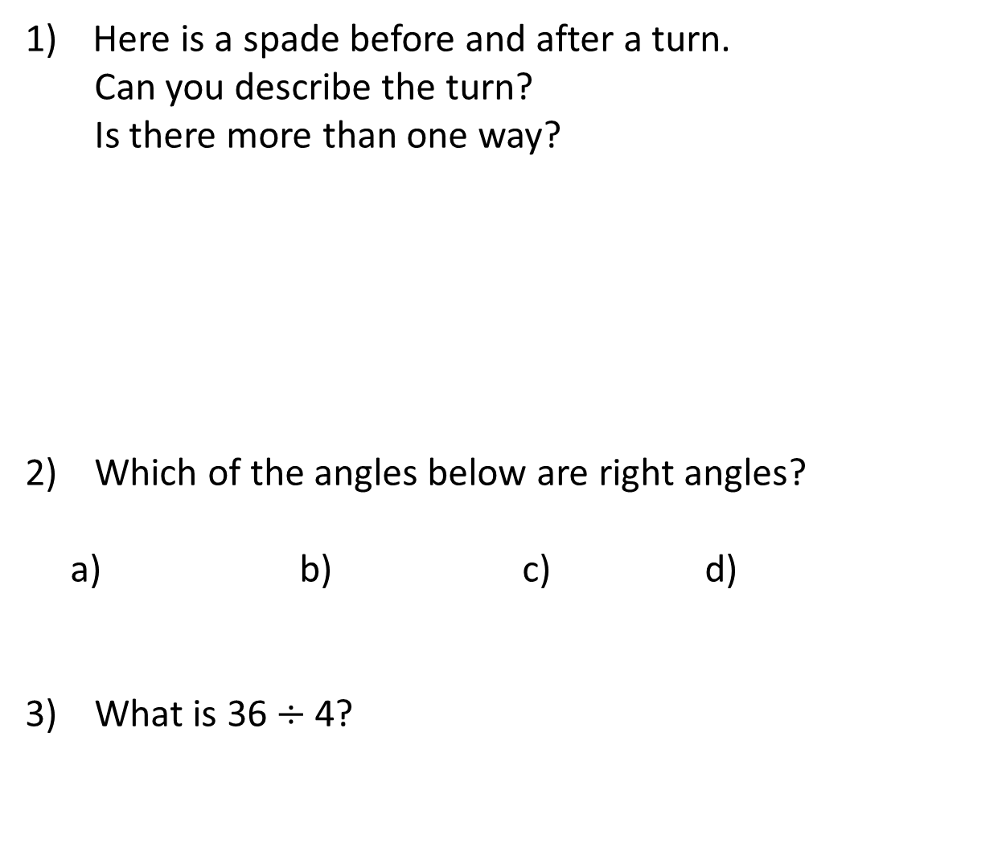
Here is a spade before and after a turn.
Can you describe the turn?
Is there more than one way?
2) Which of the angles below are right angles?
a) b) c) d)
3) What is 36 $÷$ 4?
$\frac{\text{1}}{\text{4}}$turn anti-clockwise
$\frac{\text{3}}{\text{4}}$turn clockwise
before
after
b and c
9

Slide 6
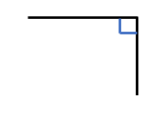

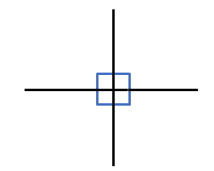
Have a think
right angle
A right angle is a quarter of a full turn.
There are 4 right angles in a full turn.
Angles are measured in degrees.
There are 360 degrees in a full turn.
How many degrees are in one right angle?

Slide 7



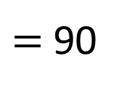
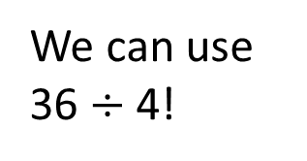
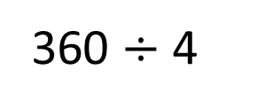
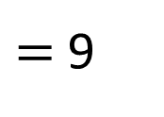
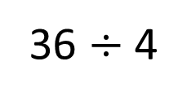
How many degrees are in a right angle?
There are 4 right angles in a full turn.
We can use 36 $÷$ 4!
There are 360 degrees in a full turn.
360 $÷$ 4
$=$ 90
36 $÷$ 4
$=$ 9
There are 90 degrees in a right angle.

Slide 8
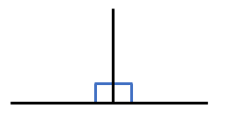
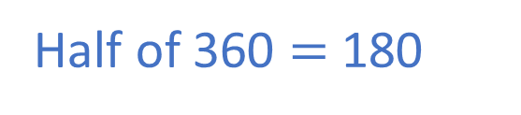
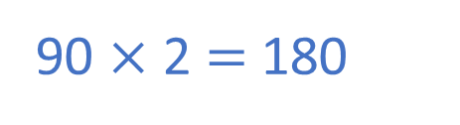
How many degrees are there in half of a full turn?
Two right angles are equal to half of a full turn.
A right angle is 90 degrees.
Have a think
90 × 2 $=$ 180
Half of 360 $=$ 180
There are 180 degrees in half of a full turn.

Slide 9
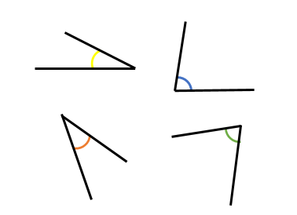
Here are 4 angles.
Have a think
smaller than
All of the angles are ___________ a right angle.
less than
All of the angles are ________ 90 degrees.
Angles less than 90 degrees are called acute angles.

Slide 10
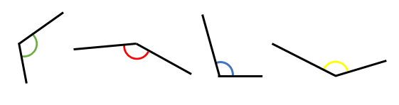
Here are 4 more angles.
Have a think
greater than
All of the angles are ___________ a right angle.
greater than
All of the angles are ___________ 90 degrees.
Angles more than 90 degrees and less than 180 degrees are called obtuse angles.

Slide 11
Put these angles in order from smallest to largest.
a)
b)
c)
d)
right
angle
acute
obtuse
Have a think

Slide 12


I think these are both right angles.
The angle on the left is smaller.
Is Tiny correct?
Have a think
Both angles are equal.
They both measure 90 degrees.

Slide 13
I can see some obtuse angles
I can see some acute angles.
obtuse
obtuse
acute
acute
What types of angles do you see?
Have a think

Slide 14

Your Task!
Right your name using a ruler!
Use your colours to mark on your:
Acute angles
Right angles
Obtuse angles

