Slide 1
Wednesday 16th March 2022
LO: To plan, write and edit
C: News Report

Slide 2
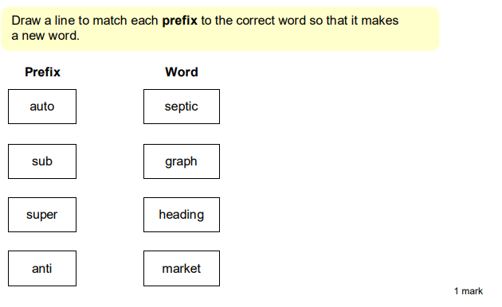
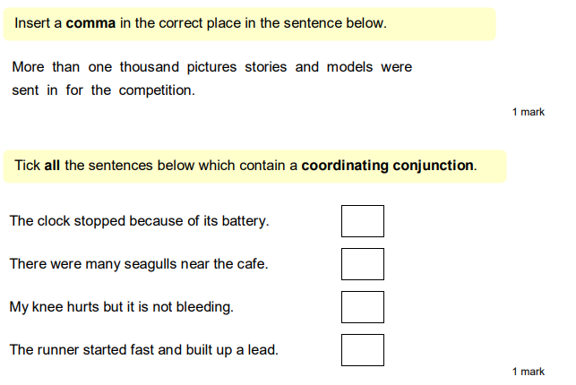
Starter:

Slide 3
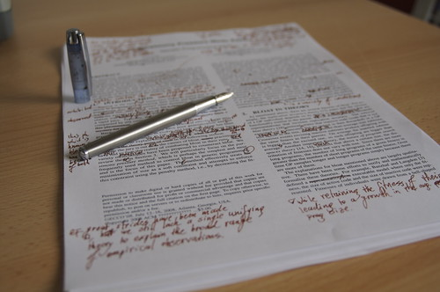
Edit your work from yesterday using my marking to help you!

Slide 4
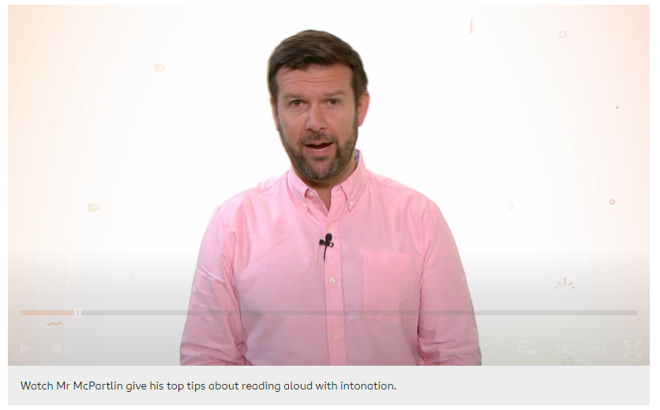
We are going to practise reading our news reports ready to green screen them so they can be broadcast!
https://www.bbc.co.uk/bitesize/topics/zs44jxs/articles/z8pbf82

Slide 5
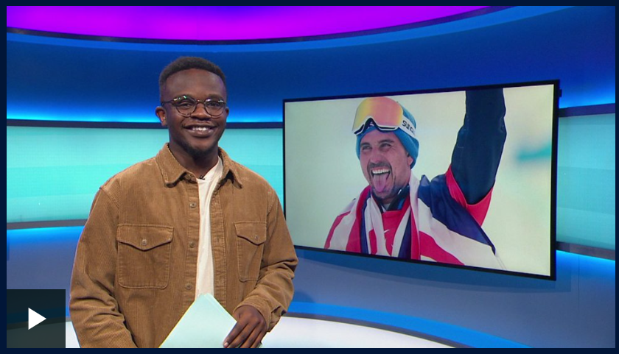
Watch some News Round.
What do news reporters sound like? How do they use intonation to keep people interested?
https://www.bbc.co.uk/newsround/news/watch_newsround

Slide 6
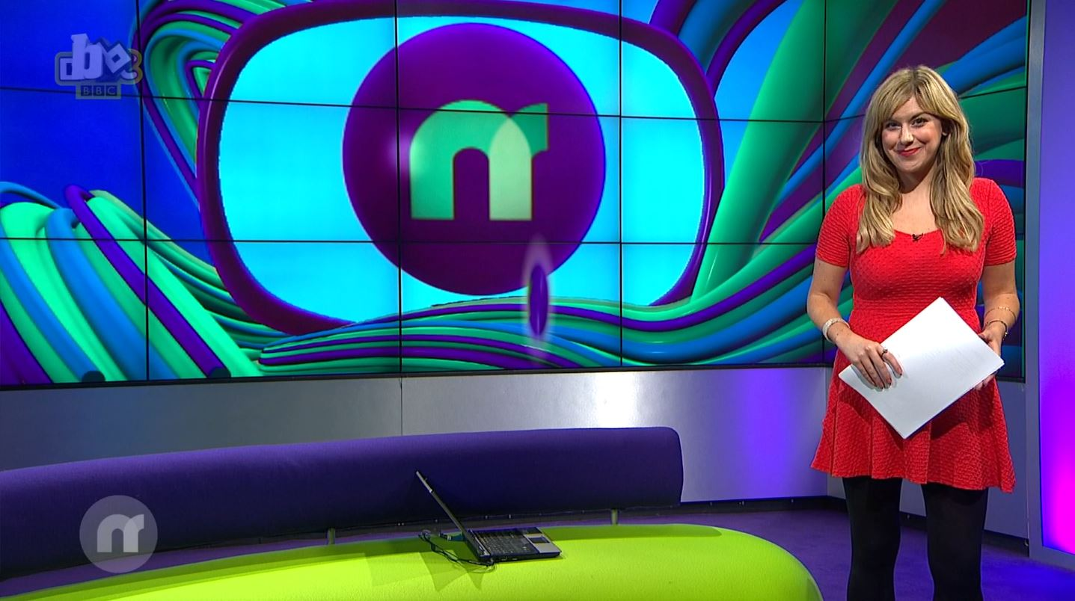
TIME TO PRACTISE

