Slide 1
Wednesday 16th March 2022
LO: To plan, write and edit
C: News Report

Slide 2
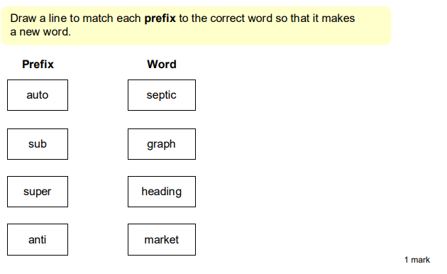
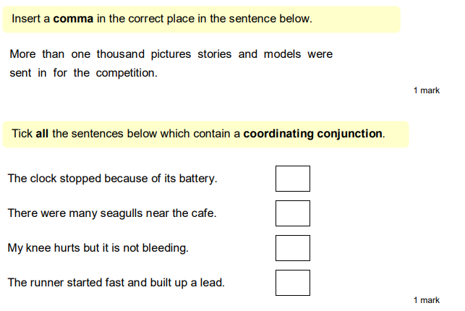
Starter:

Slide 3
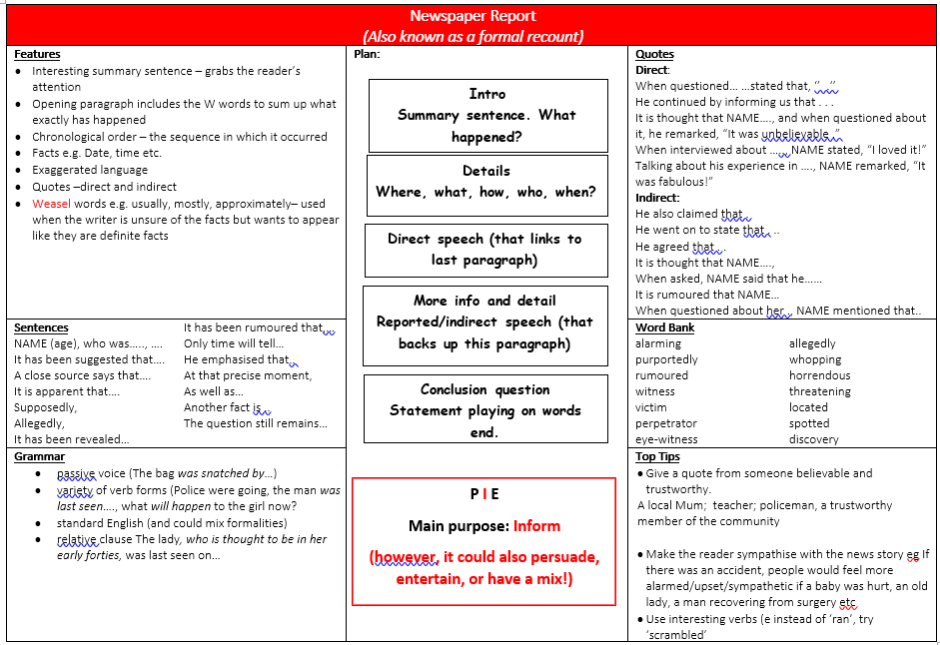
Look at your knowledge organiser. What is the next thing we need to write?

Slide 4
What other information do you need to include?
Think about the information which may be important for the read to know!

Slide 5
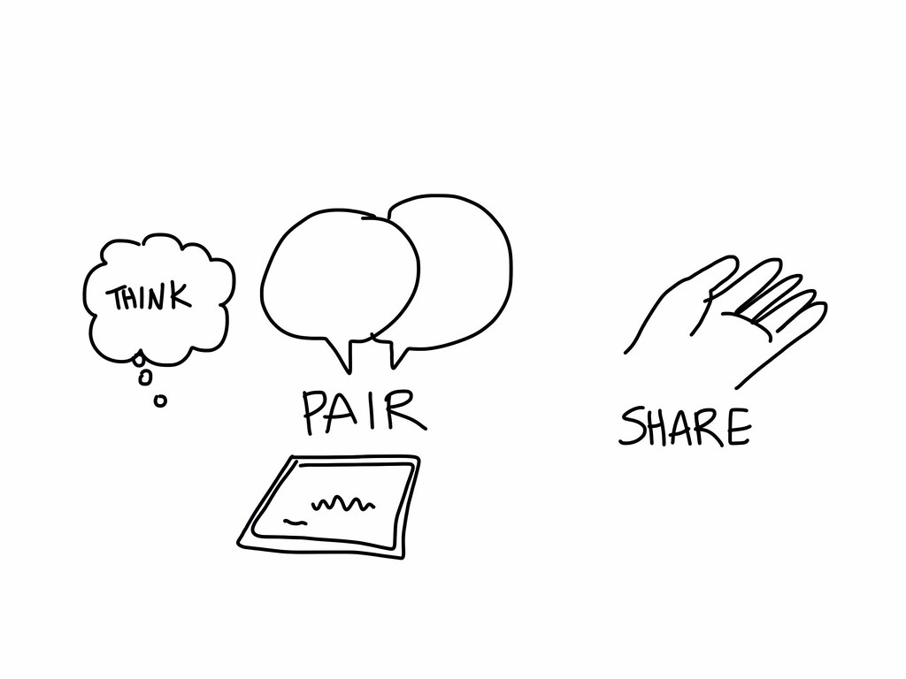
Have a go at coming up with ideas with your partner.

Slide 6

Now, it is your turn to write.
Remember, only include the important details!

Slide 7
EDITING TIME
Check through your work carefully!
Have you included capital letters?
Have you included full stops?
Have you included commas after fronted adverbials?
Do you need to check any spellings?
Have you included speech correctly?

Slide 8
CONCLUSION
You need to sum up your article.
Can you include a pun or a rhetorical question?

