Slide 1
Tuesday 15th March 2022
LO: To plan, write and edit
C: News Report

Slide 2
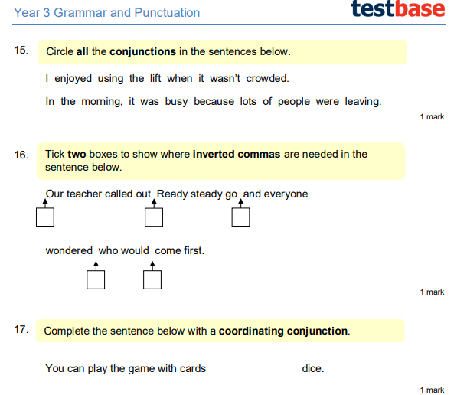
Starter

Slide 3
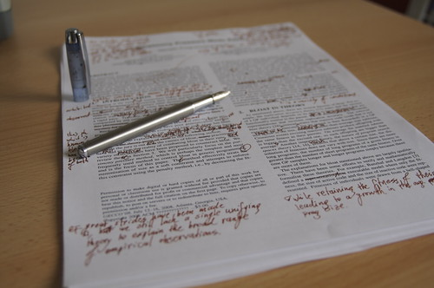
Edit your work from yesterday using my marking to help you!

Slide 4
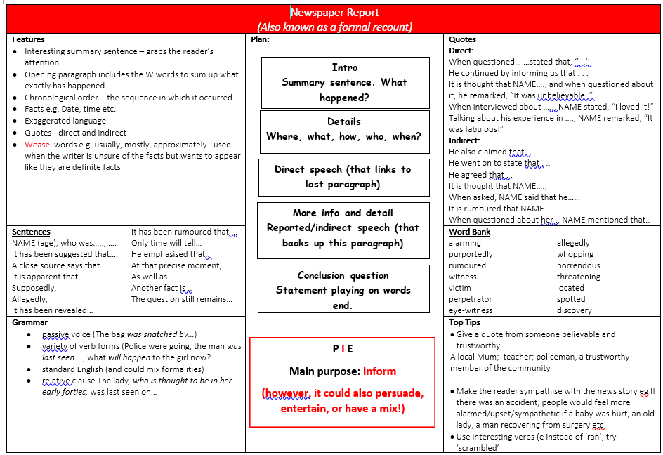

Slide 5

Let’s look over our transcripts from the eye-witnesses. Are there any quotes that would be useful to support our article?

Slide 6
How are we going to put these into the report?

Slide 7

It is your turn to include some in your writing!

