Slide 1

Tuesday 8thJune 2021
LO: To use imaginative description
C: Setting description
MY
STORY

Slide 2
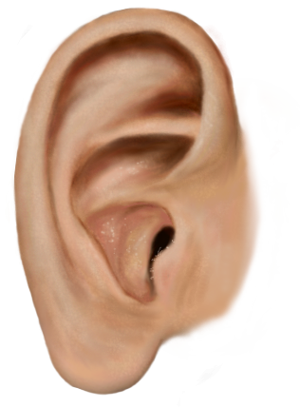

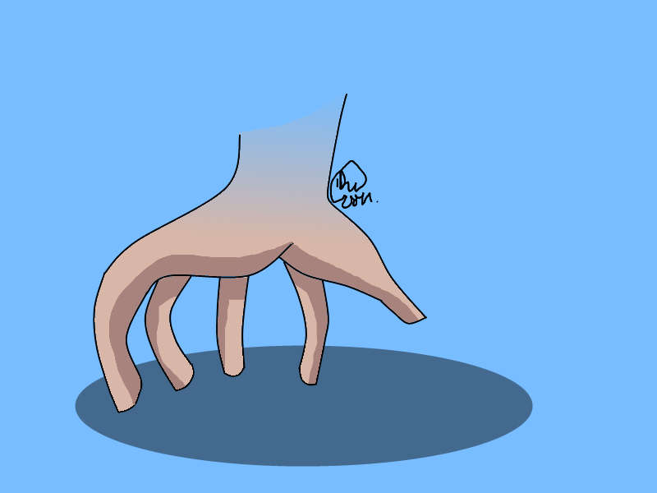


Look at your setting from yesterday.
Can you describe it to your partner?
hear
touch
taste
see
smell

Slide 3
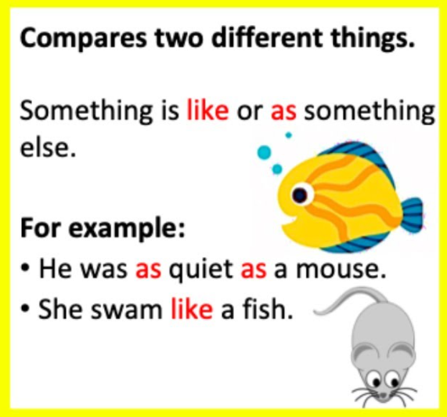
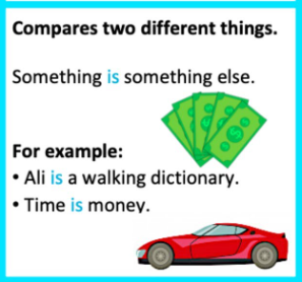
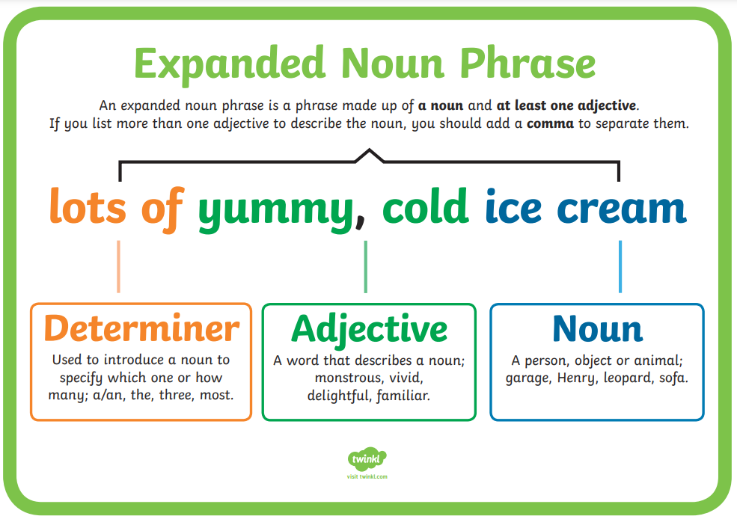
What techniques could we use?
similes
metaphors
expanded noun
phrases

Slide 4
Can you spot the 5 settings in this passage of text?
I walked through the wood like I did every Saturday on my way to my friend’s house. However, today was different. There was a different smell in the air, the tree’s leaves were rustling angrily in the breeze and a strong, musty smell lingered all around. As breathed in, I could taste damp, rotting leaves. A sparrow was gazing angrily at the forest floor: such a strange sight, as this was normally a peaceful forest. I stood on a large, soggy twig below the tree where the sparrow was perched. I let out a shocked scream as I tripped. The sparrow flew aware fearfully. I could here it’s wings beating down on the leaves of the giant trees.

Slide 5
Think about your setting and the descriptive vocabulary you have already written.
Can you come up with any similes, metaphors or expanded noun phrases to improve them?

Slide 6
Task
Write your own descriptive paragraph.

