Slide 1
16.6.2021
L.O: To use fractions.
C: Fractions of a set of objects (1).

Slide 3




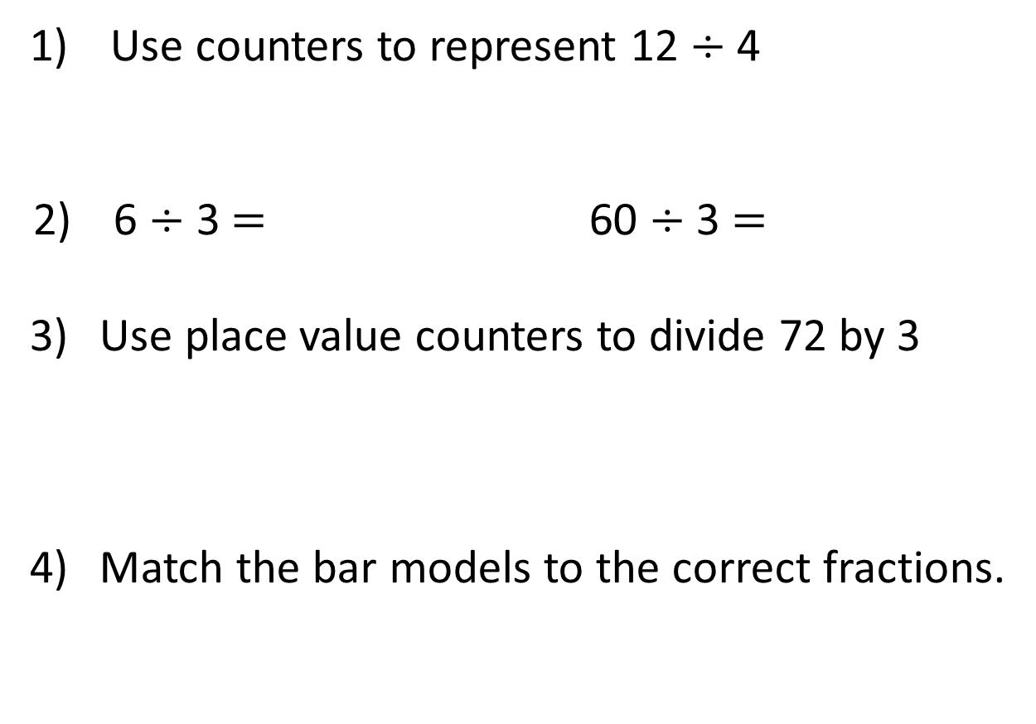
Use counters to represent 12 $÷$ 4
6 $÷$ 3 $=$ 60 $÷$ 3 $=$
Use place value counters to divide 72 by 3
Match the bar models to the correct fractions.
$\frac{\text{1}}{\text{3}}$
$\frac{\text{1}}{\text{4}}$
$\frac{\text{1}}{\text{2}}$
$\frac{\text{1}}{\text{6}}$

Slide 4






Use counters to represent 12 $÷$ 4
6 $÷$ 3 $=$ 60 $÷$ 3 $=$
Use place value counters to divide 72 by 3
Match the bar models to the correct fractions.
2
20
24
$\frac{\text{1}}{\text{3}}$
$\frac{\text{1}}{\text{4}}$
$\frac{\text{1}}{\text{2}}$
$\frac{\text{1}}{\text{6}}$

Slide 5
I do
We do
You do

Slide 6
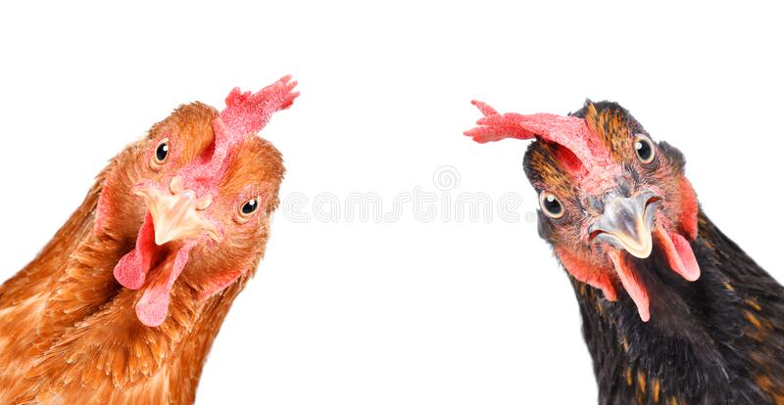
I do
Rodney has 12 chickens. Unfortunately, one third of them escape!
How many chickens escaped?

Slide 7
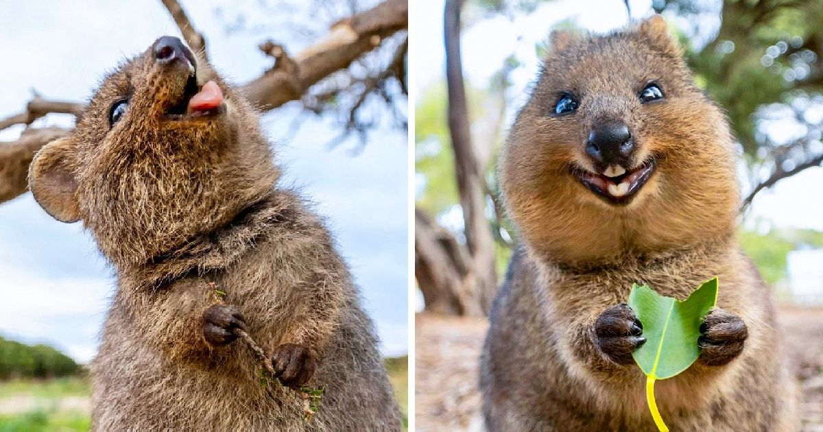
We do
There are twenty four quokkas on the island. 1/6 of them live on the east side of the island. How many live there?

Slide 8
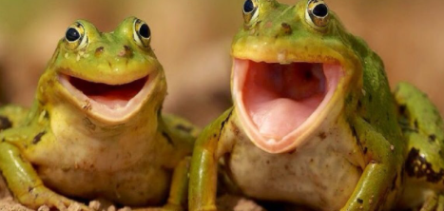
You do
There are 12 frogs in the pond. 1/3 are yellow and ¼ are blue. How many are yellow? How many are blue?

Slide 9
You do
There are 12 frogs in the pond. 1/3 are yellow and ¼ are blue. How many are yellow? How many are blue?
Your turn!

