Slide 1
Monday 14th March 2022
LO: To plan, write and edit
C: News Report

Slide 2
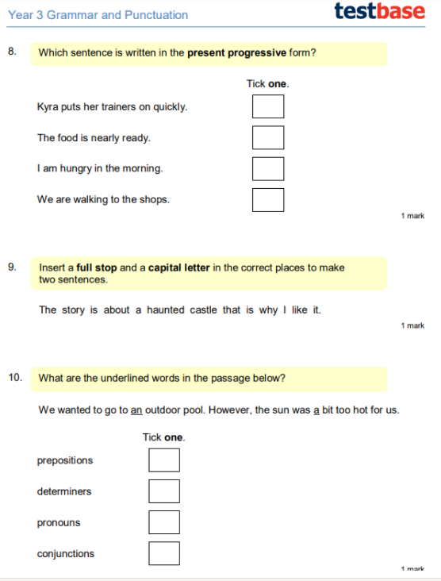
Starter:

Slide 3
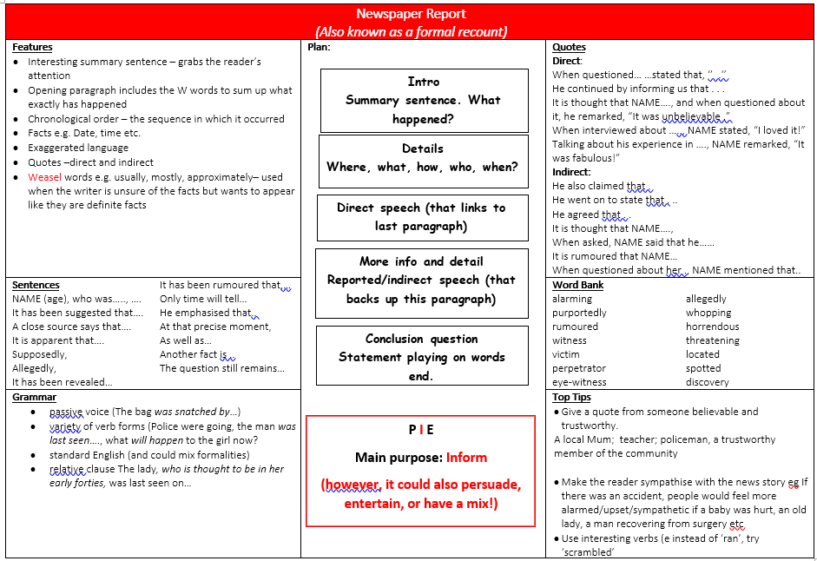
Look at your knowledge organiser. What is the first thing we need to write?

Slide 4
What
Where
When
Who
How
On Monday 29th February, residents of Warfield, Bracknell awoke to find . . .

Slide 5
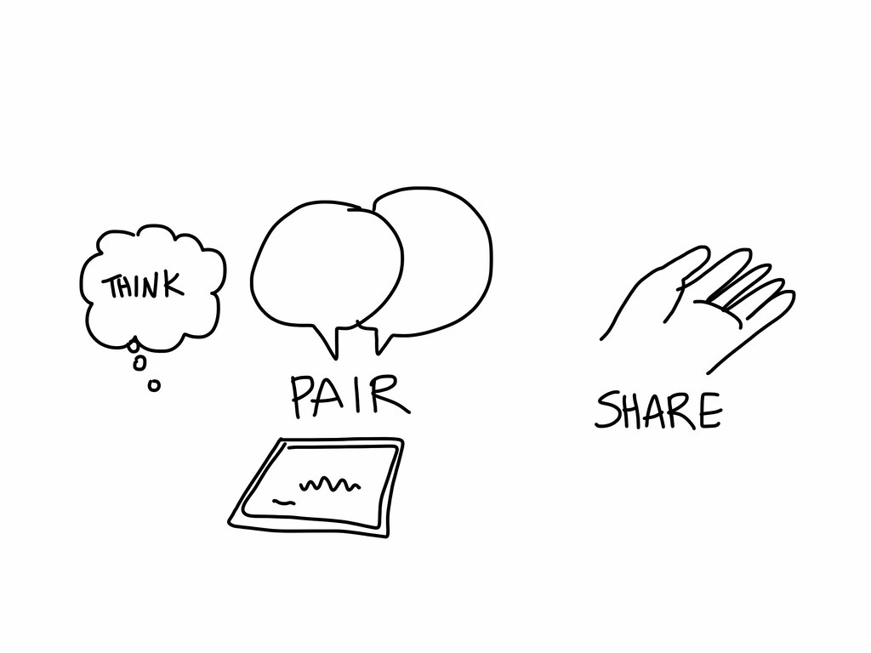
Have a go at coming up with an introduction with your partner.

Slide 6

Now, it is your turn to write.
Remember, only include the important details!

Slide 7
EDITING TIME
Check through your work carefully!
Have you included capital letters?
Have you included full stops?
Have you included commas after fronted adverbials?
Do you need to check any spellings?

