Slide 1
Tuesday 21st September 2021
L.O: To investigate light and shadow.
Key questions to think about....
How can you move a shadow?
Is a shadow always the same shape?
What detail can you see in a shadow?

Slide 2
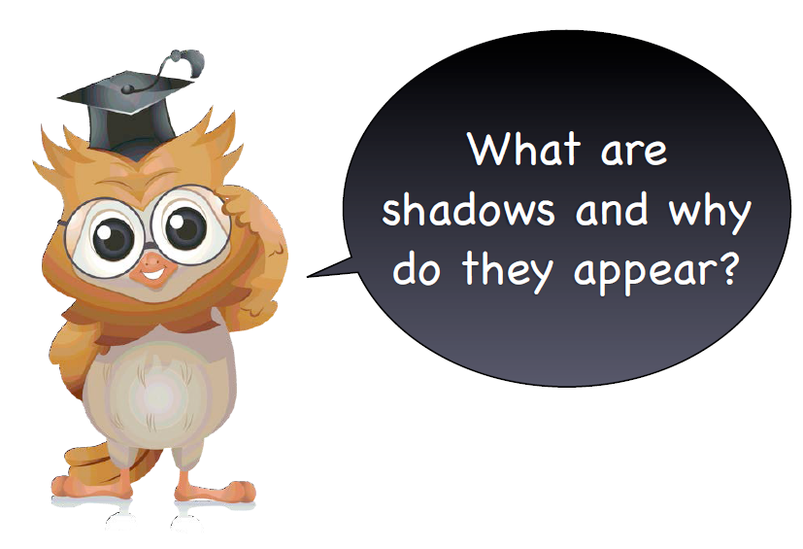
Today we are going to go outside and explore shadows

Slide 3
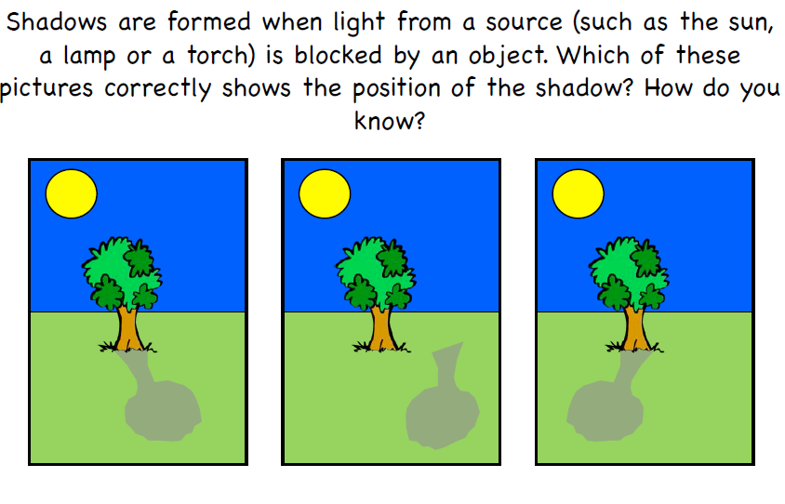

Slide 4

As part of his science lesson, Jim had to draw his shadow. This is what he drew:
I’m happy today, so I’ve included my smile on my shadow.
His teacher said that he has made a mistake. Can you help explain where he has gone wrong?

Slide 5
A _______ is made when an object ______ light. The object must be opaque or translucent to make a shadow. A ________object will not make any shadow, as light will pass straight ________it.
blocks
through
shadow
transparent

Slide 6

Time to experiment!

Slide 7

Use the shadow puppet posters to chose an animal!
Shine a lamp in a dark place and try to create the shape!

Slide 8
Move closer to the lamp. How does your shadow change?
Move further from the lamp. How does your shadow change?
Move the lamp around…to the side…higher up…be creative! How does the shadow change?

Slide 9
Your task:
Paddling - Draw pictures to show your findings to the questions. Include these words to label and explain it.
SHADOW BLOCK LIGHT MOVE
Snorkelling - Draw pictures to show your findings to the questions . Include the
Paddling words as well as these:
STRAIGHT LINES TRAVELS
Diving - Draw pictures to show your findings to the questions, then answer this RP question:
Why does a glass jar not create a clear shadow?
Use the words TRANSPARENT and OPAQUE to help you.

