Slide 1
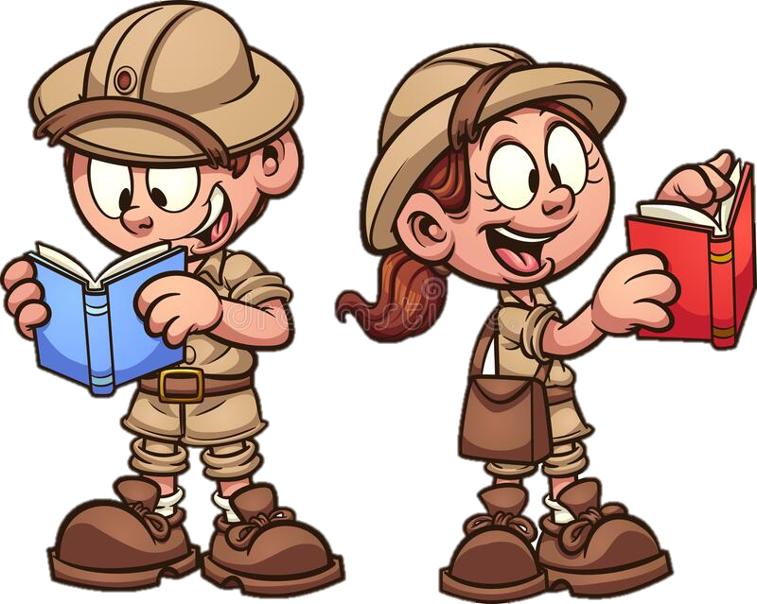
Tuesday 21st September 2021
LO: To write an opening
C: Finding Something Tale

Slide 2
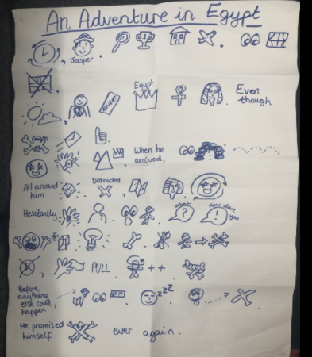
First, let’s recap the opening of our Jasper Story!

Slide 3
Today we are going to write the opening of our story!
In the opening we meet our main character and introduce our setting.

Slide 4
You are going to work with your partner on your whiteboards first, then write up your introduction independently.

Slide 5
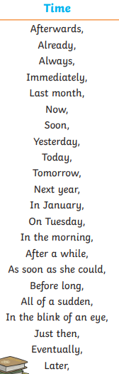
First let’s start with a time adverbial...

Slide 6
Now let’s introduce our main character and their characteristics...

Slide 7

Now let’s find out about their dream/goal...

Slide 8

Now they need to find out about their adventure...

Slide 9

Finally they need to travel to their setting...

Slide 10
Now it is your turn to write up your introduction.

Slide 11
Let’s here what you have written!

