Slide 1

Monday 20th September 2021
L.O: To practice new vocabulary.
C: Let’s do the Pharaoh!

Slide 2
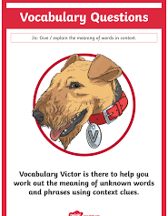
We are going to use our Vocabulary Victor skills today!
Why is it important to learn new words?

Slide 3

Let’s play fastest finger on page 74.

Slide 4
Let’s read up to page 78.
Look out for any new words.

Slide 5
Your task is to match up our new words to their definition.

